Slide 1
INTERVENTION WITH MATHLINKS
Cynthia Raff
cynthia@mathandteaching.org
Theresa Lee
theresa@mathandteaching.org
The Center for Mathematics and Teaching [a 501(c)(3) non-profit]
www.mathandteaching.org/essentials/
TODAY’S FOCUS:
Proportional Reasoning
Notes:
Welcome to our presentation on MathLinks: Essentials – Proportional Reasoning.
If you don’t know us…CMAT is a non-profit and we develop middle school mathematics curriculum and resources, and support teachers in using them through professional development.
We worked together in the mathematics department at UCLA for about a decade.
Then about 14 years ago we left the university to form CMAT.

Slide 2
AGENDA
An Intervention Plan
Experiences and Research
How the MathLinks Essentials Proportional Reasoning
fits into the plan
Notes:
Here is what will be covered in this presentation.

Slide 3

GETTING STUDENTS BACK ON TRACK
Creating YOUR plan
Identifying the major work
of the grade or focus topics
Including needed review and backfill…
and frontloading if desired
Using appropriate content pitched to your students’ needs
Increase confidence on the way to greater success
Notes:
Some ways to get students back on track. Here are some things we have learned from those having success.
Focus on your major grade level bands.
Backfill is fine, but some mix in frontloading to give students a good foundation for a topic before they see it in their core class. This gives student confidence on a new topic.
Most intervention students can do the work but they learn differently, and may need different strategies and supports. They need meaning to attach to concepts in order to have success.
The goal is to increase confidence and students’ chances for success.

Slide 4
WHAT THE RESEARCH TELLS US
Ongoing Formative Assessment and Feedback
Do we need to test our
struggling learners a lot?
Alternate Strategies
Must students know more than one strategy?
Rehearsal
What’s the right kind of rehearsal/practice and how much is the right amount?
Balance Basic Skills and Conceptual Development
If Basic Skills AND Conceptual Development are both important,
how do you pull that off?
Teacher Support
How can we support teachers in this work?
Notes:
Though we have years of experience, here is what the research says and what questions we get from teachers.
More frequent feedback and guidance will help for students to have success.
Offing students more than one strategy can be helpful, then assist them in picking the one that is most beneficial for their needs.
Practice differs from student to student, so it’s nice to have options and make sure they have a good shot of getting the problems right.
Build concepts, then guide the students to procedures. This is especially important for struggling learners. They need meaning and connection for things to make sense.
And of course, teachers need support. We agree!!

Slide 5
THE MathLinks: ESSENTIALS PROGRAM
Modules | Pkt 1 Gr levels | Pkt 2 Gr levels | Pkt 3 Gr levels
Number Base 10 | 4-6 | 4-5 | 5-6
Fractions | 3-4 | 4-5 | 5-6
Proportional Reasoning | 6 | 6-7 | 7
Integers | 6 | 7 | 7
Expressions & Equations | 6 | 7 | 8
Functions | 8 | 8 | 8
Grade 4-6
Foundational work
Grade 6-8
Major work
Notes:
As you see here, proportional reasoning is part of the major work of middle school.

Slide 6

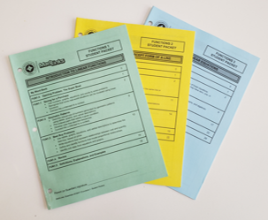
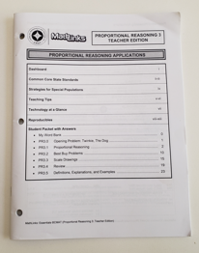
TODAY’S SOURCE MATERIALS
Student Packets
Teacher Edition
Notes:
Materials for this session are drawn from our experience, research, and our MathLinks Programs. Activities are from MathLinks: Essentials Proportional Reasoning module, which includes 3 consumable student packets, 1 teacher guide, and…

Slide 7
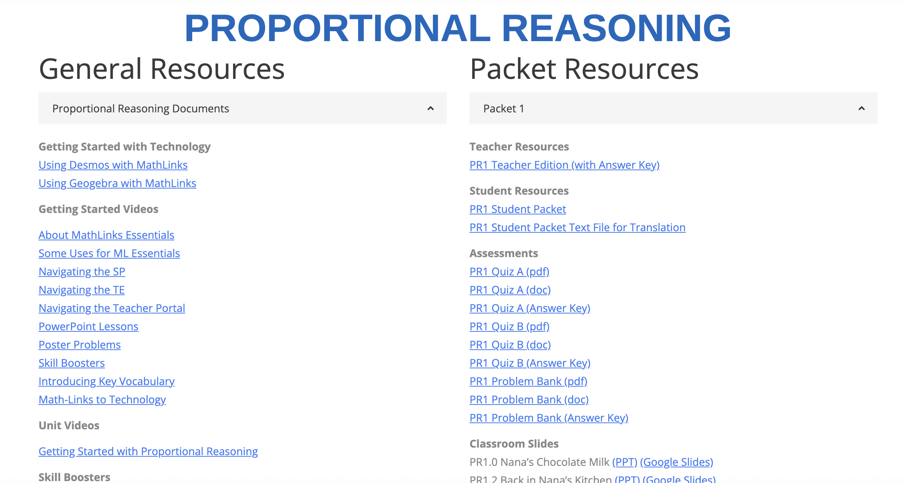
TODAY’S SOURCE MATERIALS
Teacher Portal – Online Resources
Notes:
And a secure teacher portal with additional components.

Slide 8
MathLinks: PROPORTIONAL REASONING
First Unit: “Packet 1”
Ratio Representation
Focus on Grade 6 content
Notes:
Lets get started. Student Packet 1 focuses on Ratio Representation and is mostly 6th grade standards.

Slide 9
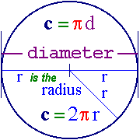


WHY PROPORTIONAL REASONING?
RATIOS AND RATES ARE EVERYWHERE
In mathematics
Geometry
Slope
Daily activities
Speed limits
Recipes
Pricing
Health
In the environment
Global warming
Natural resources
Notes:
In mathematics
Geometry: The value of circumference to diameter
Slope: The ratio of the increase in a y-variable to the increase in an x-variable
In the environment
Global warming: glaciers that are receding
Natural resources: The ratios of electric to hybrid to gas-powered vehicles on the road
Daily activities
Speed limit: 25 miles per hour
Recipes: Two cups of water for every cup of oatmeal
Pricing: Cheese is $5 per pound
Health: calories burned in 15 minutes of jogging

Slide 10
GRADE 6: RATIO REPRESENTATIONS
Give students tools to think multiplicatively!
Tape diagrams
Double Number Lines
Arrow diagrams
Equivalent Ratios
Tables
Notes:
In 6th grade, representations help students transition from additive to multiplicative thinking. The various representations lay this groundwork and make this kind of reasoning accessible.

Slide 11
RED AND WHITE MIXTURES
C
A
D
B
Arrange the cards from lightest pink to darkest pink.
Draw the cards in order and label them.
Notes:
The first lesson in the packet is on Tables and Tape Diagrams which we introduce using Paint Mixtures. Students order paint mixture cards from lightest pink to darkest pink and explain reasoning along the way.

Slide 12
RATIOS AND TABLES
What are some words that describe this paint mixture?
For every 2 parts red,
there are 3 parts white.
Out of 5 total parts,
2 of them are red.
The ratio of white to red is 3 to 2.
What are some ratios that describe this paint mixture?
Parts red : Parts white → 2 : 3
Parts red : Total parts → 2 : 5
Parts white : Parts red → 3 : 2
Notes:
Getting students comfortable using various ways to look at ratios makes them more confident in what they are comparing. Such as comparing color to color, and color to total parts.

Slide 13
A TABLE FOR THIS PAINT MIXTURE
Paint Mixture Table
column identifier | i | ii | iii | iv | v | vi | vii
Parts of red paint | 2
Parts of white paint | 3
Total parts
4
10
14
1
6
15
21
1
5
10
25
35
1
Notes:
Putting information in a table helps students see the various parts and how they relate to each other. They can draw upon the information from previous entries to help determine the fractional parts.

Slide 14
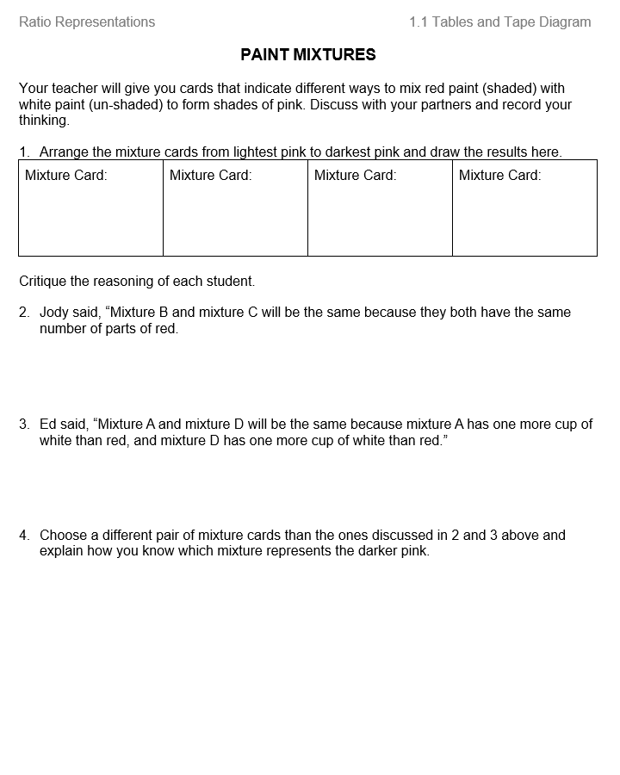
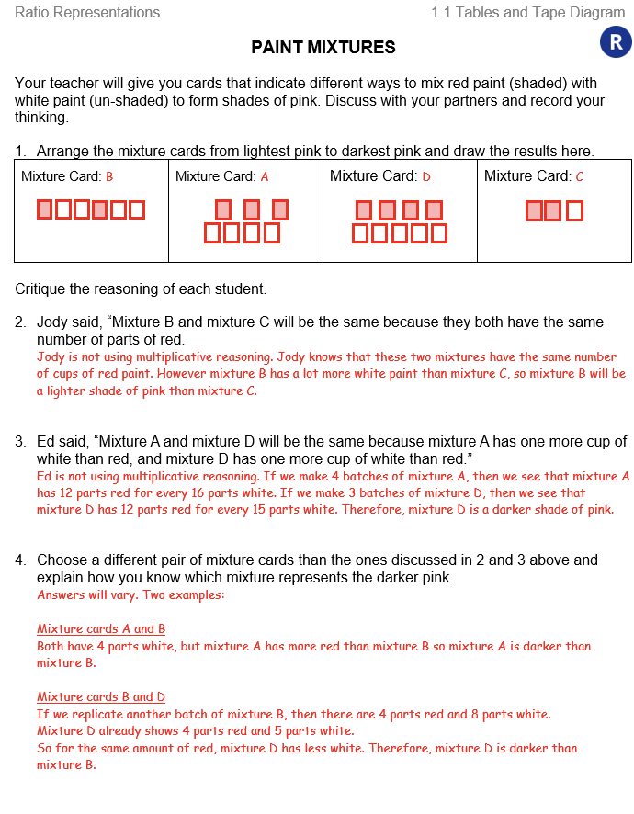
STUDENT PAGES
Notes:
Here are the student pages and the Teacher Pages with the answer key that go with the start of paint mixtures work.

Slide 15
DOUBLE NUMBER LINES
Sienna earns $32 for every four hours of babysitting.
Show Sienna’s wages on a double number line.
0
0
8
1
16
2
32
4
48 64 80 96
6 8 10 12
dollars
hours
unit rate
Show the unit rate on the double number line for the ratio dollars : hours.
Notes:
The second lesson in the packet is on Tables and Double Number Lines. Here we see Sienna babysits and earns $32 for four hours of work.
Students record this information on a double number line. Like all number lines, you start at zero.
Why do you think we skipped a tick mark when we placed $32 and 4 hours where we did? We skip counted by 2s for the hours and half of $32 is $16, and then filled in the remainder of the number lines.
How do you find the unit rate? Maybe you decided that half of two is one so half of $16 is $8.

Slide 16
COMPARE AND CONNECT
How are a table and a double number line the same? Different?
Comparing Tables and Double Number Lines
Same | Different
What patterns do you notice on the double number line representation?
Notes:
We want to compare and connect strategies. A discussion on the similarities and differences between these two helps students make sense of the different representations and determine which ones to use for various situations.

Slide 17


EQUIVALENT RATIOS
We can say that the ratios of fish to frogs are equivalent in these pictures.
Picture 1
Picture 2
What do you think equivalent ratios means?
Notes:
WE end this Ratio Representation packet looking at equivalent ratios using an arrow diagram and discuss the meaning of equivalent ratios.

Slide 18
RATIO OF FISH TO FROGS
3:2
9:6
Picture 1
Picture 2
Why are the ratios of fish to frogs equivalent?
# of fish :
# of frogs
3 : 2
9 : 6
same multiplier
We will call this an “arrow diagram.”
Notes:
We make a ratio for fish to frogs in each picture and using an arrow diagram we show they are equivalent and they both have the same multiplier.

Slide 19



RATIO OF PIGS TO PANDAS
1 : 2
2 : 3
Picture 3
Picture 4
Are the ratios of pigs to pandas equivalent?
# of pigs :
# of pandas
1 : 2
NO!
2 : 3
different multiplier
Notes:
By contrast, you can see here that these are not equivalent ratio as they have different multipliers.

Slide 20
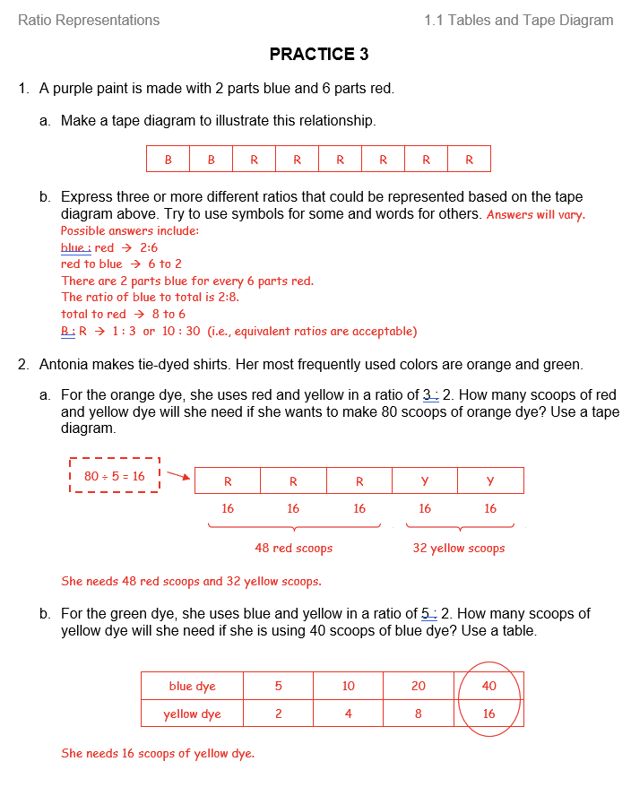
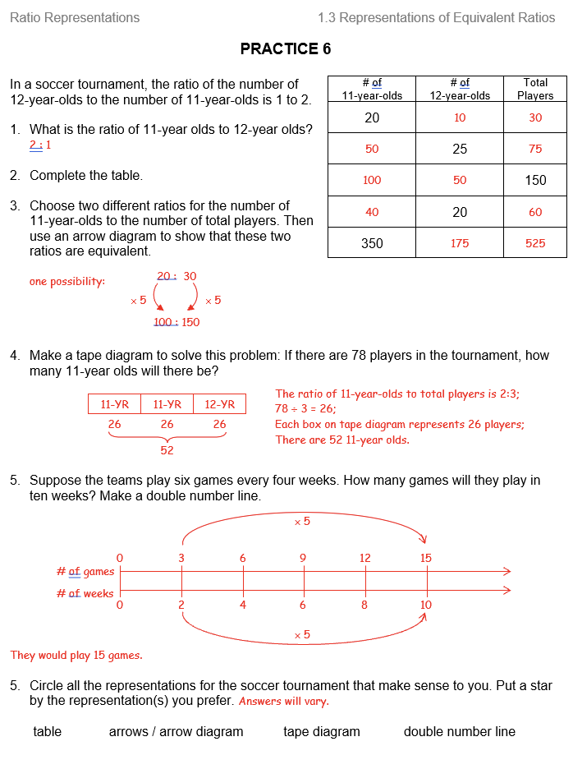
REHEARSAL IS IMPORTANT
Notes:
As mentioned, rehearsal is important, so make sure to offer frequent opportunities to practice after developing a concept.

Slide 21
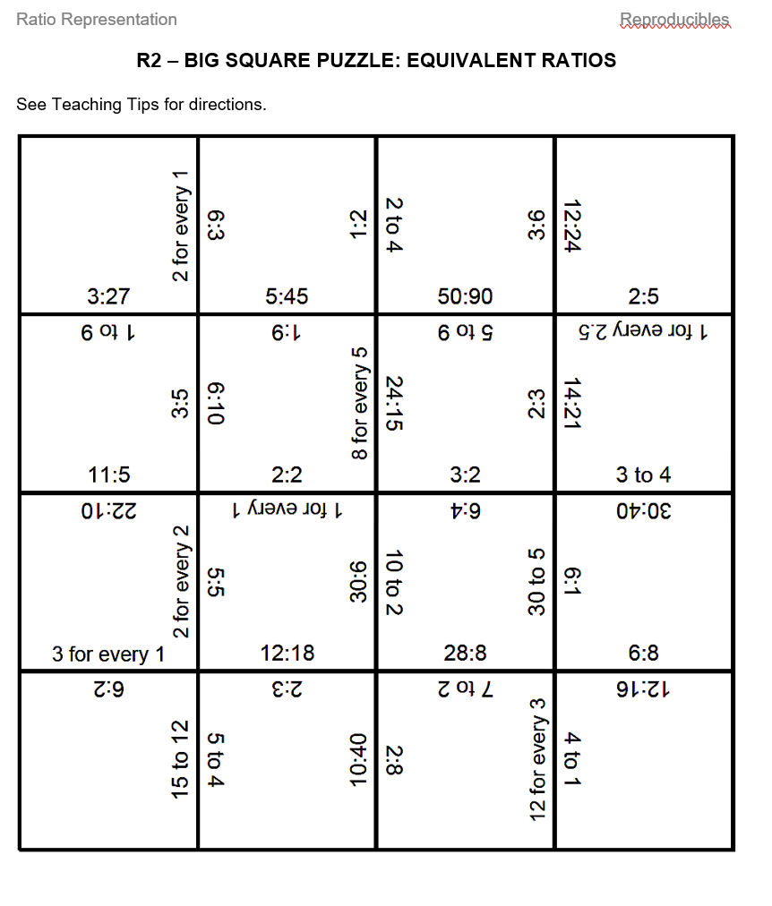
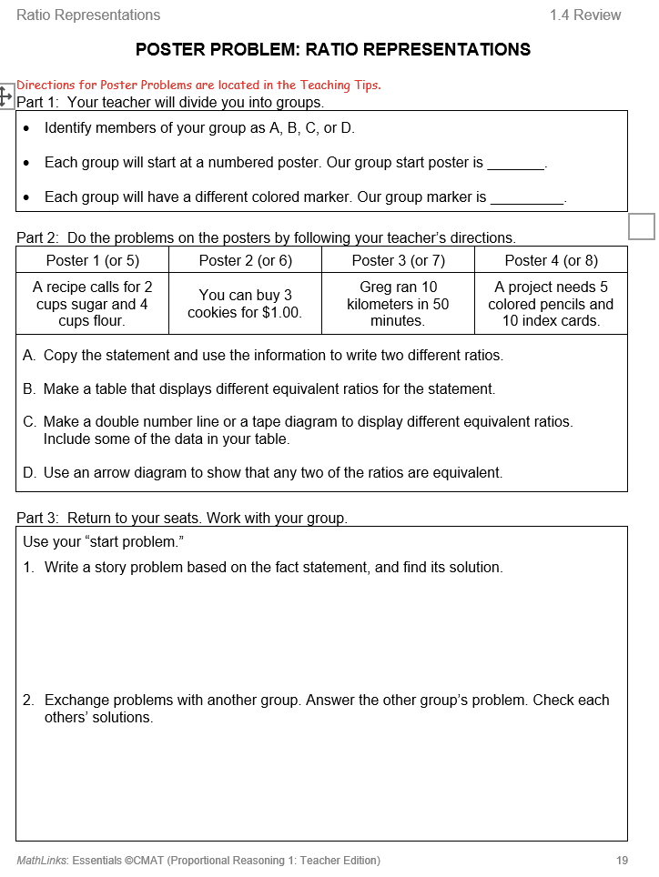
UNIT REVIEW
Notes:
We think that students should have plenty of opportunities to collaborate and talk about the mathematics they’re learning. After three lessons in our student packets conclude, we have a review section with engaging problems and activities, usually for partner work. You see a completed big square puzzle and a poster problem here.

Slide 22
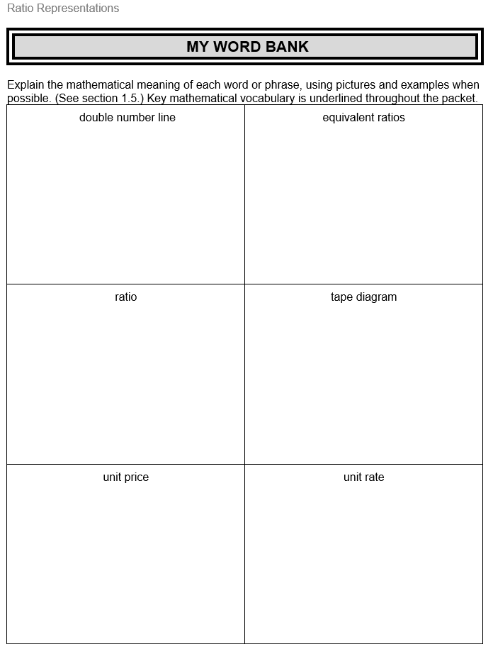
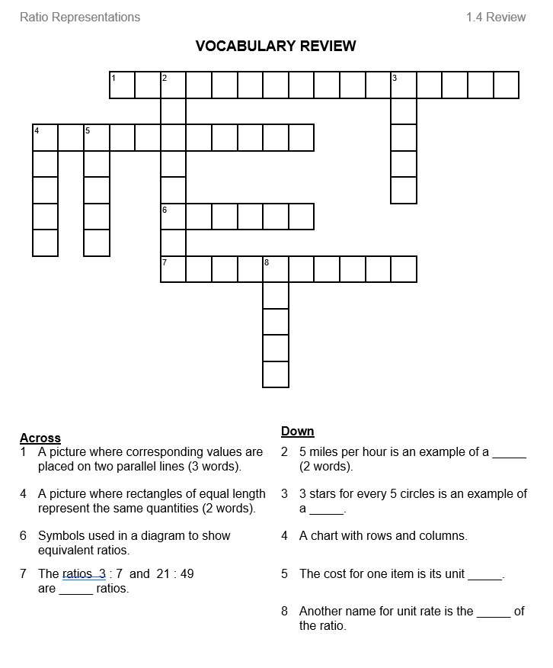
VOCABULARY SUPPORT
Notes:
And vocabulary is addressed through out the packet with the students being able to record the meaning on the My Word Bank and practice on the Vocabulary Review.

Slide 23
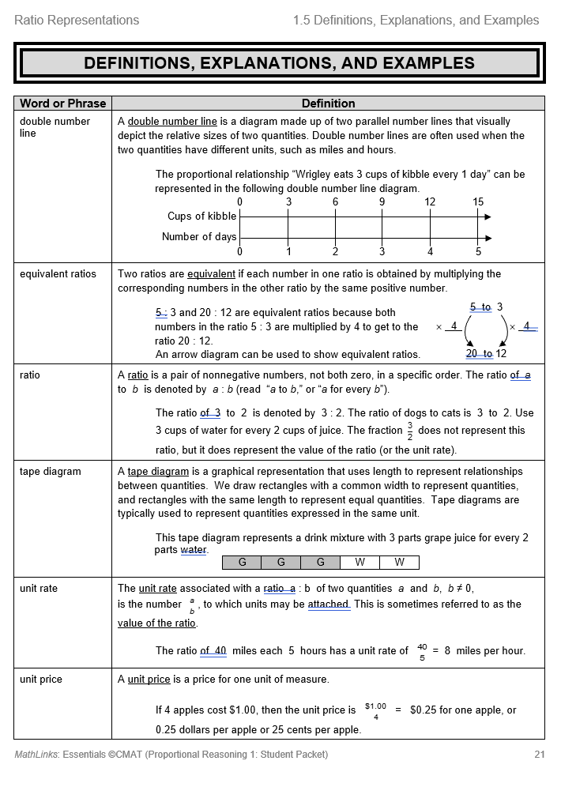
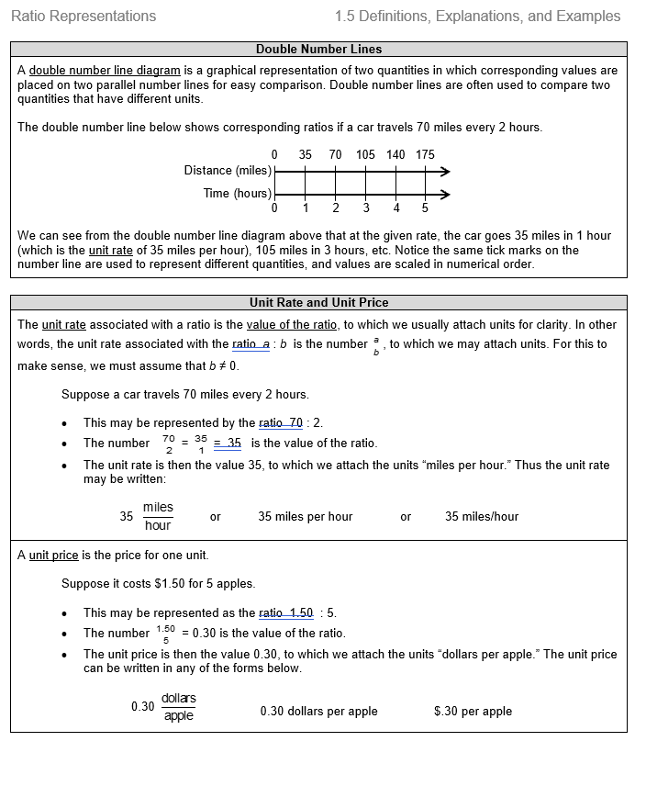
STUDENT RESOURCE SECTION
Notes:
Every Student Packet has a Student Resource section in the back that is specific to the topics and content in that packet. It includes definitions and examples.

Slide 24
MathLinks: PROPORTIONAL REASONING
Second Unit: “Packet 2”
Percent
Focus on Grades 6 and 7 content
Notes:
The second student packet is predominantly 7th grade content on Expressions and Balance.

Slide 25



WHY PROPORTIONAL REASONING?
PERCENTAGES ARE EVERYWHERE TOO!
In Electronics:
Battery life
Shopping
Sales tax
Discounts
Money management
Interest rates
Commissions
Taxes
Notes:
Percentages are everywhere too, in our electronics, in shopping, and in money management.

Slide 26


GROWTH SPURTS
A plant then and now
A tree then and now
2ft 4ft
10 ft 12 ft
What do we know?
What do you wonder?
Which do you think had the
greater growth spurt?
Defend your thinking.
Notes:
The opening problem for this packet is Growth Spurts. We introduce this situation, encourage students to measure each and create a reasonable scale. Students defend their thinking as they discuss which had the greater growth spurts.
Listen for additive thinking vs multiplicative thinking.
Additive thinking would be that they both grew the same amount.
Multiplicative thinking would be that the plant grew more. It doubled in height while the tree only grew 1/5th of its original height.

Slide 27
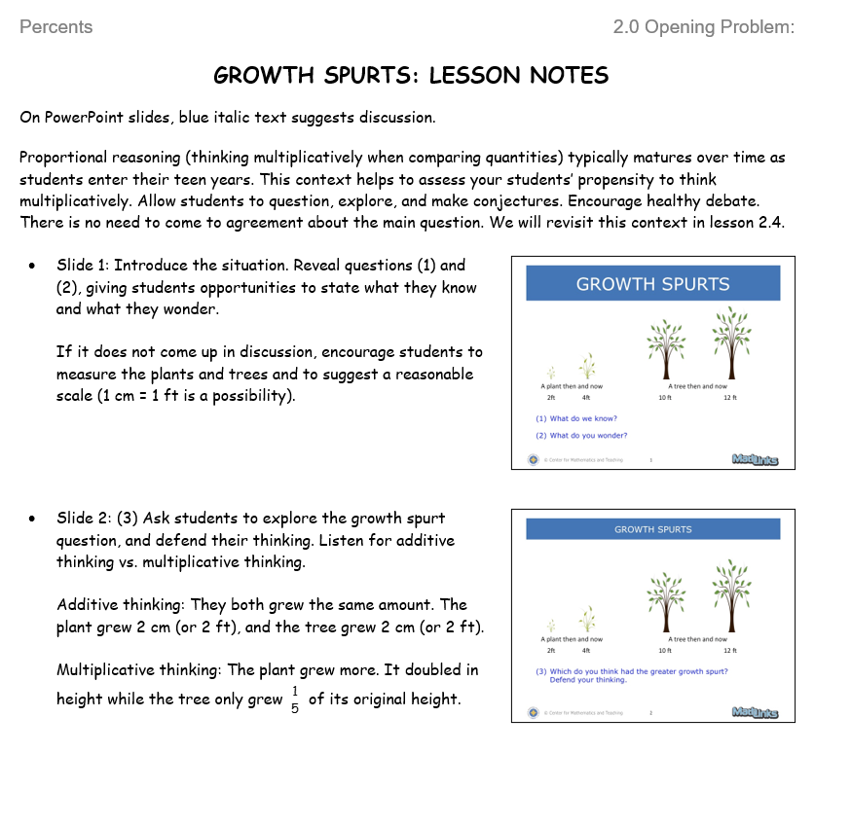
TEACHER SUPPORT IN MathLinks
Notes:
To support our teachers, we provide a slide deck and lesson notes to accompany the lesson.

Slide 28
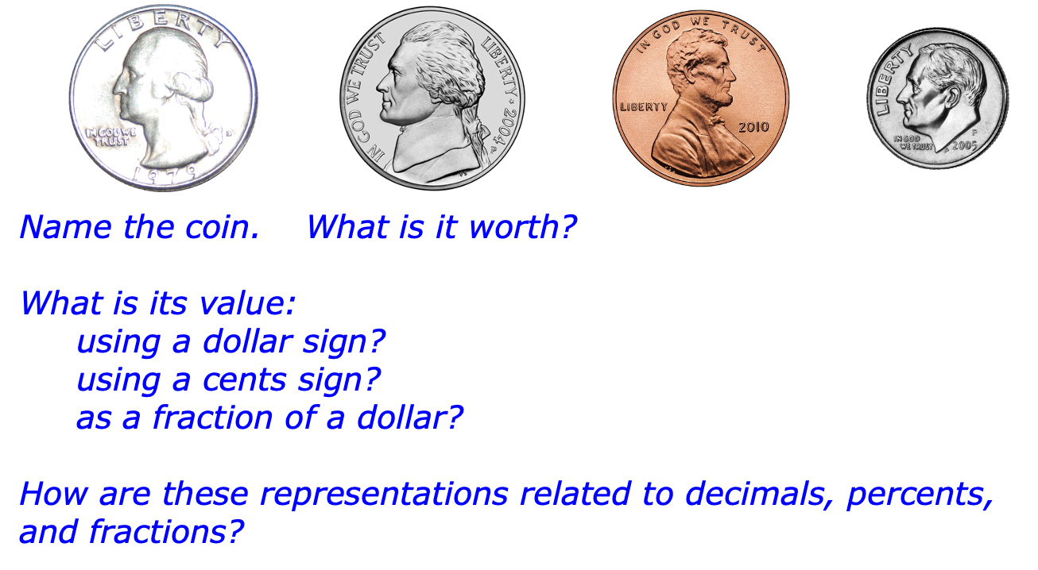
MONEY STRATEGY FOR PERCENT CONVERSIONS
Notes:
The first lesson is Percent as a Number. We use hundred squares and money to remind students that percent means per hundred.
In this example, we discuss how the value these coins connects to representations for fractions, decimals, and percents.

Slide 29
PERCENTS AND
DOUBLE NUMBER LINES
What is 40% of 60?
Show how to solve the problem with a double number line.
0
6
12
18
24
30
36
42
48
54
60
?
Number
Percent
percent
0
10
20
30
40
50
60
70
80
90
100
?
24 is 40% of 60
Notes:
The next lesson is Percent of a Number. We challenge students to create a double number line to show that 24 is 40% of 60. The ratio 24:60 is the same as the ratio 40:100.

Slide 30
DIGGING DEEPER: WHAT IS 40% of 60?
0
6
12
18
24
30
36
42
48
54
60
Number
Percent
0
10
20
30
40
50
60
70
80
90
100
What are some ratios suggested by the circles and squares?
What do the ratios represent?
Name some equivalent fractions suggested by the circles and squares.
Notes:
We encourage students to state ratios suggested by the circles and squares and discuss their meaning using ratio language.

Slide 31
ANOTHER ONE
15 is what percent of 50?
Use a double number line to solve the problem.
0
5
10
15
20
25
30
35
40
45
50
?
Number
Percent
0
10
20
30
40
50
60
70
80
90
100
?
15 is 30% of 50
Notes:
We look at another example, this time the part and whole are given and find that 15 is 30% of 50.

Slide 32
DIGGING DEEPER: 15 is what percent of 50?
0
5
10
15
20
25
30
35
40
45
50
Number
Percent
0
10
20
30
40
50
60
70
80
90
100
Name some equivalent fractions suggested by the circles and squares.
Notes:
And do some more ration language practice.

Slide 33
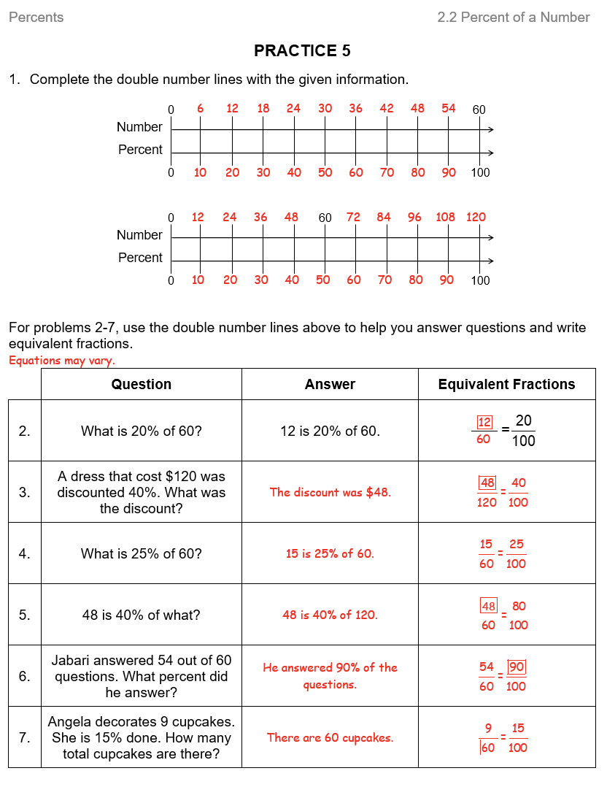
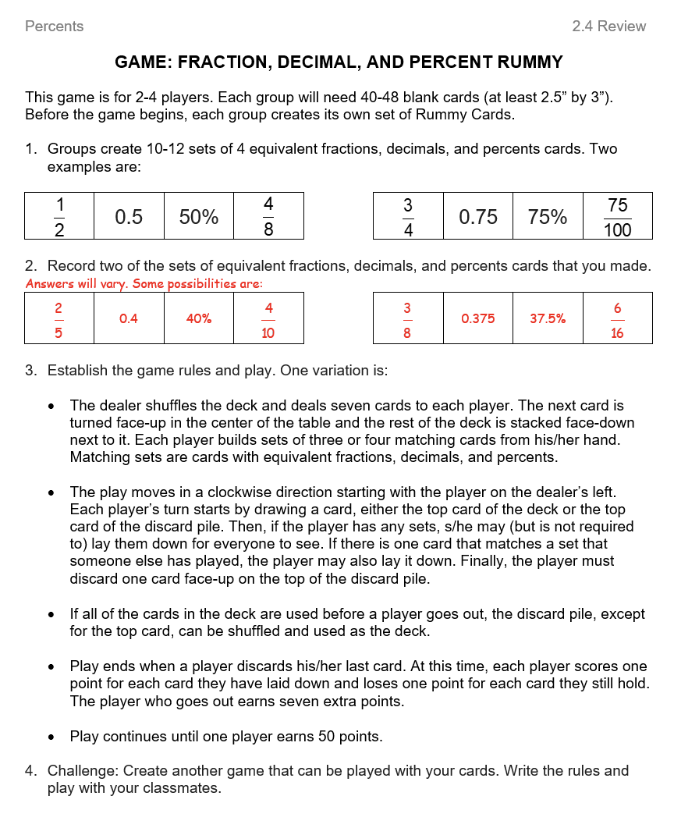
PRACTICE and REVIEW
Notes:
Once again there is practice and review. This time the review is a card game to help keep students actively engaged and talking with their peers.

Slide 34
MathLinks: PROPORTIONAL REASONING
Third Unit: “Packet 3”
Proportional Reasoning Applications
Focus on Grade 7 content
Notes:
The last packet in the Expressions and Equations module is mostly 8th grade standards and works on building formal algebra.

Slide 35
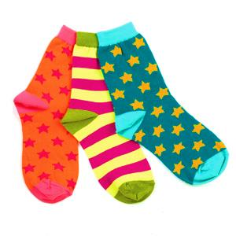
SOCKS
SOX ‘R US
2 pairs for $3.00
CRAZY SOCKS
5 pairs for $6.00
What do we know?
What do you wonder?
What are some different representations we could use to explore this situation mathematically?
Notes:
Best buy problems help students understand proportional relationships.

Slide 36
UNIT PRICES
What is a unit price?
SOX ‘R US
2 pairs for $3.00
CRAZY SOCKS
5 pairs $6.00
If we assume a proportional relationship, which is the better buy? Use unit prices to justify your answer.
Now use another representation. Explain how your representation shows that Crazy Socks is the better buy.
Notes:
We open the discussion about unit price. This is the most straightforward computation for determining the better buy, although students have been using other strategies in previous lessons. We give time for students to determine the better buy with other representations, which gives more insight into proportional relationships.

Slide 37
TABLES
SOX ‘R US
2 pairs for $3.00
CRAZY SOCKS
5 pairs $6.00
How should we set up the table(s)?
What should the headings be?
How can we tell from the table(s) which is the better buy?
Sox ‘R Us
Crazy Socks
# of pairs
(x)
Cost in $
(y)
# of pairs
(x)
Cost in $
(y)
2 3
5 6
4 6
10 12
6 9
15 18
8 12
20 24
10 15
25 30
Notes:
This slide provides scaffolding and hints was needed. We see that for the same quantity we can compare cost and determine the better buy.

Slide 38
FROM NUMBER LINES TO GRAPHS
0 2 4 6 8 10 12
Cost
0 2 4 6 8 10 12
Cost
# of pairs of socks
0 2 4 6 8 10 12
Watch two number lines transform into coordinate graph.
0 2 4 6 8 10 12
# of pairs of socks
Notes:
We connect data repesented on a double number line and a coordinate plane. Cost becomes our y-axis and number of pairs of socks our x-axis.

Slide 39
GRAPHS
Why do you think some lines are solid and some are dotted on the graph?
Sox ‘R Us Crazy Socks
0 2 4 6 8 10 12
Cost
More socks for the same money at Crazy Sox
0 2 4 6 8 10 12
# of pairs of socks
Notes:
This line questions solid lines and discrete points. Points best represent the situation, but if the variables represent a proportional relationship, all pints will lie on a line through the origin. We can discuss how the various lines are useful to see the trend.

Slide 40
TABLES
SOX ‘R US
2 pairs for $3.00
CRAZY SOCKS
5 pairs $6.00
Sox ‘R Us
Crazy Socks
# of pairs
(x)
Cost in $
(y)
# of pairs
(x)
Cost in $
(y)
2 3
5 6
4 6
10 12
1 1.5
1
1 1.2
1
y = 1.5x
y = 1.2x
unit rate!
What does the coefficient of x represent in the equation?
Notes:
We revisit the table and determine the rule. The table suggest a proportional relationship because one variable is a multiple of another. This is evident in the equations which are in the form y = kx where k is the constant of proportionality and also the unit rate.

Slide 41
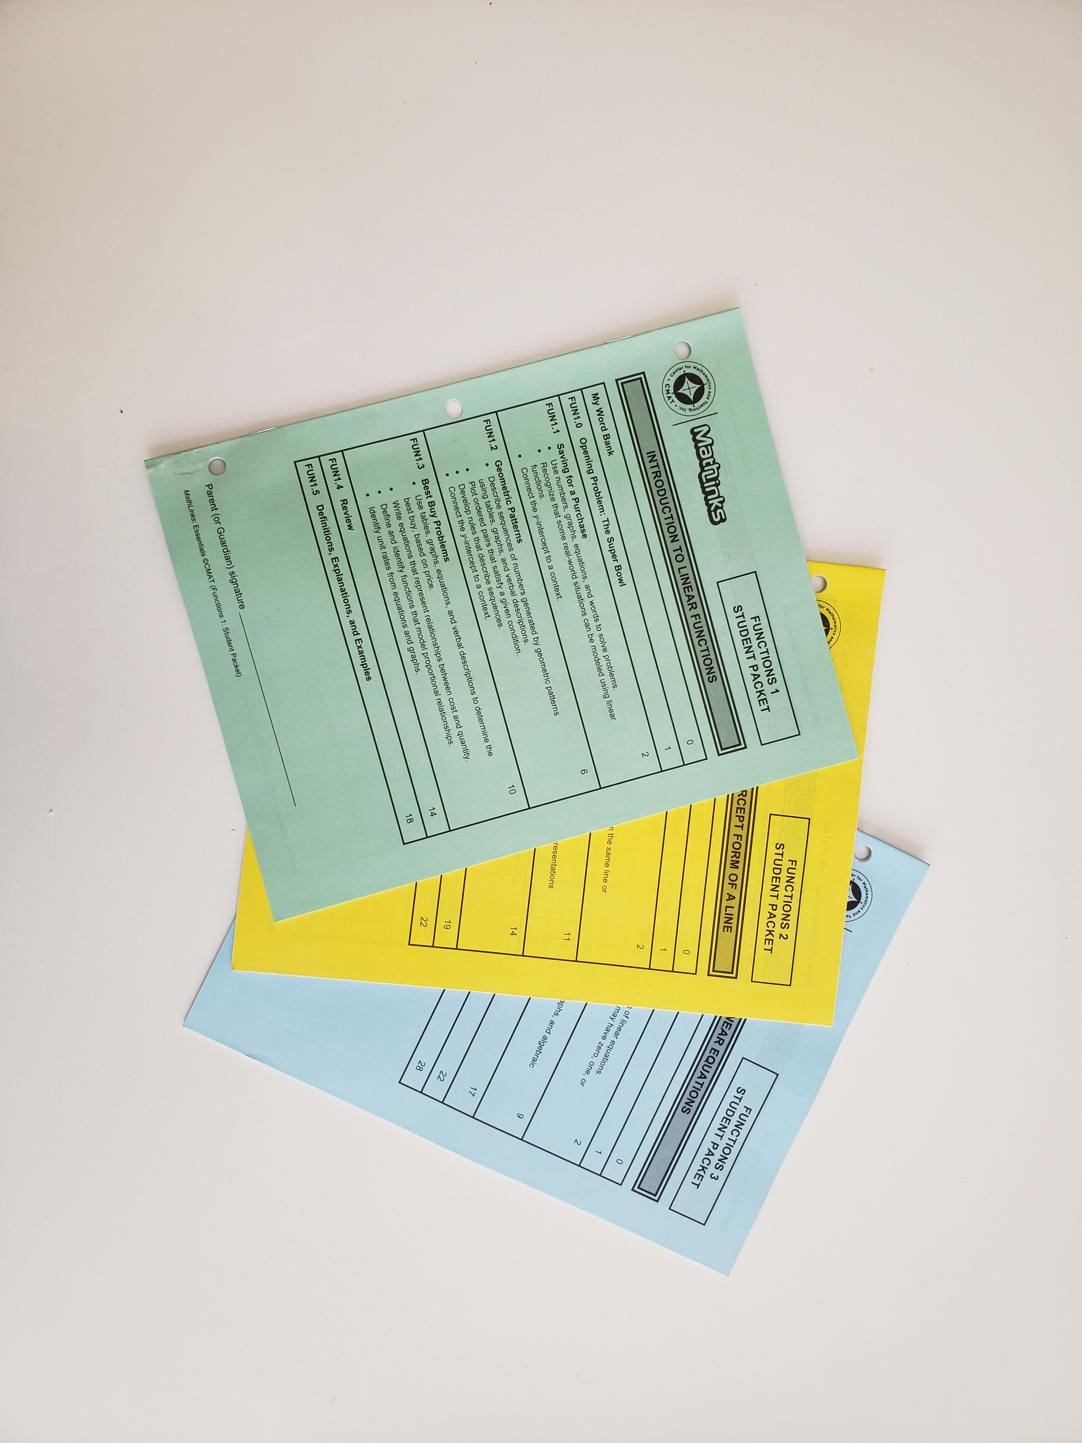
STUDENT PACKETS
Every packet includes:
An opening problem
Attention to vocabulary
Three multi-period lessons
Review activities
Definitions, explanations, and examples
Notes:
As a recap, the student packets include…

Slide 42
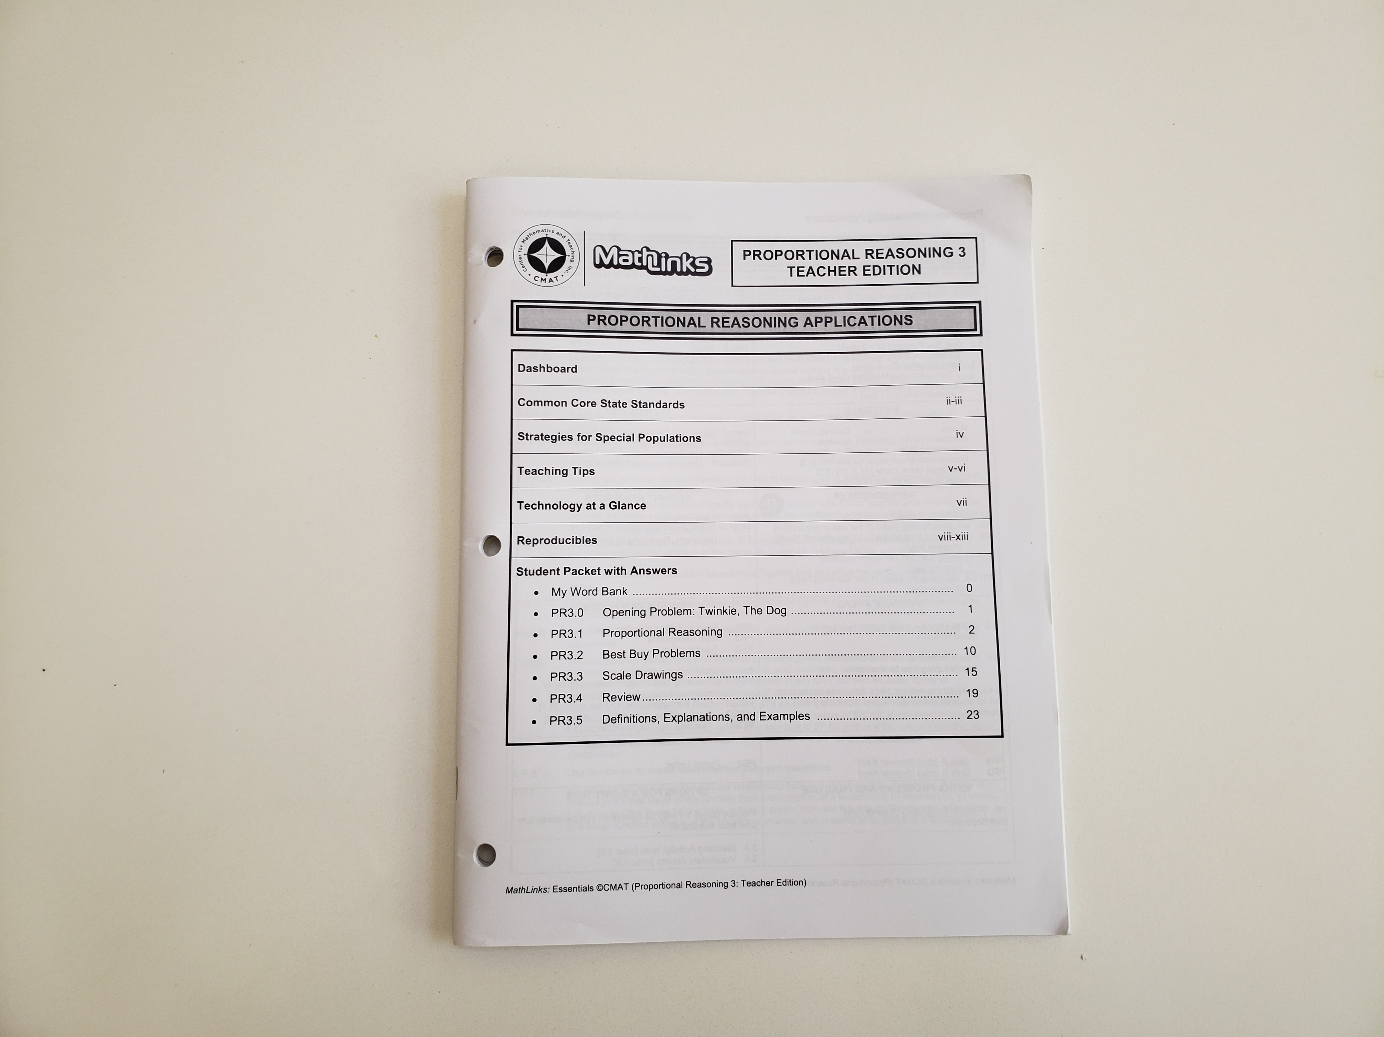
TEACHER EDITION
You’ll find:
Planning dashboard
Standards
Teaching notes
Tech activities
Reproducibles
Answer key
Lesson plans with
slide decks
Notes:
And the teacher edition includes….

Slide 43
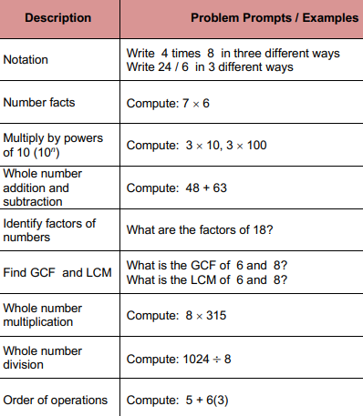
SKILLS PRACTICE WITH “SKILL BOOSTERS”
Example
You have 7th or 8th graders
in intervention
you’re concentrating on
integer operations,
solving equations,
etc.
Notes:
Skill Boosters do not relate to any of our Essentials units and are meant to fill in those well below grade level holes in content. They are skills practice meant to be done in a 5 – 10 minute daily routine. Here you see the Whole Number outline of topics.

Slide 44
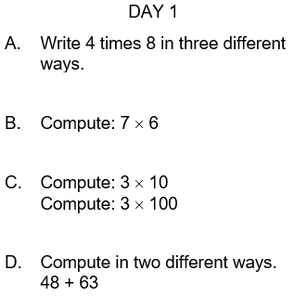
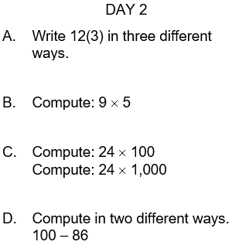
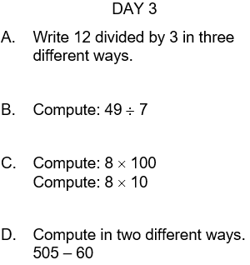
SKILL BOOSTERS EXAMPLES
Notes:
And a sample of small daily problem sets like these that you use over the course of several days or weeks.

Slide 45
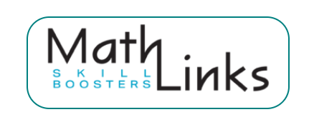
ALSO AVAILABLE…
Whole Numbers
Fraction Concepts
Fraction Addition and Subtraction
Fraction Multiplication and Division
Decimal and Percent Concepts
Integers
Equations
A daily routine
About 5-10 minutes per day
Notes:
Here are all the Skill Booster topics that are set up in the same format.

Slide 46
THE MathLinks: ESSENTIALS PROGRAM
Modules | Pkt 1 Gr levels | Pkt 2 Gr levels | Pkt 3 Gr levels
Number Base 10 | 4-6 | 4-5 | 5-6
Fractions | 3-4 | 4-5 | 5-6
Proportional Reasoning | 6 | 6-7 | 7
Integers | 6 | 7 | 7
Expressions & Equations | 6 | 7 | 8
Functions | 8 | 8 | 8
Grade 4-6
Foundational work
Grade 6-8
Major work
Notes:
MathLinks: Essentials has six modules that cover the major work of middle school. Each module has three Student Packets. You can mix and match any of these modules or packets to fit the needs of your students.

Slide 47
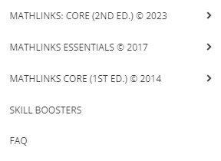
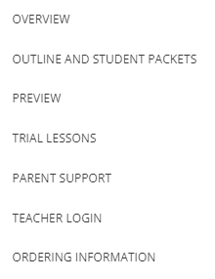
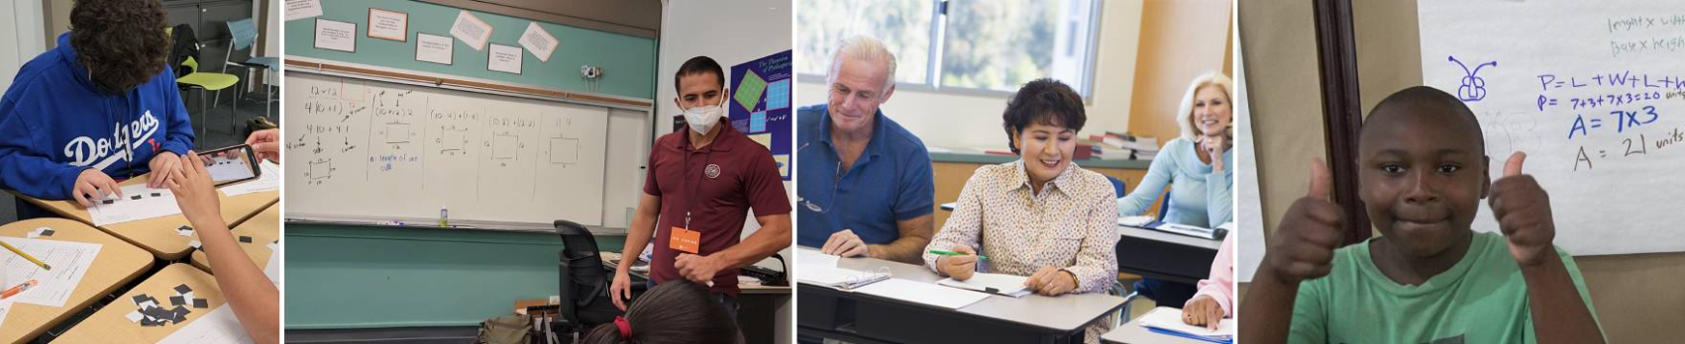

CHECK OUT THE PROGRAM
www.mathandteaching.org
Notes:
To see more, go to our website at mathandteaching.org, curriculum, MathLinks essentials, overview. Outline and Student Packets will lead you to each of the 18 packets and give you the option to flip through each Student Packet.

Slide 48

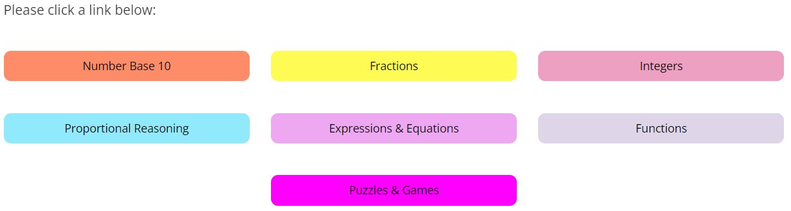

THE TEACHER PORTAL
BONUS
Secure
password-protected
access for teachers
Notes:
Our Teacher Portal provides slide decks, extra problems banks, quizzes, technology resources, etc.

Slide 49
CONTACT US
The Center for Mathematics and Teaching
Non-profit 501(c)(3)
www.mathandteaching.org/essentials/
Cynthia Raff
cynthia@mathandteaching.org
THANK YOU FOR VIEWING THIS PRESENTATION!!
Notes:
Thank you for taking your time go through this presentation.

