Slide 1
INTERVENTION WITH MATHLINKS
Cynthia Raff
cynthia@mathandteaching.org
Shelley Kriegler
shelley@mathandteaching.org
The Center for Mathematics and Teaching [a 501(c)(3) non-profit]
www.mathandteaching.org/essentials/
TODAY’S FOCUS:
EXPRESSIONS AND EQUATIONS
Notes:
Welcome to our presentation on MathLinks: Essentials – Expressions and Equations.
If you don’t know us…CMAT is a non-profit and we develop middle school mathematics curriculum and resources, and support teachers in using them through professional development.
We worked together in the mathematics department at UCLA for about a decade.
Then about 14 years ago we left the university to form CMAT.

Slide 2
AGENDA
An Intervention Plan
How the MathLinks Essentials Expressions and Equations
fits into the plan
Experiences and Research
Notes:
Here is what will be covered in this presentation.

Slide 3

GETTING STUDENTS BACK ON TRACK
Creating YOUR plan
Identifying the major work
of the grade or focus topics
Including needed review and backfill…
and frontloading if desired
Using appropriate content pitched to your students’ needs
Increase confidence on the way to greater success
Notes:
Some ways to get students back on track. Here are some things we have learned from those having success.
Focus on your major grade level bands.
Backfill is fine, but some mix in frontloading to give students a good foundation for a topic before they see it in their core class. This gives student confidence on a new topic.
Most intervention students can do the work but they learn differently, and may need different strategies and supports. They need meaning to attach to concepts in order to have success.
The goal is to increase confidence and students’ chances for success.

Slide 4
WHAT THE RESEARCH TELLS US
Ongoing Formative Assessment and Feedback
Do we need to test our
struggling learners a lot?
Alternate Strategies
Must students know more than one strategy?
Rehearsal
What’s the right kind of rehearsal/practice and how much is the right amount?
Balance Basic Skills and Conceptual Development
If Basic Skills AND Conceptual Development are both important,
how do you pull that off?
Teacher Support
How can we support teachers in this work?
Notes:
Though we have years of experience, here is what the research says and what questions we get from teachers.
More frequent feedback and guidance will help for students to have success.
Offing students more than one strategy can be helpful, then assist them in picking the one that is most beneficial for their needs.
Practice differs from student to student, so it’s nice to have options and make sure they have a good shot of getting the problems right.
Build concepts, then guide the students to procedures. This is especially important for struggling learners. They need meaning and connection for things to make sense.
And of course, teachers need support. We agree!!

Slide 5
THE MathLinks: ESSENTIALS PROGRAM
Modules | Pkt 1 Gr levels | Pkt 2 Gr levels | Pkt 3 Gr levels
Number Base 10 | 4-6 | 4-5 | 5-6
Fractions | 3-4 | 4-5 | 5-6
Proportional Reasoning | 6 | 6-7 | 7
Integers | 6 | 7 | 7
Expressions & Equations | 6 | 7 | 8
Functions | 8 | 8 | 8
Grade 4-6
Foundational work
Grade 6-8
Major work
Notes:
As you see here, Expressions and Equations is part of the major work of middle school.

Slide 6

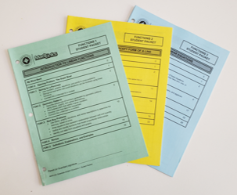
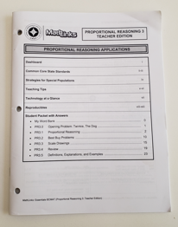
TODAY’S SOURCE MATERIALS
Student Packets
Teacher Edition
Notes:
Materials for this session are drawn from our experience, research, and our MathLinks Programs. Activities are from MathLinks: Essentials Proportional Reasoning module, which includes 3 consumable student packets, 1 teacher guide, and…

Slide 7
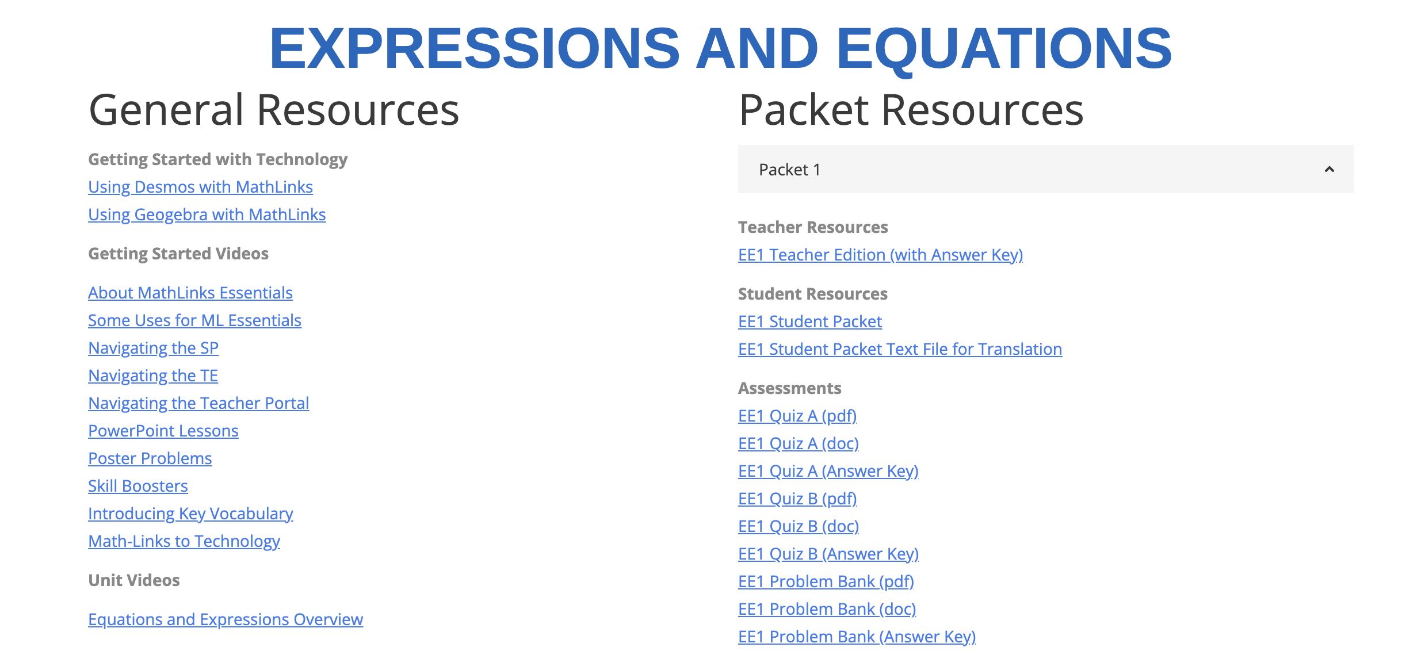
TODAY’S SOURCE MATERIALS
Teacher Portal – Online Resources
Notes:
And a secure teacher portal with additional components.

Slide 8
MathLinks: EXPRESSIONS AND EQUATIONS
First Packet 1
Variables and Balance
Focus on Grade 6 content
Notes:
The first Student Packet focuses on Variables and Balance and is mostly 6th grade standards.

Slide 9
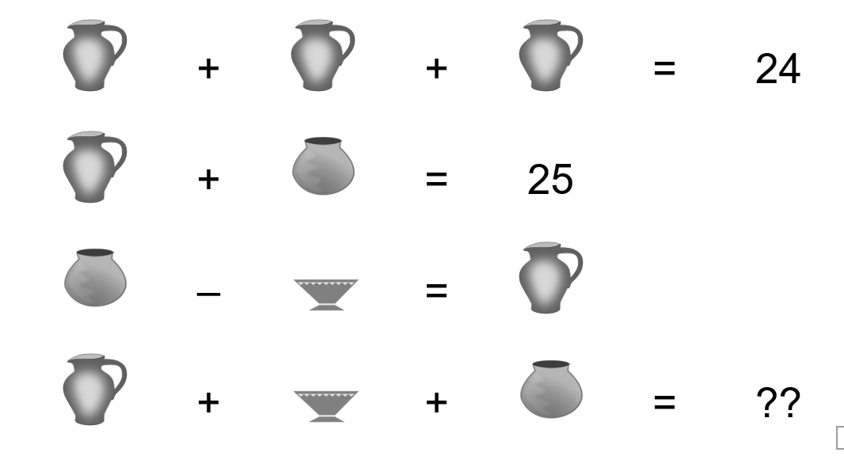
OPENING PROBLEM
The same containers have the same value or “weight.”
What is the value of each container? Explain your reasoning.
Notes:
Here is the opening problem. This is an introductory exposure to expressions, equations, and variables.

Slide 10
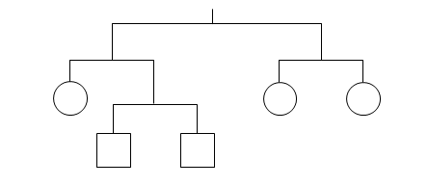
MOBILES
Suppose the total weight is 12.
Find the weight of each shape. Explain your reasoning.
Write three equations based on weights on the mobile.
Notes:
Balance puzzles start this packet. These mobiles allow students to visually see that both sides need ot be balanced. Understanding balance, leads to substitution, and then connect to equations. Students may want to apply a “shorthand” such as “c” is for the weight of a circle in order to write an equation.

Slide 11
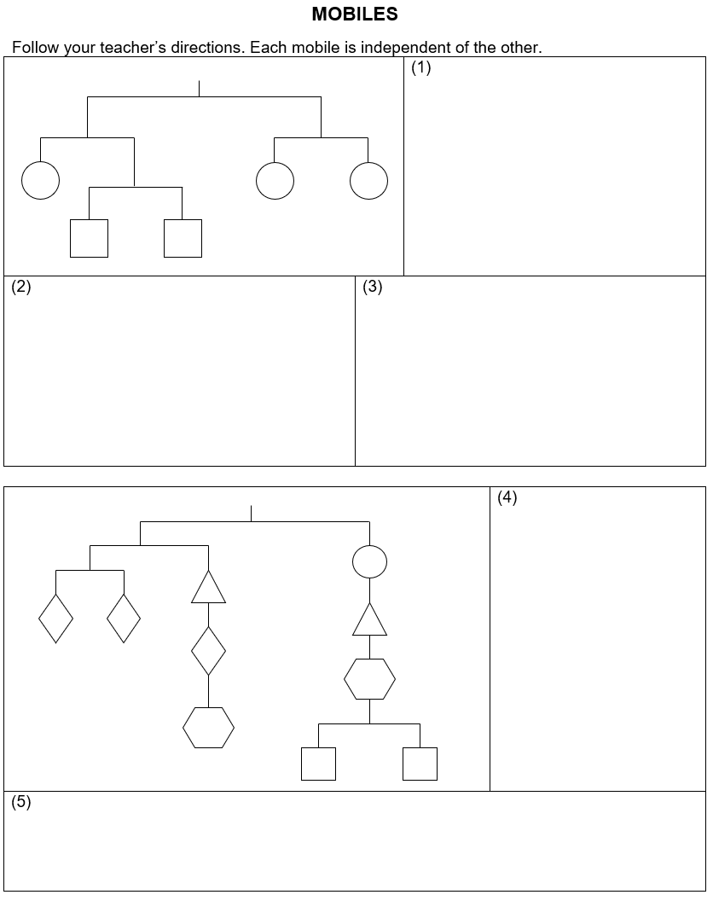
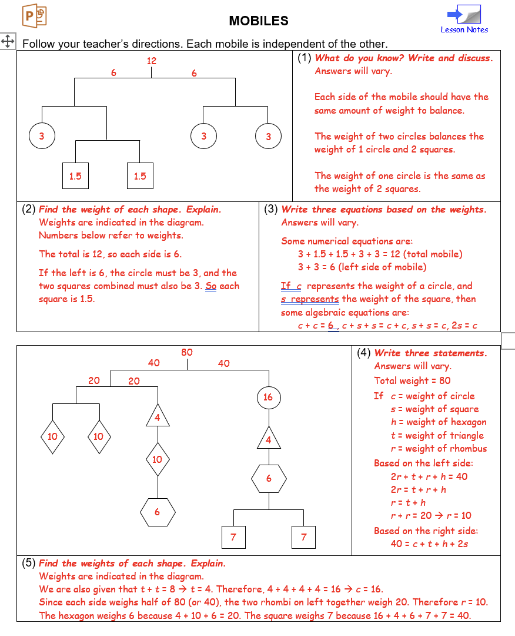
STUDENT PAGES
Notes:
Here are the student pages and the Teacher Pages with the answer key that go with these balance puzzles

Slide 12
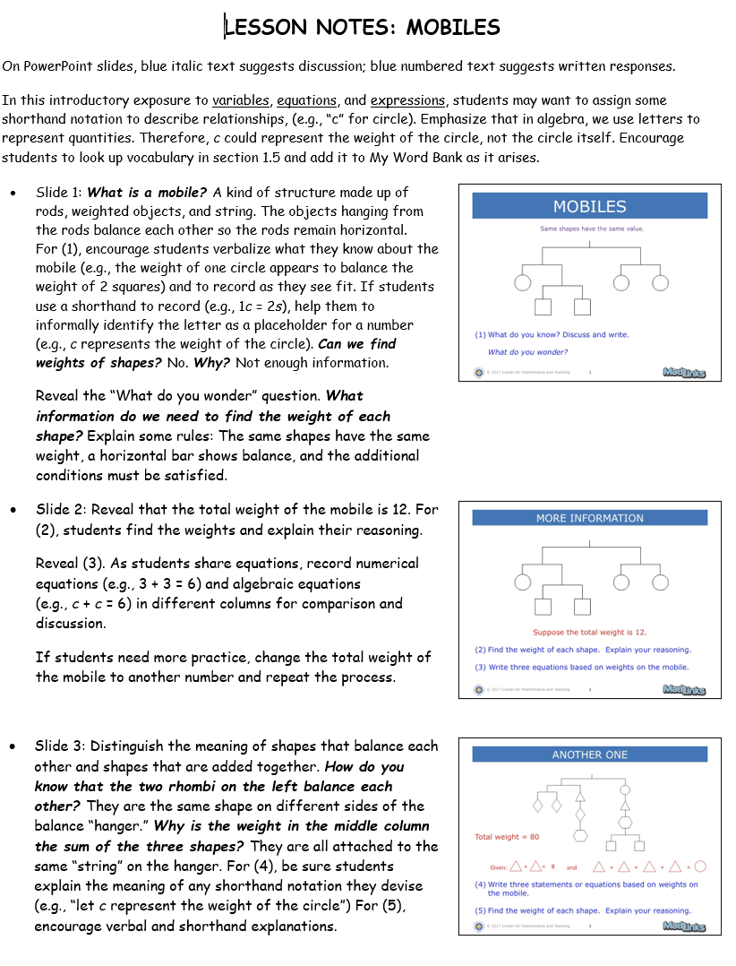
TEACHER SUPPORT IN MathLinks
Notes:
We also provide a slide deck and lesson notes to accompany the lesson.

Slide 13

VARIABLES AND EXPRESSIONS
Use letters to represent costs for menu items.
Let c = cost of a cheese slice
Let p = cost of pepperoni slice
Let s = cost of small drink
Let m = cost of medium drink
Let L =cost of large drink
2 slices of cheese pizza and one small drink, please!
Write the cost of this order using letters (variables). Then compute the cost.
c + c + s
s = 1.00 + 1.00 + 0.95 = 2.95
s = 2(1.00) + (0.95) = 2.95
$2.95
2c + s
How would you record this order?
Notes:
We move into the second lesson on variables and expressions using a “Pizza Place” to help define variables. We use this menu activity to make equivalent expressions and solve equations for missing variables. Make sure the students recognize that the variable represents the cost of the item. This is a great opportunity for pairs of students to discuss and critique each others’ reasoning.

Slide 14

Another order
Write a variable expression for the cost of this order.
2 slices of cheese pizza and one small drink, please!
One way:
(2c + s) + (2c + s)
Me too!
A Second Way:
2c + s
2c + s
4c + 2s
4c
+ 2s
A Third Way:
= 2(2c + s)
(2c + s) + (2c + s)
= 4c + 2s
Notes:
We ask students to write expressions for the cost of the order represented here. This is a great opportunity for pairs of students to discuss and critique each others’ reasoning.

Slide 15
VARIABLES AND EQUATIONS
What is an equation?
The cost of one slice of pepperoni pizza and another item is the same as the cost of 3 slices of cheese pizza.
Write an equation to represent this situation.
Notes:
We discuss that equations assert that two expressions ae equal.

Slide 16
EQUATION SOLVING STRATEGY: SUBSTITUTION
Solve and check. How do you know?
3x = 15
Think:
“3 times what number is 15? ”
x must be 5.
Check: 3(5) = 15
15 = 15
Notes:
We conclude this packet with Mental Math and helping students with sense making strategies. We give them a kind of script or sentence starter to help them talk through the equation.

Slide 17
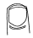
MORE EQUATION SOLVING
WITH SUBSTITUTION
Solve and check. How do you know?
Think:
“Half of what [under my finger] is 12?
Since half of 24 is 12,
3 + f must equal 24”
Now finish the problem!
Check:
Now finish the check!
Notes:
Here we have the cover up method, with the same type of dialogue as the previous slide.

Slide 18
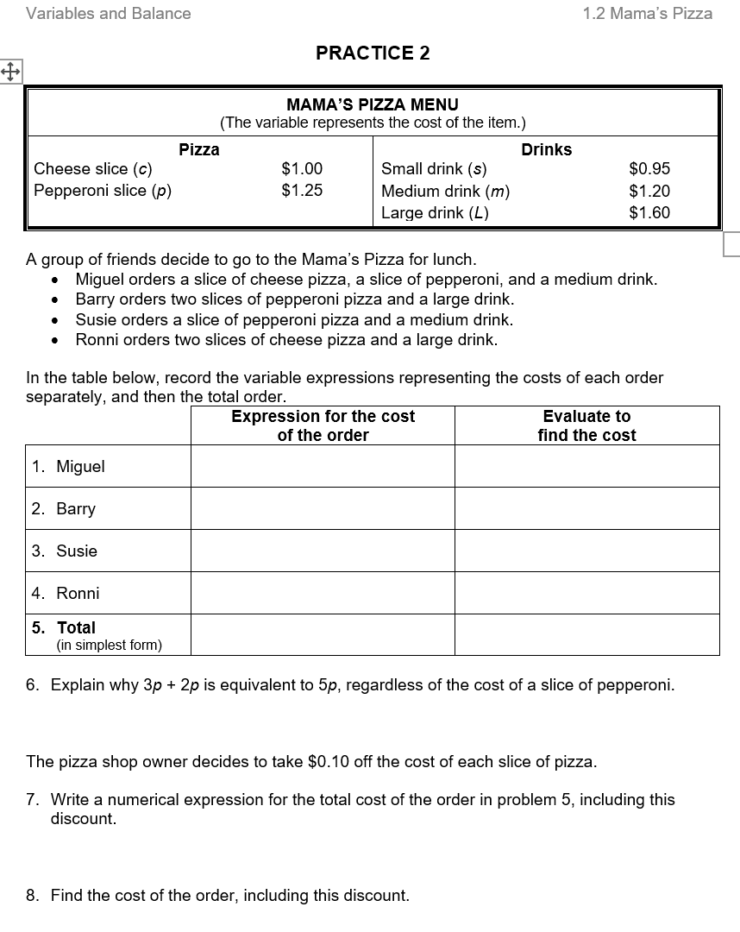
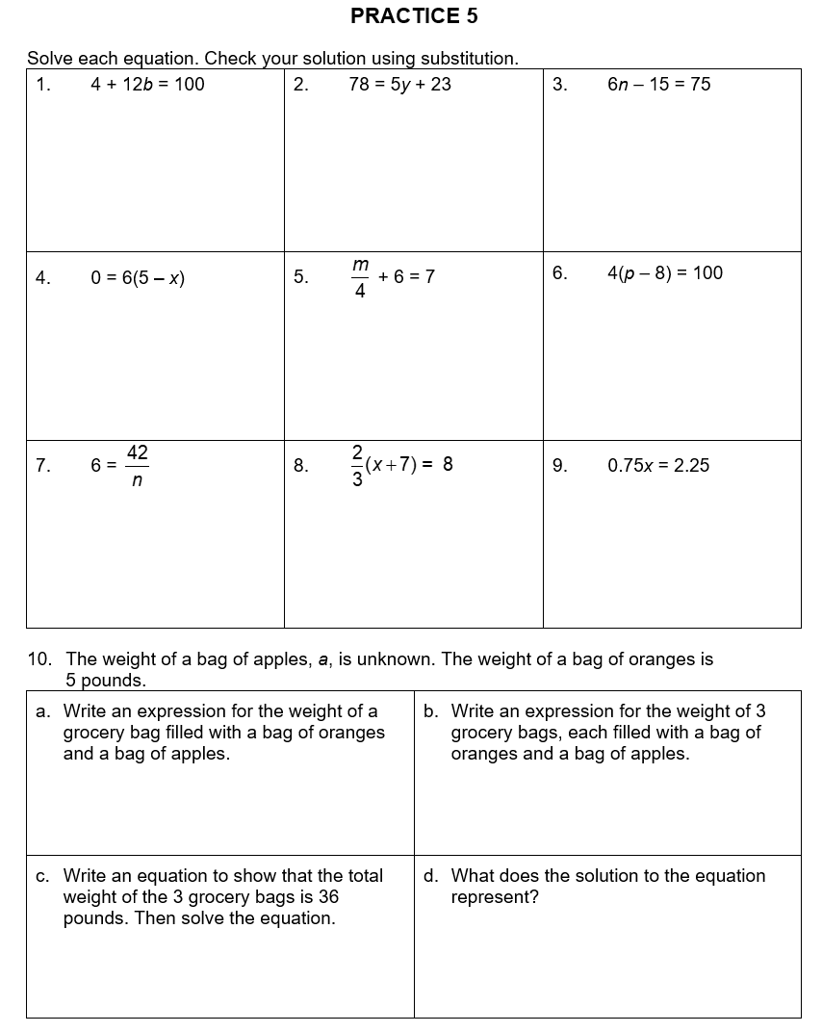
REHEARSAL IS IMPORTANT
Notes:
There is plenty of practice in the Student Packet and on the Teacher Portal

Slide 19
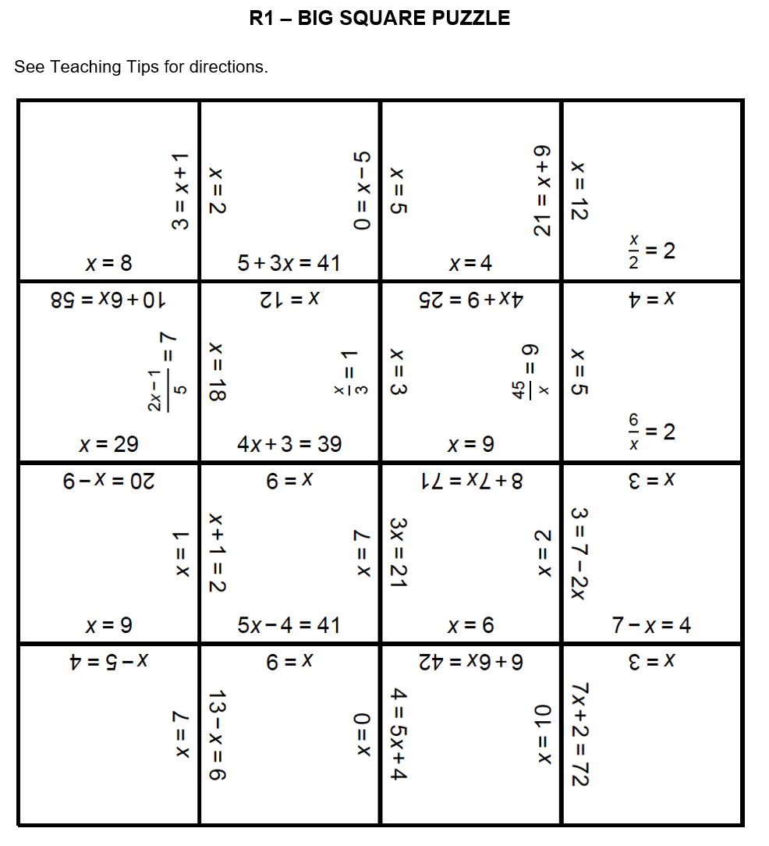
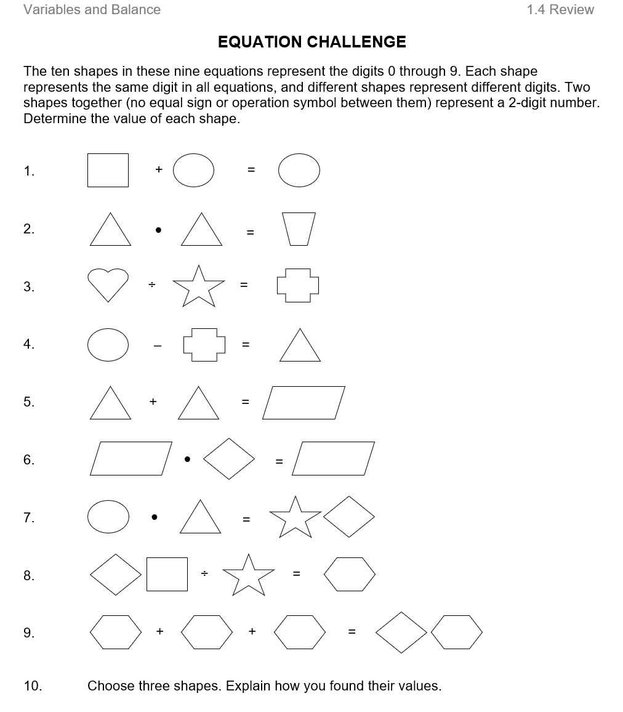
UNIT REVIEW
Notes:
Every packet has a review section with engaging problems.

Slide 20
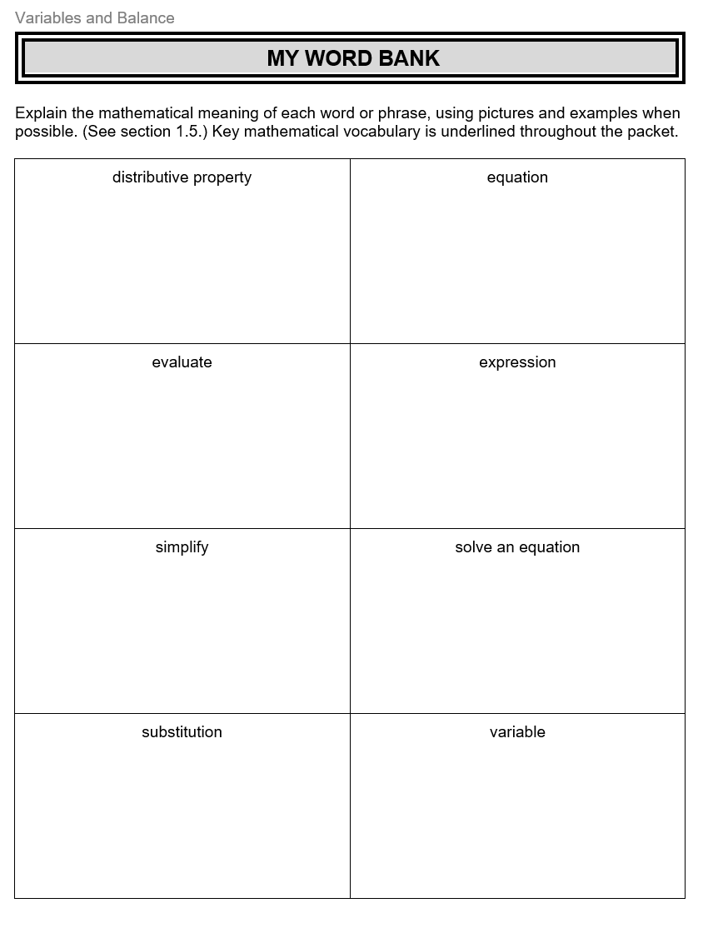
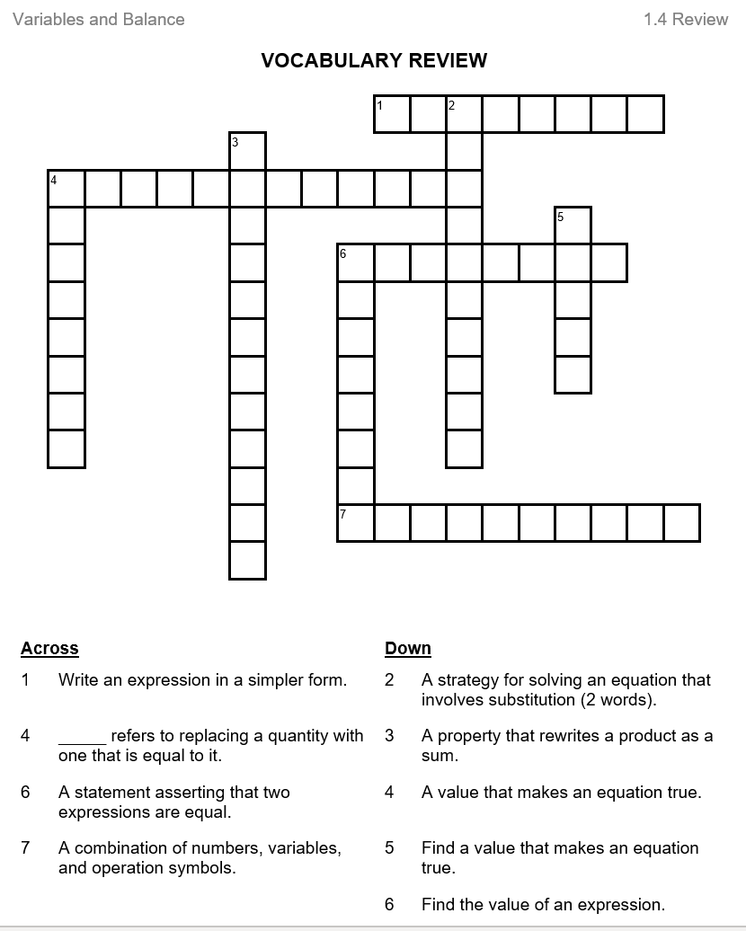
VOCABULARY SUPPORT
Notes:
And vocabulary is addressed through out the packet with the students being able to record the meaning on the My Word Bank and practice on the Vocabulary Review.

Slide 21
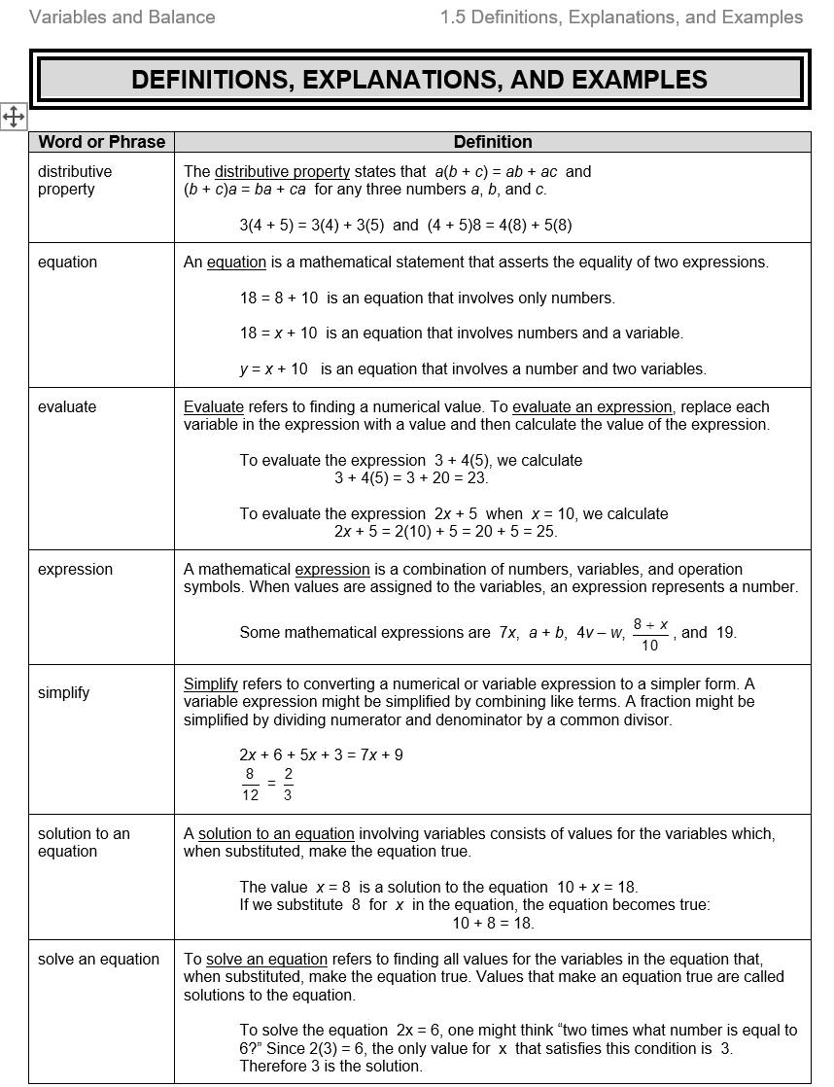
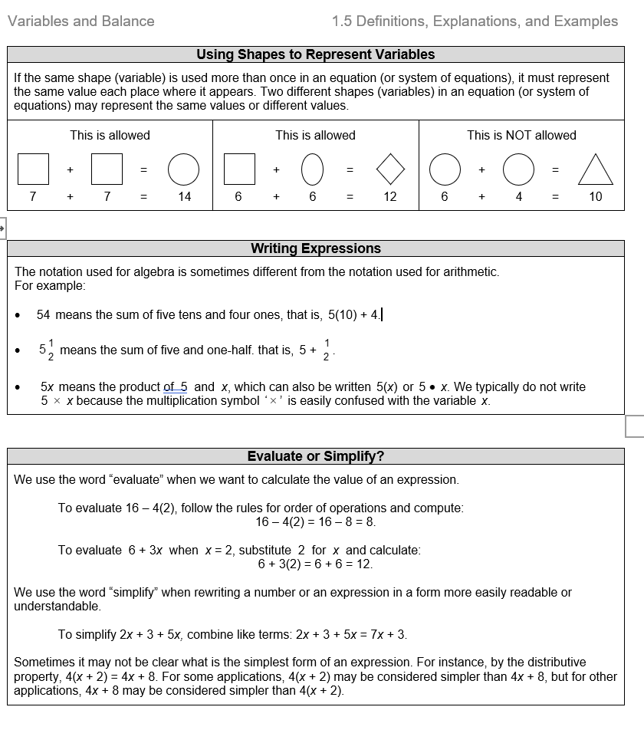
STUDENT RESOURCE SECTION
Notes:
Every Student Packet has a Student Resource section in the back that is specific to the topics and content in that packet. It includes definitions and examples.

Slide 22
MathLinks: EXPRESSIONS AND EQUATIONS
Packet 2
Expressions and Balance
Focus on Grade 7 content
Notes:
The second student packet is predominantly 7th grade content on Expressions and Balance.

Slide 23

THE LAKE PROBLEM
Some adults and children need
to cross a lake on their hike.
They have a small canoe that
can’t hold everyone.
How many one-way trips are needed to get
everyone across the lake?
What do we know?
What do you wonder?
Notes:
This packet opens with The Lake Problem. Information is revealed in pieces so that students can make sense of it and become motivated to engage in the problem solving experience. This problem requires perseverance. There is intentionally not enough information in this slide. Chart all responses and validate all input.

Slide 24

SOME DETAILS
1 canoe can hold:
  1 child alone
  OR
  2 children together
  OR
  1 adult alone
C
C C
A
Everyone can paddle the canoe.
The only way to get across the lake is to use the canoe.
Notes:
We then provide more detail, such as how students might want to sketch the trips and how many one canoe can hold.

Slide 25
ATTACKING THE PROBLEM
What strategies could we use
while solving this problem?
A last bit of important information:
There are 6 adults and 2 children that need to get across the lake.
Now you can start to solve the problem.
Reminder: We are looking for the
least number of trips to accomplish this.
Notes:
You may want to discuss strategy before revealing who needs to cross the lake.

Slide 26
INTRODUCTION TO CUPS AND COUNTERS
Record the meaning of cups and counters.
COUNTERS may be used
to represent integers.
CUPS may be used to
represent unknowns.
V
Value : +1
Record as :
Value : -1
Record as:
Value : unknown (x)
Record as:
+
–
V
Notes:
This first lesson focuses on equivalant expressions with a hands-on manipulatives. We use cups and counters to represent numbers and variables.

Slide 27
BUILD, DRAW, AND WRITE EXPRESSIONS
3
-2
3x
x + 3
x – 3
2x - 3
  V + +
V + +
V + +
Notes:
We spend time building, drawing and writing expressions. You want to be sure students have a good foundation of how to represent expressions with this model.

Slide 28
EQUIVALENT EXPRESSIONS
Three friends ordered pizza slices and drinks at Mama’s Pizza. They used variables to record the cost.
They let
c = the cost of a slice of cheese
p = the cost of a slice of pepperoni
s = the cost of a small drink
m = the cost of a medium drink
Copy the expression they wrote for the COST of their order:
2c + m + p + s + 2p + m
2c + m + p + s + 2p + m
What items did they order?
One friend thought the order could be written in a simpler way.
What do you think she meant by this?
Rewrite the order in a simpler way.
Look up the meaning of like terms. Add it to My Word Bank.
Notes:
Here we visit Mama’s Pizza. The same variable are used on this lesson as the previous lesson. We focus on combining like terms and encourage students to understand that combining like terms makes sense.

Slide 29
REWRITING EQUIVALENT EXPRESSIONS
DETAILED SOLUTION
Build it. Draw it. Rewrite it by combining like terms.
4x – 3 – 3x + 5
4x – 3 – 3x + 5
= x
+ 2
V
V
V
V
Notes:
When we model an expression with cups and counters, it become clear how to combine like terms.

Slide 30

EQUATION SOLVING STRATEGY: BALANCE
+ +
+ + +
+ +
+ +
V
V
+ + +
+ +
Let’s replace the scale with a line to show balance.
What equation do you think this represents?
What can we do to BOTH sides?
Continue the “building” process until the equation is solved.
Write some steps and the solution.
Check it using substitution.
Notes:
We revisit balance in the form of a balance scale to build and solve equations using cups and counters.

Slide 31
Possible Pathway for solving equation
9 = 2x + 5
Interested?
Here’s the formal algebra
+ +
+ +
+ +
+ + +
V
V
+ + +
+ +
4 = 2x
There must be 2 counters in each cup.
2 = x
Don’t forget to check!
9 = 2(2) + 5 ?
9 = 4 + 5
9 = 9
Notes:
Let’s look at the equation from the previous page. You solve by making legal moves and thinking what we can do to both sides of the equation and then we link it to formal algebra as well.

Slide 32
THE HUNDRED CHART PUZZLE
This is a hundred chart.
1 | 2 | 3 | 4 | 5 | 6 | 7 | 8 | 9 | 10
11 | 12 | 13 | 14 | 15 | 16 | 17 | 18 | 19 | 20
21 | 22 | 23 | 24 | 25 | 26 | 27 | 28 | 29 | 30
31 | 32 | 33 | 34 | 35 | 36 | 37 | 38 | 39 | 40
41 | 42 | 43 | 44 | 45 | 56 | 47 | 48 | 49 | 50
51 | 52 | 53 | 54 | 55 | 56 | 57 | 58 | 59 | 60
61 | 62 | 63 | 64 | 65 | 66 | 67 | 68 | 69 | 70
71 | 72 | 73 | 74 | 75 | 76 | 77 | 78 | 79 | 80
81 | 82 | 83 | 84 | 85 | 86 | 87 | 88 | 89 | 90
91 | 92 | 93 | 94 | 95 | 96 | 97 | 98 | 99 | 100
This is the Greek letter “sigma.”
It means “sum.”
Notes:
The packet ends with a great puzzle using the hundred chart. We introduce a basic hundreds chart and use algebra clues to practice writing expressions, building and solving equations, and reasoning. This slide is used to remind students of the configuration of a hundreds chart and introduce the symbol Sigma meaning sum as we will use it as shorthand in our puzzle pieces.

Slide 33
Puzzle Piece C
A hundred chart is cut into 26 pieces. This is puzzle piece “C”
n
(31)
n+1
(32)
n+10
(41)
n+11
(42)
What do you wonder?
Copy this piece. Use the given
information to find the numbers.
Notes:
Student will receive a hundreds chart cut up into various pieces and need to solve the value of each square by making an equation and using algebra clues.

Slide 34
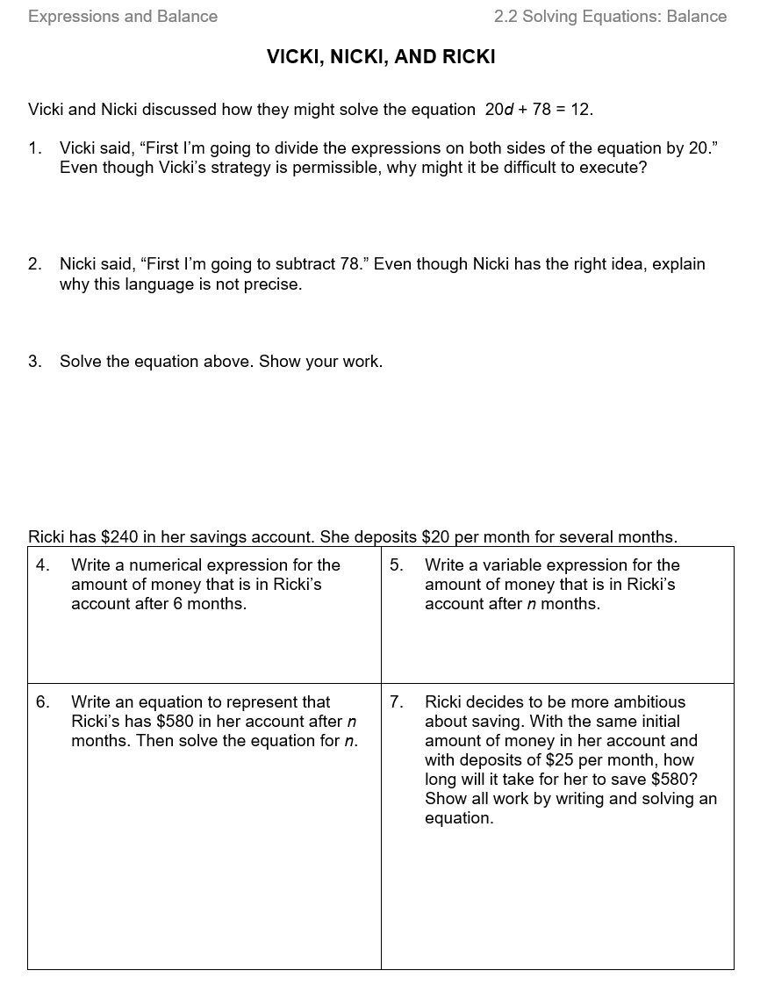
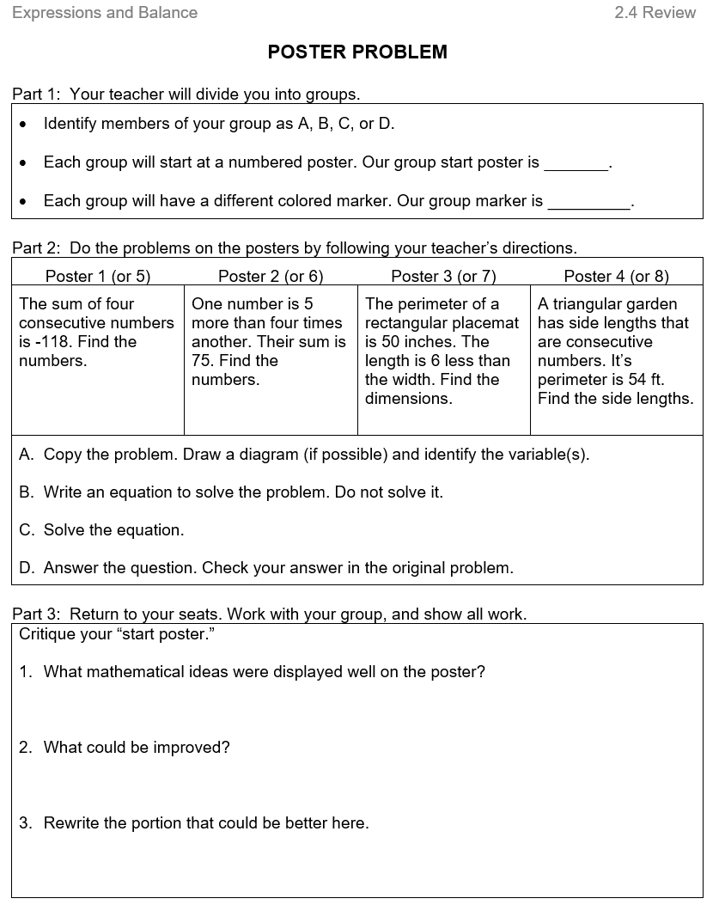
PRACTICE and REVIEW
Notes:
Once again there is practice and review.

Slide 35
MathLinks: EXPRESSIONS AND EQUATIONS
Packet 3
Expressions, Equations, and Applications
Focus on Grade 8 content
Notes:
The last packet in the Expressions and Equations module is mostly 8th grade standards and works on building formal algebra.

Slide 36
CUPS AND COUNTERS
THE UPSIDE-DOWN CUP
We use COUNTERS to represent integers.
We use CUPS to represent unknowns.
V
V
Value : +1
Record as : +
Value : -1
Record as: –
Value: unknown (x)
Record as: V
Value : opposite of the
unknown (-x)
Record as:
V
Notes:
We use cups and counters again in this packet, however now we are introducing the upside down cup to represent the opposite of the unknown.

Slide 37
ZERO PAIRS
Remember zero pairs?
V
V
What do you think this means?
Copy each expression below and simplify.
Build or draw if helpful.
x + 3 – 2x – 3
-2 – x + 2 + 4x
Notes:
We revisit the concept of zero paris with integers, and the connection with zero pairs with variables.
The additive inverse property applies to both numbers and variables.

Slide 38
THE DISTRIBUTIVE PROPERTY
Write as a sum using the distributive property.
-3(x + 2)
First think:
3 groups of (x + 2)
Then find its opposite
= -3x
– 6
V
V
V
V
V
V
3x + 6
Why do you think this is such a common mistake?
-3(x + 2) = -3x + 2
Notes:
And then practice the model with the distributive property. Seeing the model tends to help students avoid this common mistake.

Slide 39
WHAT ARE WE GONNA DO WITH
THAT UPSIDE DOWN CUP?
Example 1: What’s the solution?
Example 2: What’s the solution?
-2x = 2
-x + 3 = 1
x = -1
x = 2
Build the original equation.
Build the original equation.
V
V
+ +
V
V
V
V V
– –
+
+ +
+
Use the model to get the correct number of counters in the cup.
Use the model to get the correct number of counters in the cup.
We can’t put counters in upside-down cups!
But we can take the opposite of both sides.
We can make zero pairs with cups.
Notes:
These examples illustrate how to use the model with an equation that includes the opposite of an unknown.

Slide 40

EQUATION SOLVING STRATEGY:
FORMAL ALGEBRA
Record the algebraic steps. Drawings may be helpful.
Add prop of 0
6x – 4 = 2x – 8
Drawing
–2x –2x
Add (sub) prop
of equality
4x – 4 = -8
V
V
V V
V V
V
V
Add prop of 0
+4 +4
Add prop of equality
4x = -4
– – – –
– – – –
4 4
mult (div) prop
of equality
– – – –
x = -1
The “Big One”:
mult inverse prop and
mult (div) property of 1
Notes:
And finally connecting the procedures to formal algebra, including properties.

Slide 41
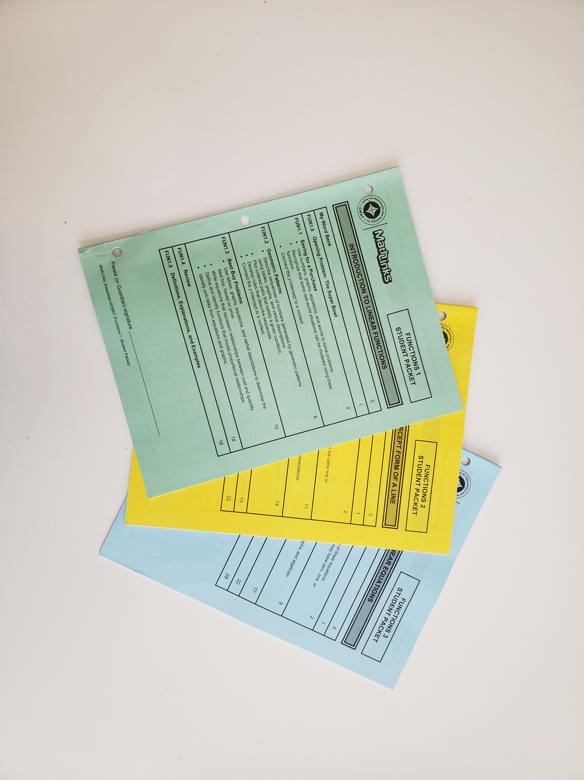
STUDENT PACKETS
Every packet includes:
An opening problem
Attention to vocabulary
Three multi-period lessons
Review activities
Definitions, explanations, and examples
Notes:
The student packets include…

Slide 42
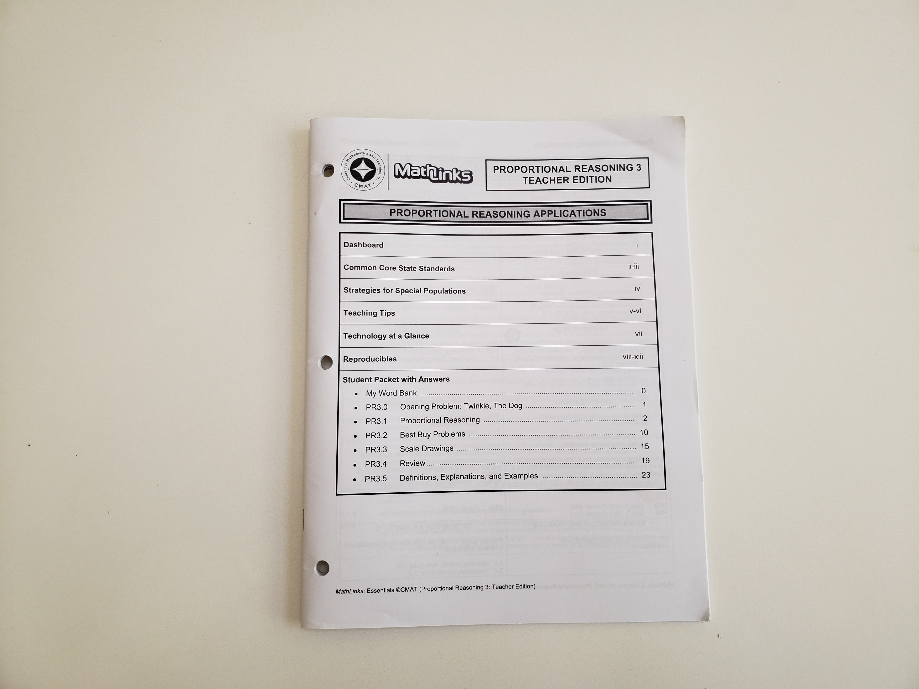
TEACHER EDITION
You’ll find:
Planning dashboard
Standards
Teaching notes
Tech activities
Reproducibles
Answer key
Lesson plans with
slide decks
Notes:
And the teacher edition includes….

Slide 43
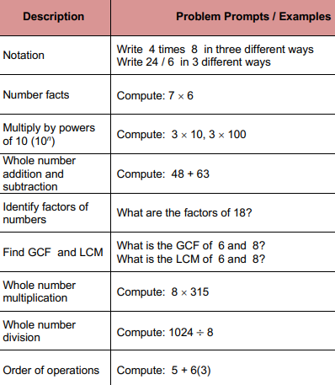
SKILLS PRACTICE WITH “SKILL BOOSTERS”
Example
You have 7th or 8th graders
in intervention
you’re concentrating on
integer operations,
solving equations,
etc.
Notes:
Skill Boosters do not relate to any of our Essentials units and are meant to fill in those well below grade level holes in content. They are skills practice meant to be done in a 5 – 10 minute daily routine. Here you see the Whole Number outline of topics.

Slide 44
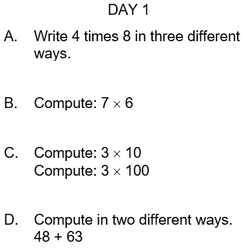
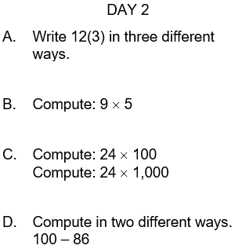
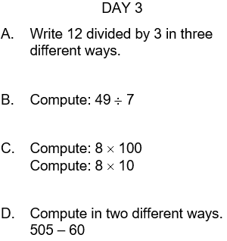
SKILL BOOSTERS EXAMPLES
Notes:
And a sample of small daily problem sets like these that you use over the course of several days or weeks.

Slide 45
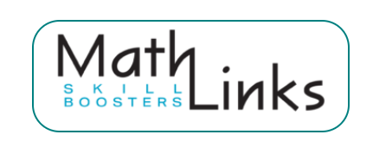
ALSO AVAILABLE…
Whole Numbers
Fraction Concepts
Fraction Addition and Subtraction
Fraction Multiplication and Division
Decimal and Percent Concepts
Integers
Equations
A daily routine
About 5-10 minutes per day
Notes:
Here are all the Skill Booster topics that are set up in the same format.

Slide 46
THE MathLinks: ESSENTIALS PROGRAM
Modules | Pkt 1 Gr levels | Pkt 2 Gr levels | Pkt 3 Gr levels
Number Base 10 | 4-6 | 4-5 | 5-6
Fractions | 3-4 | 4-5 | 5-6
Proportional Reasoning | 6 | 6-7 | 7
Integers | 6 | 7 | 7
Expressions & Equations | 6 | 7 | 8
Functions | 8 | 8 | 8
Grade 4-6
Foundational work
Grade 6-8
Major work
Notes:
MathLinks: Essentials has six modules that cover the major work of middle school. Each module has three Student Packets. You can mix and match any of these modules or packets to fit the needs of your students.

Slide 47
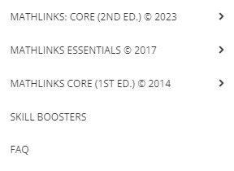
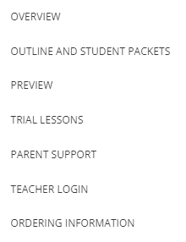
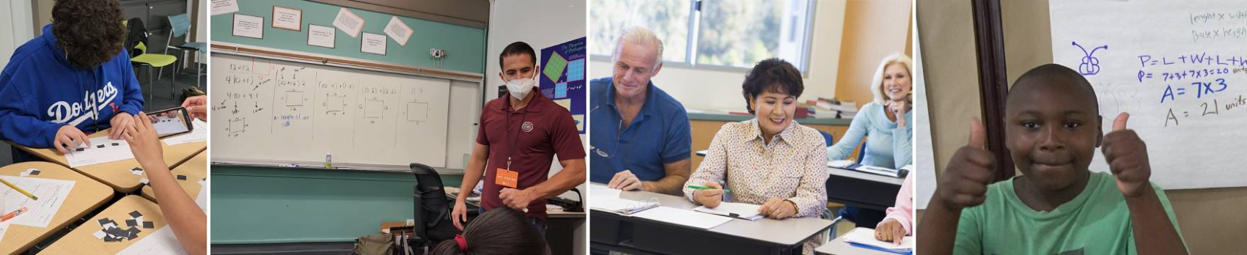

CHECK OUT THE PROGRAM
www.mathandteaching.org
Notes:
To learn more, go to our website at mathandteaching.org, curriculum, MathLinkslessentials, overview. Outline and Student Packets will lead you to each of the 18 packets and give you the option to flip through each Student Packet.

Slide 48

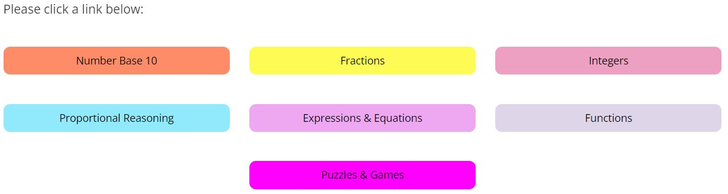

THE TEACHER PORTAL
BONUS
Secure
password-protected
access for teachers
Notes:
Our Teacher Portal provides slide decks, extra problems banks, quizzes, technology resources, etc.

Slide 49
CONTACT US
The Center for Mathematics and Teaching
Non-profit 501(c)(3)
www.mathandteaching.org/essentials/
Cynthia Raff
cynthia@mathandteaching.org
THANK YOU FOR VIEWING THIS PRESENTATION!!
Notes:
Thank you for taking your time go through this presentation.

Slide 50
Another One
3(2x + 1) =21
(Expression) Can we simplify EACH SIDE?
(Equation) What can we do to BOTH SIDES?
Continue the “building” process until the equation is solved.
Write some steps and the solution.
Check it using substitution.

Slide 51
Possible Pathway for a more complex equation
3(2x + 1) = 21
+ + + + + +
+ + + + + +
+ + + + + +
VV
+++
+
Interested?
Here’s the formal algebra
VV
+
+
VV
6x + 3 = 21
There must be 3 counters in each cup.
6x = 18
x = 3
Don’t forget to check!
3(2x + 1) = 21?
3(3 • 2 + 1) = 21?
3(6 + 1) = 21?
3(7) = 21?
21 = 21?

Slide 52
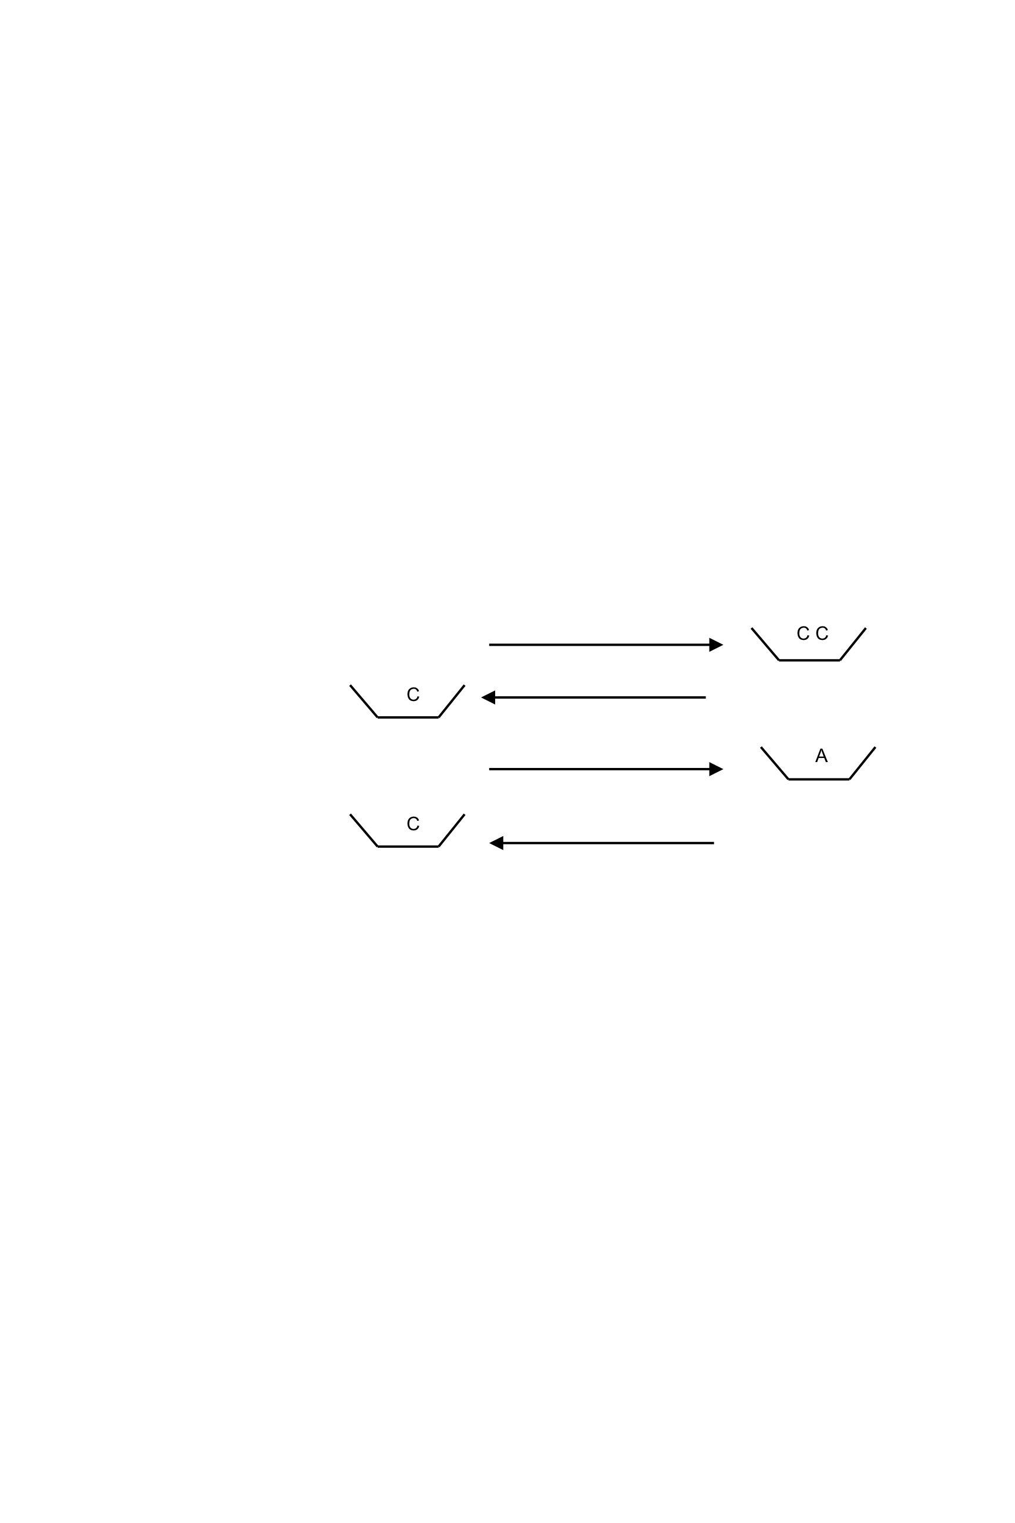
ONE STRATEGY
C
C C
C
A
One-way trips
6 adults remain since 2 children crossed
6 adults remain and one child comes back with the canoe
5 adults and 1 child remain
5 adults and 2 children remain since the second child comes back with the canoe

Slide 53
EQUATION SOLVING STRATEGY:
FROM BALANCE TO PROPERTIES
Can we simplify EACH SIDE?
2(x + 3) = 4(x – 1)
What can we do to BOTH SIDES?
2x + 6 = 4x – 4
-2x = -2x
6 = 2x – 4
+4 = +4
10 = 2x
V
V
+ + +
+ + +
V V
V V
5 = x
+ +
– – – –
+ +
+ + + +
Notes:
One is clean, but two needs to be distributed first.

Slide 54
BUILDING EQUATIONS
-4(x + 1) = -2x – 6
Can we simplify
EACH SIDE?
-4x – 4 = -2x – 6
What can we do to
BOTH SIDES?
-2x – 4 = -6
-2x = -2
2x = 2
x = 1
V
V
V
V
V
V
V V
– – – –
– – – –
+ +
– –

