Slide 1
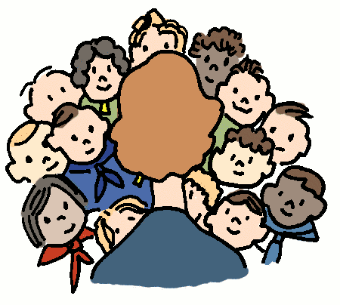
8-4 MATH TALKS
Data Talks (Slides 2-7)
Picture Talks (Slides 8-11)
Number Talks (Slides 12-15

Slide 2
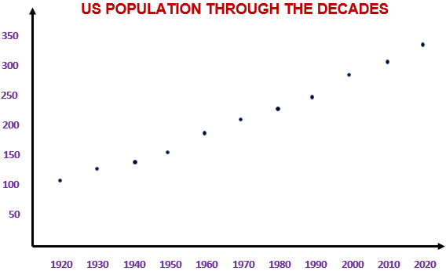
DATA TALK A
Millions
of people
What could the horizontal axis represent?
The vertical
axis?
years
Source: https://usafacts.org/data/topics/people-society/population-and-demographics/population-data/population/

Slide 3
DATA TALK A
Millions
of people
Does this represent an increase or decrease in population?
How do you know?
years

Slide 4
DATA TALK A
Millions
of people
Does the growth appear to be constant over time?
How do you know?
years

Slide 5
DATA TALK A
Millions
of people
About how many times more people are there in the US now compared to 100 years ago?
years

Slide 6
DATA TALK A
Millions
of people
What could be some positive aspects of population growth?
Negative?
years

Slide 7


DATA TALK B
FACTS and STATISTICS
Boys in middle and high school sometimes use protein supplements and steroids.
38
____% have tried protein supplements*
What number seems too low?
Too high?
About right?
*Source: https://knoxvillemoms.com/weird-facts-to-help-us-better-understand-teens/

Slide 8
PICTURE TALK A
Step 1
Step 2
Step 3
How is the pattern growing?
What will Step 4 look like?
How many objects are in Step 5?
Use words or algebraic symbols to represent the number of objects in ANY step (a rule for Step n).
Does a rule make it easier to determine the number of objects in Step 5 or Step 12?

Slide 9
PICTURE TALK B
Step 1
Step 2
Step 3
How is the pattern growing?
What will Step 4 look like?
How many objects are in Step 5?
Use words or algebraic symbols to represent the number of objects in ANY step (a rule for Step n).
Does a rule make it easier to determine the number of objects in Step 5 or Step 12?

Slide 10
PICTURE TALK C
Step 1
Step 2
Step 3
How is the pattern growing?
What will Step 4 look like?
How many objects are in Step 5?
Use words or algebraic symbols to represent the number of objects in ANY step (a rule for Step n).
Does a rule make it easier to determine the number of objects in Step 5 or Step 12?

Slide 11
PICTURE TALK D
Step 1
Step 2
Step 3
How is the pattern growing?
What will Step 4 look like?
How many objects are in Step 5?
Use words or algebraic symbols to represent the number of objects in ANY step (a rule for Step n).
Does a rule make it easier to determine the number of objects in Step 5 or Step 12?

Slide 12
NUMBER TALK A
You need to read a 300-page book for your English class.
Would you rather… | Option 1 | Option 2
 | read 20 pages per night | read 45 pages every other night
Which option would you choose?
Be prepared to explain your reasoning.

Slide 13
NUMBER TALK B
You are earning extra money babysitting.
Would you rather… | Option 1 | Option 2
 | babysit 4 kids for 6 hours for $45 | babysit 3 kids for 8 hours for $52
Which option would you choose?
Be prepared to explain your reasoning.

Slide 14
NUMBER TALK C
You are driving to the beach and want to get there quickly.
Would you rather… | Option 1 | Option 2
 | drive 45 miles in traffic at a rate of 35 miles per hour | drive 100 miles in less traffic at a rate of 65 miles per hour
Which option would you choose?
Be prepared to explain your reasoning.

Slide 15
NUMBER TALK D
You are in charge of purchasing sports drinks for your soccer team.
Would you rather… | Option 1 | Option 2
 | purchase packages of 6 bottles at 12 oz each for $5.00 | purchase packages of 12 bottles at 9 oz each for $9.00
Which option would you choose?
Be prepared to explain your reasoning.

