Slide 1

Identifying and Capitalizing on Student Interests and Hidden Mathematical Talents:
A great Professional Development and Instructional Approach
Carole Greenes, Director
PRIME Group
cgreenes@asu.edu

Slide 2
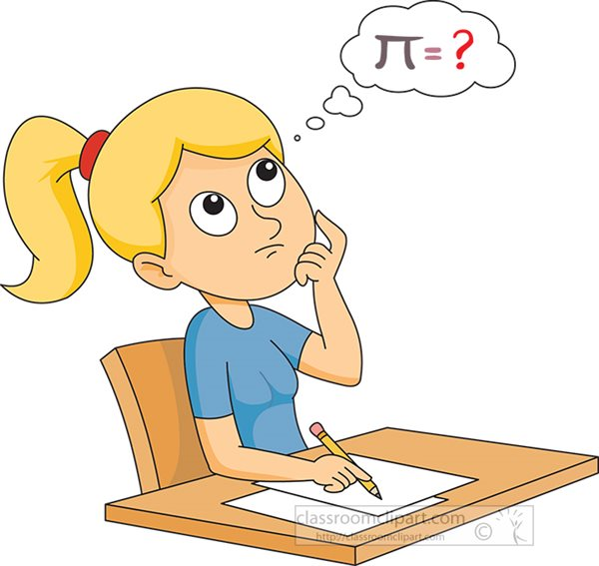
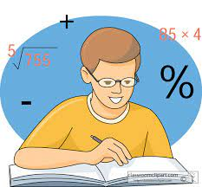
Assessments Conducted
2 Content
2 Context Preferences

Slide 3


Algebraic Reasoning Assessments
High school: Assessment designed and tested with high school students (grades 8 – 11) in Massachusetts.
Middle school: Assessment developed and tested with middle school students (grades 5 – 8) in Arizona.

Slide 4
High School Algebraic Reasoning Assessment
(Focus on Linearity, the study of lines and their representations)
Directions to Students
Solve the problems.
Rank order the problems
  1 – most difficult to solve
  7 – least difficult to solve
Why did you rank problems 1 and 2 most difficult?

Slide 5
High School Algebraic Reasoning Assessment (Focus on Linearity, the study of lines and their representations)
Directions to Teachers
Solve the problems.
Rank order the problems based on how you think your students will rank the problems.
  1 – most difficult to solve
  7 – least difficult to solve
Describe the types of difficulties students have with problems you identified as the top two most difficult.

Slide 6

Study Population
1,561 Algebra I Students in Grades 8 – 10
27 Teachers (of these students)

Slide 7
Study Results
Teacher Rankings were Significantly Different (inverse) from Student Rankings.
Student Descriptions of Difficulties were very detailed and helpful for adapting instruction.
Student Comment: “Not sure why slope has to be the change in y over the change in x. You just have to understand how to think about it differently.”
Teacher comment: “This problem would be difficult because I haven’t taught it yet.”

Slide 8
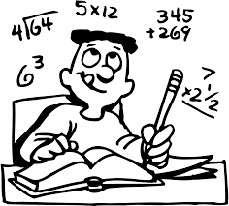
Designing Your Assessments
Include direction to have students rank problems by difficulty and provide a rationale for the most difficult problems.
  Great way to know what students know.

Slide 9

Designing Your Assessments: Number and Types of Items
7 items
3 multiple choice
3 short answer
1 extended response

Slide 10


Results of two other studies of middle and high school students showed that participation and performance increased when students were given:
Challenging problems in
interesting contexts
Time to collaborate, communicate, and think
Technology at hand

Slide 11
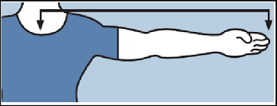




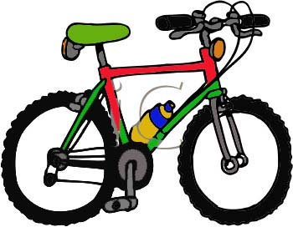

Student-Identified Contexts
That Appeal to Them
Technologies (apps)
Students Themselves
Strange Situations
Sports (individual or pairs)
Game Design
Publications

Slide 12





Students have an app-titude for using apps.

Slide 13

App Benefits for Students
Self-assessment
Expand interests
Store needed information
Tools for computation, data collection,
and display
Prepare presentations
Communicate with others
(including teachers) in and
out-of-school
Get info when needed

Slide 14


App Benefits for Teachers
The greatest benefit is that you can meet the needs of most, if not all, students.

Slide 15
App Benefits for Teachers
You can use apps to:
Assess student understanding (and maintain tests)
Differentiate instruction: Use apps for
  Review, Re-teaching, Practice, Enrichment
Maintain Data ( Keep/update) folders with
student performance data. Useful when meeting students/families)
Plan daily activities and keep those.
Communicate with students and families.

Slide 16


STUDENTS THEMSELVES

Slide 17

Equation Creation
Use all of the numbers in your phone number, including area code, to create expressions
equal to 1 – 9.
Numbers can be connected to create multi-digit numbers
Example: 480-390-0917
3478900 X 0 + 1 = 1
478900 X 0 + 3 – 1 = 2
Numbers can be used as exponents
Numbers can be used to show roots
Note: Square root is number to the ½ power.
Cubic root is number to the 1/3 power.

Slide 18
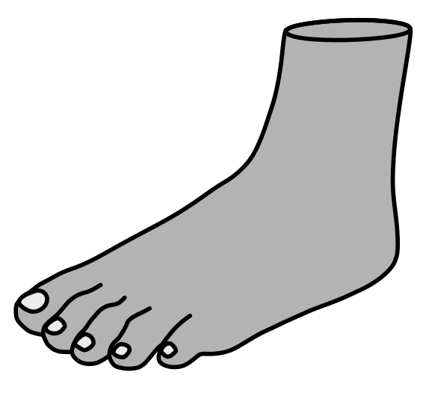
If The Shoe Fits…
Get a large piece of paper and a marker (pencil, pen).
Using one foot, step onto the paper. Mark both the back of your heel and the front of your middle toe.
Then measure, in inches, the distance between your heel and middle toe.
Use that length to match the recommended shoe size.
Note that sizes are different for men and women.

Slide 19
US Shoe Size Chart: Males
Length (inches) to Shoe Size
Inches | Shoe Size
9 1/4 | 6
9 1/2 | 6.5
9 5/8 | 7
9 3/4 | 7.5
9 15/16 | 8
10 1/8 | 8.5
10 1/4 | 9
10 7/16 | 9.5
10 9/16 | 10
10 3/4 | 10.5
10 15/16 | 11
11 1/8 | 11.5
11 1/4 | 12
11 1/2 | 12.5
11 9/16 | 13
11 3/4 | 13.5
12 | 14
12 1/8 | 15
12 1/2 | 16
13 | 17

Slide 20
US Shoe Size Chart: Females
Length (inches) to Shoe Size
Inches | Shoe Size
8 9/16 | 5
8 3/4 | 5.5
8 7/8 | 6
9 1/16 | 6.5
9 1/4 | 7
9 3/8 | 7.5
9 1/2 | 8
9 11/16 | 8.5
9 7/8 | 9
10 | 9.5
10 3/16 | 10
10 3/8 | 10.5
10 1/2 | 11
10 11/16 | 11.5
10 7/8 | 12

Slide 21
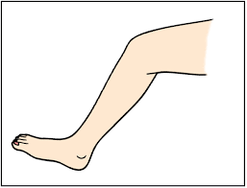
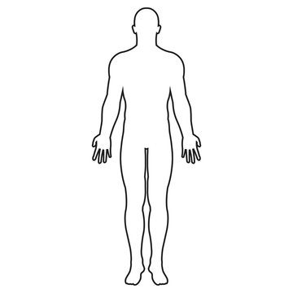
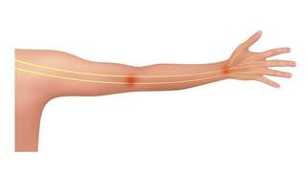

Foot Length Related to Other Body Lengths
In foot lengths, how long is your: :
Arm (shoulder to wrist)?
Leg ( hip to foot)?
Head ( top of head to bottom of chin)
Height (top of your head to bottom of your foot)?

Slide 22

Strange Situations

Slide 23
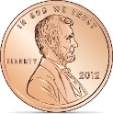
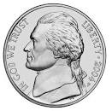
What’s Your Cents Worth?
As of March 2022:
Value Cost of Production
Penny 1cent 2.1 cents
Nickel 5 cents 8.52 cents
Cost of production is how many times the value of the
penny? nickel?
In cost of production, how many pennies would be equal in cost to production of 50 nickels?

Slide 24

Weird Numbers
EMIRP is PRIME in reverse
13 is a PRIME Number. Its reverse is 31 which is also Prime. So, 31 is the EMIRP of 13.
23 is a PRIME Number. Its inverse is 32 which is not Prime. So, 23 has no EMIRP.
Which two- and three-digit PRIME numbers have EMIRPs?
What is the difference between a PRIME and its EMIRP?

Slide 25
PROBLEMS WITHOUT FIGURES
S.Y. Gillan
1909
Every problem calls for two distinct and widely different kinds of work:
First the solution which involves a comprehension of the conditions of the problem and their relation to one another; second, the operation. First, we decide what to do; this requires reasoning. Then we do the work; this is a merely mechanical process, and the more mechanical the better. A calculating machine, too stupid to make a mistake, will do the work more accurately than a skillful accountant.
Adding, subtracting, multiplying, and dividing do not train the power to reason, but deciding in a given set of conditions which of these operations to use and why, is the feature of arithmetic that requires reasoning.
360 problems! Download for free!

Slide 26
PROBLEMS WITHOUT FIGURES
#74 What is the easiest way to find the sum of all the numbers printed on a January calendar?
#103 If the diameter of a wheel is known in feet, how can the number of revolutions it makes in any number of miles be found?
#193 If you know the sum and the difference of two numbers, how can you find the numbers?
#323 John is twice as hold as Henry. How will their ages compare when Henry is as hold as John is now?

Slide 27
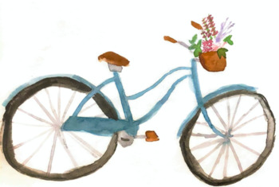
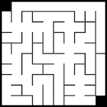
Sports

Slide 28

Wheeling Along!
Type of Bike Wheel Diameter (inches) Wheel Circumference ( inches)
Small Wheel Bike 20 ­­­­­­­­­­­­­­­­­____________
Junior Mountain Bike 24 ­­­­­­­­­­­­­­­­­____________
Mountain Bike 29 ­­­­­­­­­­­­­­­­­____________
Biking one mile, how many more times will a Small Wheel Bike tire rotate than a tire on a:
Junior Mountain Bike?
Mountain Bike?

Slide 29
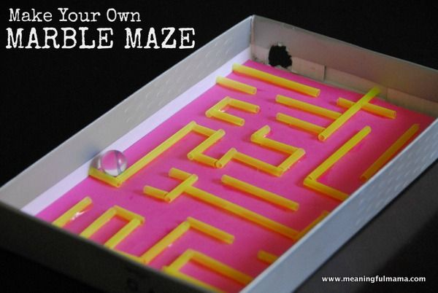
A-Maze-ing
Create a box-top maze
Materials for each group
Large box top – same size/group: cut holes for Entry and Exit at diagonally opposite corners.
Cardboard to cut to create partitions
One marble
Books to use to support edge of box top near entry (need to determine angle of inclination)
Timer (app)
Scissors

Slide 30
A-Maze-ing Project
Procedure
All groups are signaled to start their timers as they place the marble in the Entry hole and time the marble from Entry to Exit.
The marble must be in motion at all times. If the marble stops, the elevation or partitions may be adjusted, but the timer continues throughout.
Collect and Record Data for Each Trial
Elevation of box top, and how that was determined.
Time (in seconds) to reach exit.
Winner: Team that keeps the marble rolling for the greatest amount of time.

Slide 31
Conducted with High School Students
Pi Pitch
Prep: On blacktop, draw a large square with an inscribed circle (r = 1 ft) .
Experiment (each student/group):
Stand 8 ft back from the square.
Pitch pennies aiming for the circle. Do this 100 times.
Keep track of the number of pennies that land inside the circle and the number of pennies that land outside the circle but inside the square.
Pennies that land outside the square should be tossed again.
Analyses: (for each student)
Record the ratio of number of pennies that land in the circle to number of pennies that land in the square. (Remember: pennies inside the circle are also inside the square, but not vice versa.)
Compare each ratio to 𝝅 /4

Slide 32
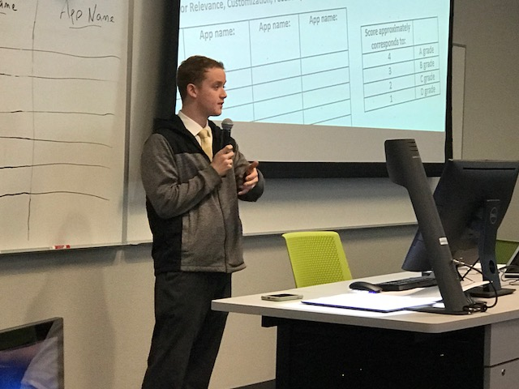

Performance
Showcase Open House for Family and Friends
Slide presentations by students individually.
Students respond to audience questions.
Preparation for the presentation helps to formalize learned concepts, skills, and reasoning methods.

Slide 33

Game Design and Publications: MATHadazzle
Requirement to participate: Interest
Originally scheduled for 3 hours on the weekend.
Students didn’t want to stop, so I shut off the lights after 4 to 4 ½ hours!

Slide 34
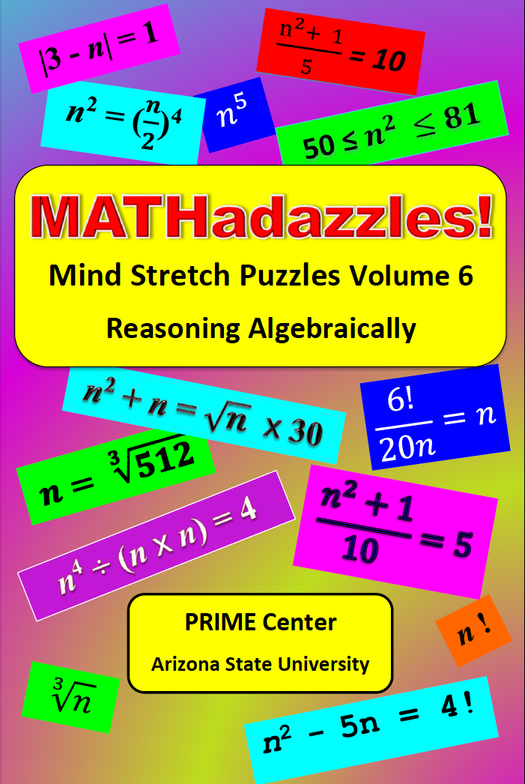
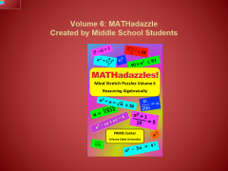
Volume 6: MATHadazzle
Created by Middle School Students

Slide 35
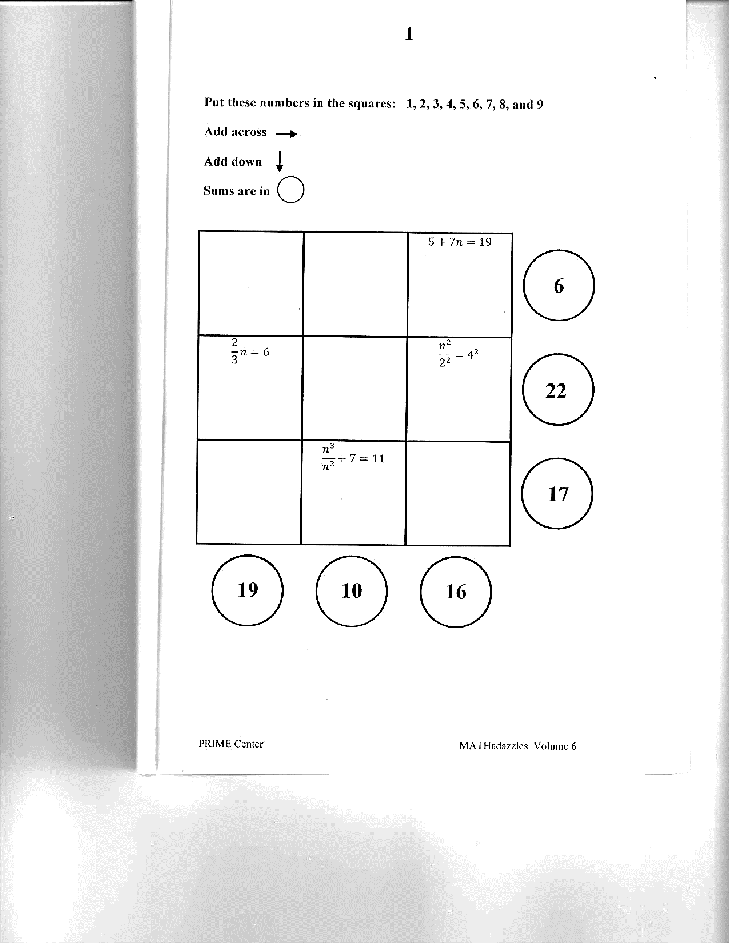
Volume 6: MATHadazzle
Sample Problem

Slide 36
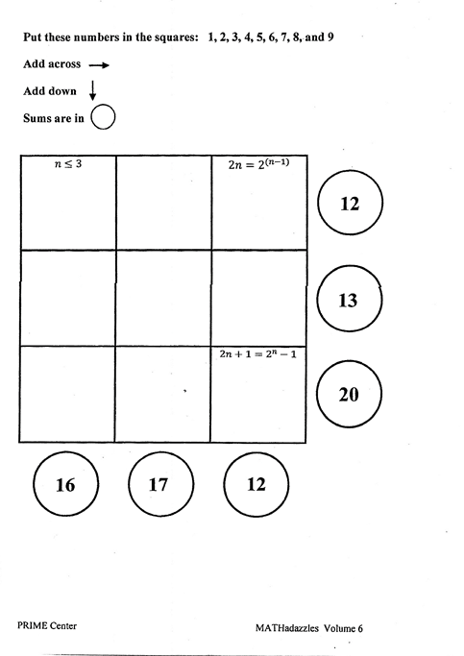
Created By Middle School Students

Slide 37
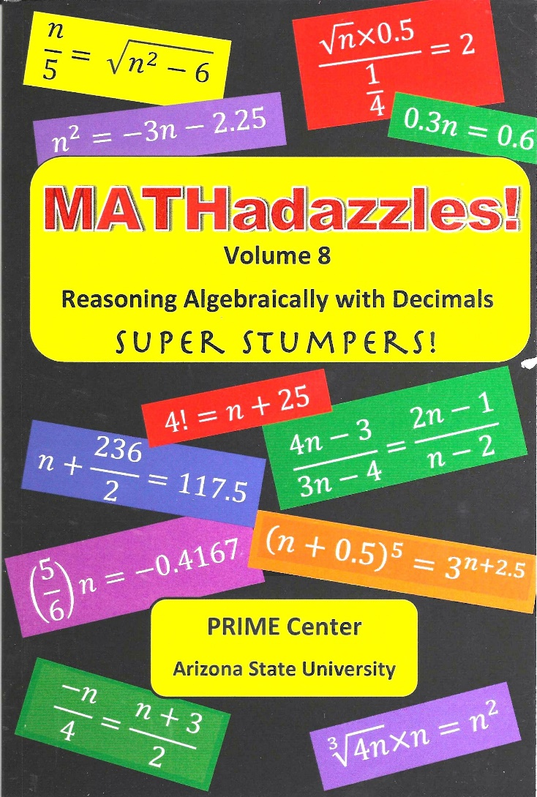
Volume 8: MATHadazzle
Created by High School Students

Slide 38
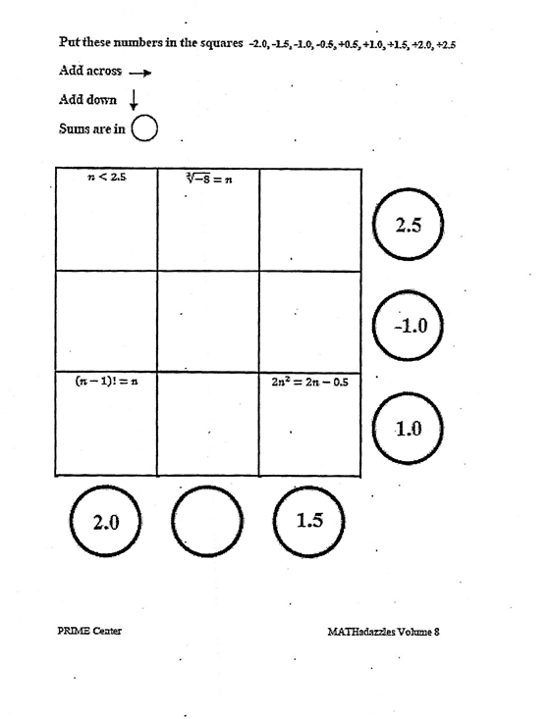
MATHadazzle created by High School Students

Slide 39
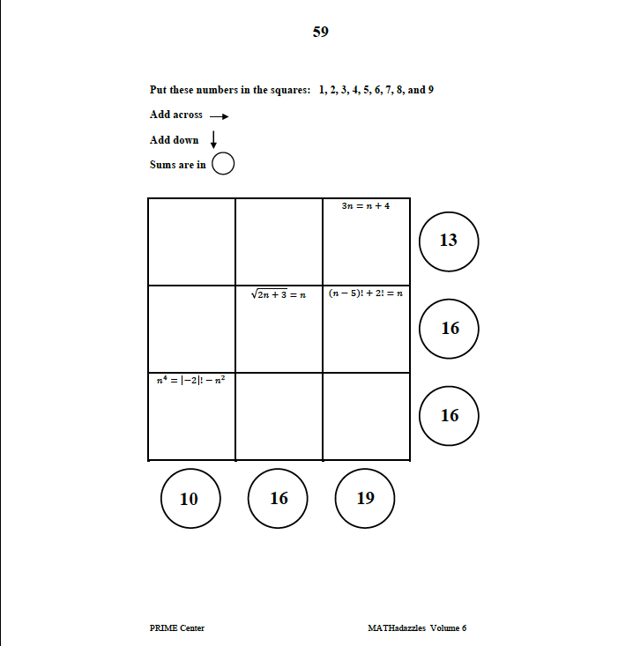
MATHadazzle created by High School Students

Slide 40
Final Recommendations
First work with colleagues to identify projects, puzzles, and games that will challenge your students.
Provide sufficient time for students to collaborate with peers and others (e.g., students in other classes or schools)
Permit students to use devices for information searches as well as for calculations.
Require a product (e.g., written or oral presentation to friends and families) of procedures and processes employed.

Slide 41

Gifts to You and Your Students

Slide 42
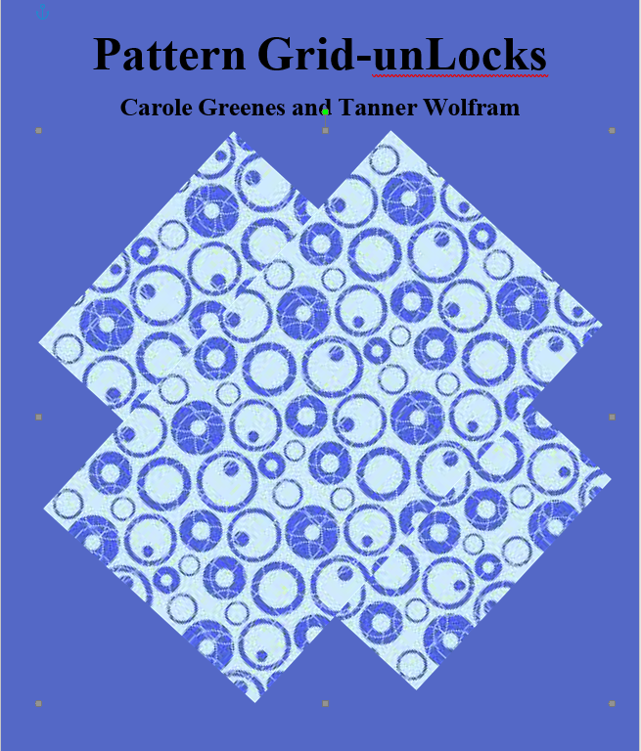

Slide 43
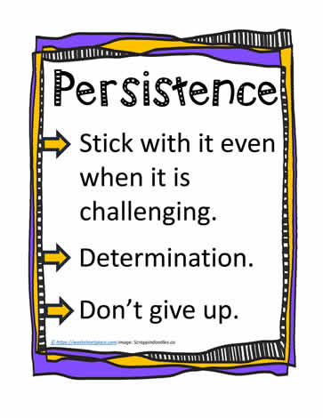
Pattern Grid-unLocks
Focus on spatial reasoning
Develops experimentation talents (identify a possible solution, test it, revise if necessary)
Develops persistence

Slide 44
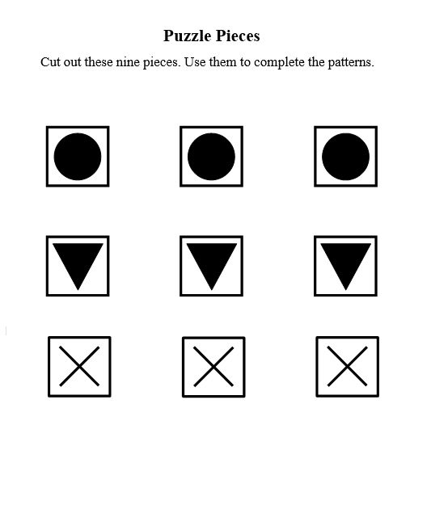

Slide 45
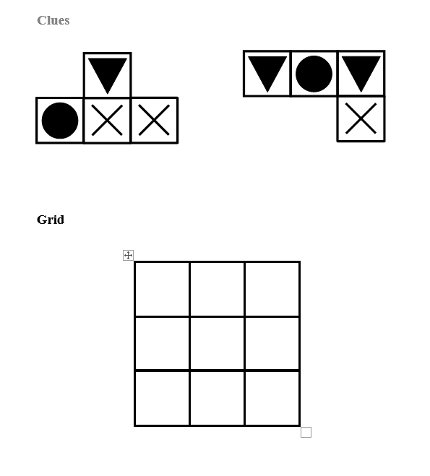

Slide 46
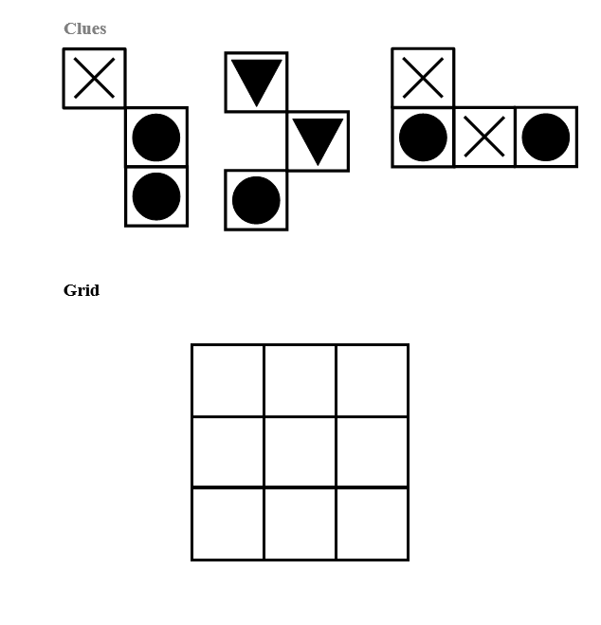

Slide 47
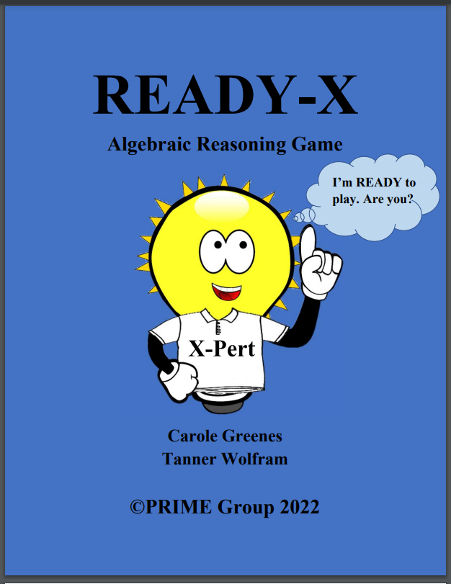

Slide 48
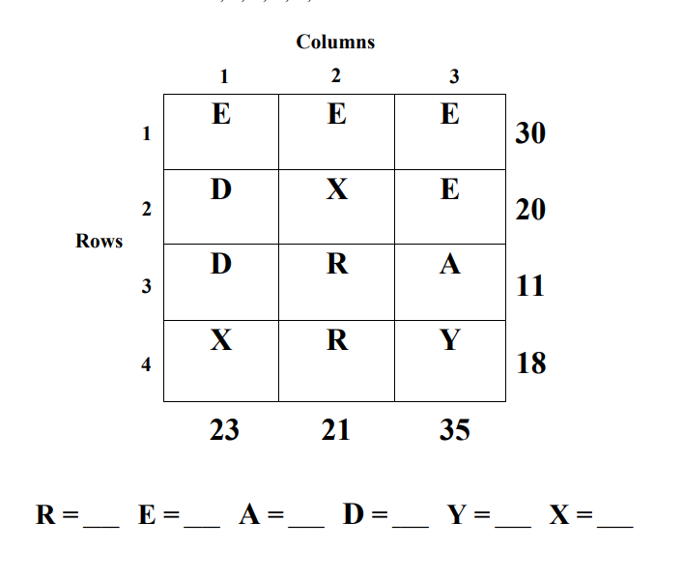
READY -X
Solve for the values of R,E,A,D,Y,X.

Slide 49
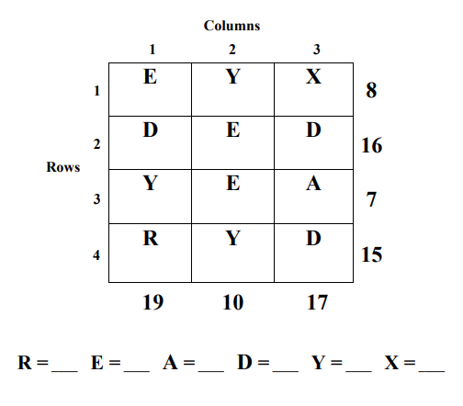
READY -X
Solve for the values of R,E,A,D,Y,X.

Slide 50
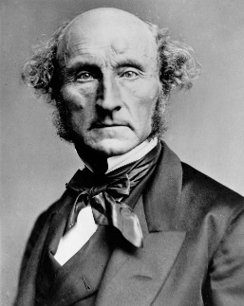
Message to All Educators
A pupil from whom nothing is ever demanded which he cannot do, never does all he can.
John Stuart Mill
(1806 – 1873)
English Philosopher and Economist

Slide 52
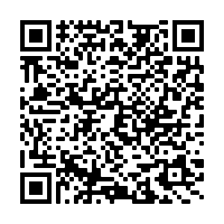
Scan for slides and two free books from Carole!
Go to Carole’s Corner at
www.mathandteaching.org/caroles-corner

