Slide 1
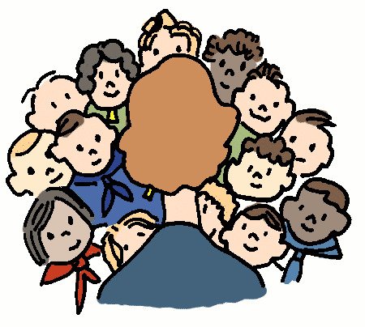
7-5 MATH TALKS
Data Talks (Slides 2-6)
Number Talks (Slides 7-12)

Slide 2
DATA TALK A
Life Expectancy of Various Animals (in years)
What factors contribute to whether certain animals
have a shorter or longer life span, on average?

Slide 3
DATA TALK A
Life Expectancy of Various Animals (in years)
100
80
60
40
20
0
What are some reasonable numbers that could
go along the vertical axis of the graph?
What are the minimum and maximum,
the increments for numbering the vertical axis?

Slide 4
DATA TALK A
Life Expectancy of Various Animals (in years)
100
80
60
40
20
0
chicken
cheetah
cow
tortoise
rattlesnake
alligator
elephant
sea urchin
Where do you think these 8 animals might go on the graph?
alligator
cheetah
chicken
cow
elephant
rattlesnake
sea urchin
tortoise

Slide 5
DATA TALK A
100
80
Any surprises?
Any questions?
60
40
20
0
chicken
cheetah
cow
tortoise
rattlesnake
alligator
elephant
sea urchin
What fraction of a tortoise’s life is a chicken’s?
What fraction of an alligator’s life is a cow’s?
Compare a rattlesnake’s lifespan to an elephant’s.

Slide 6
DATA TALK B
FACTS and STATISTICS
boys
In 8th, 10th and 12th grades, studies show that _____
report higher self-esteem than _____.
girls
In which blanks would you place boys and girls?
Did you know???
Girls consistently have higher GPAs than boys throughout middle and high school.
*Source: https://knoxvillemoms.com/weird-facts-to-help-us-better-understand-teens/

Slide 7
NUMBER TALK A
How many ’s are in 1?
How many ’s are in 2?
How many ’s are in 1 ?
Be prepared to explain or show your reasoning

Slide 8
NUMBER TALK B
How many ’s are in 3?
How many ’s are in 6?
How many ’s are in 6?
Be prepared to explain or show your reasoning

Slide 9
NUMBER TALK C
How many ’s are in ?
How many ’s are in ?
How many ’s are in ?
Be prepared to explain or show your reasoning

Slide 10
NUMBER TALK D
Day 1a
What are some numbers or numerical
expressions that are equivalent to ?
Be prepared to explain or show your reasoning
Day 1b
What are some numbers or numerical
expressions that are equivalent to ?
Be prepared to explain or show your reasoning

Slide 11
NUMBER TALK E
Day 2a
What are some numbers or numerical
expressions that are equivalent to 2 ?
Be prepared to explain or show your reasoning
Day 2b
What are some numbers or numerical
expressions that are equivalent to -1 ?
Be prepared to explain or show your reasoning

Slide 12
NUMBER TALK F
Day 3a
What are some numbers or numerical
expressions that are equivalent to 2.3?
Be prepared to explain or show your reasoning
Day 3b
What are some numbers or numerical
expressions that are equivalent to -1.8?
Be prepared to explain or show your reasoning

