Slide 1
SMASH Game 6
Science | Math | Art | Sports | History
100 | 100 | 100 | 100 | 100
200 | 200 | 200 | 200 | 200
300 | 300 | 300 | 300 | 300
400 | 400 | 400 | 400 | 400
500 | 500 | 500 | 500 | 500

Slide 2
Science - 100
What is the name of the science dealing with atmospheric conditions, including weather and climate?

Slide 3
Science - 100
Answer: Meteorology

Slide 4
Science - 200
If a family has two boys, what are the chances that their next child will be a boy?
?

Slide 5
Science - 200
Answer: ½ or 50%

Slide 6
Science - 300
How many time zones are in the world?

Slide 7
Science - 300
Answer: 24

Slide 8
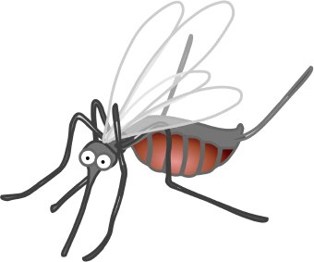
Science - 400
What land-based insect is known for its extraordinary ability to lift objects up to 20 times its own body weight?
I can’t lift anything!

Slide 9
Science - 400
Answer: Ant

Slide 10
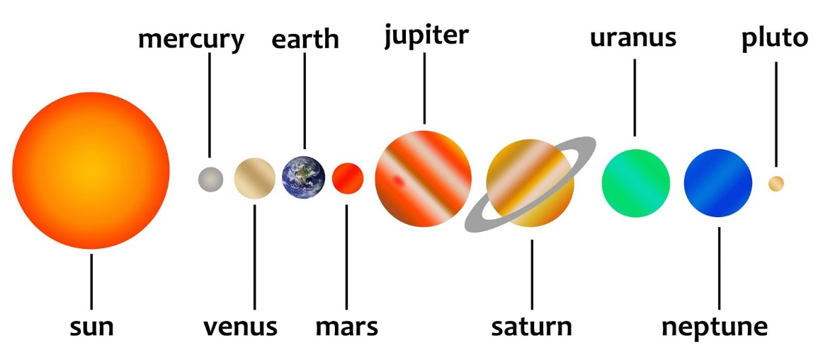
Science - 500
Which planet in our Solar System has the shortest day?

Slide 11
Science - 500
Answer: Jupiter

Slide 12
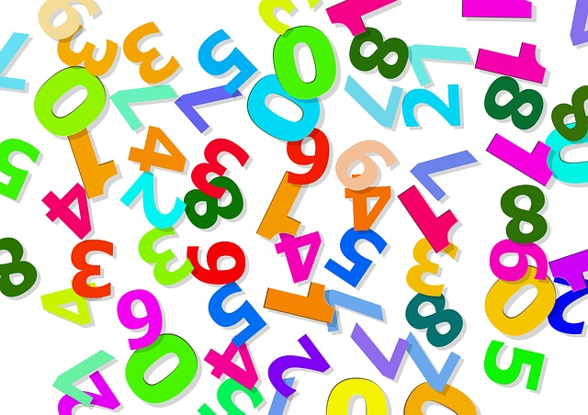
Math - 100
1089 multiplied by what number gives its reciprocal 9801 as the product?

Slide 13
Math - 100
Answer: 9

Slide 14
Math - 200
The greatest prime number less than 100 is how much more than the least prime number less than 100?
I’m Prime! My only factors are myself and 1.

Slide 15
Math - 200
Answer: 95
(97 – 2)

Slide 16
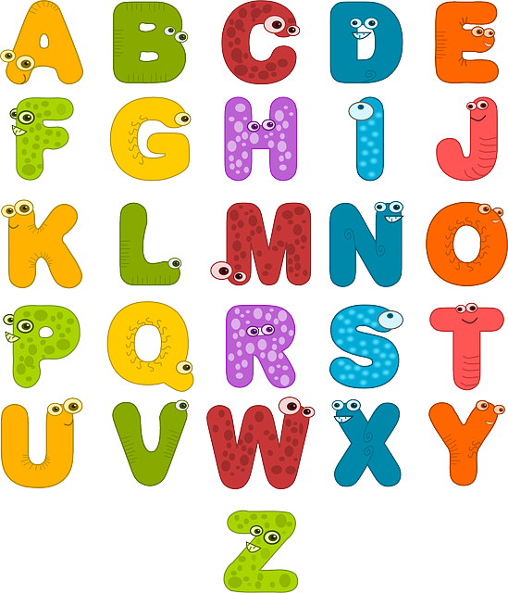
Math - 300
How many times does the letter A appear in the word name of a number, 0 through 1000?

Slide 17
Math - 300
Answer: 1 time
(only in the word thousand)

Slide 18
Math - 400
The word name for what number has its letters in alphabetical order?

Slide 19
Math - 400
Answer: Forty

Slide 20
Math - 500
How much greater is the 7th Triangular number than the 7th Fibonacci number?

Slide 21
Math - 500
Answer: 13
(7th Triangular number: 21
7th Fibonacci number: 8)

Slide 22
Art - 100
A symphony typically consists of how many movements?

Slide 23
Art - 100
Answer: 4

Slide 24
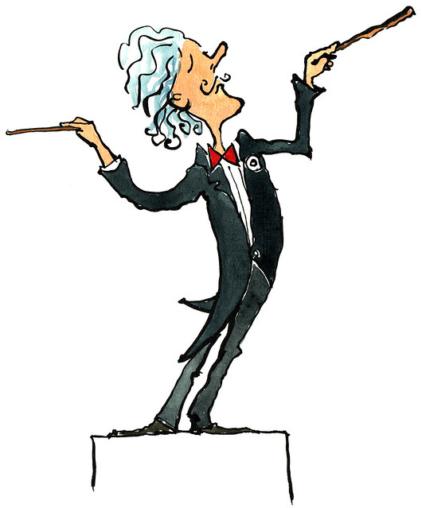
Art - 200
In what year was the 1812 Overture composed?
Hint: it was written 104 years after the signing of the Declaration of Independence.

Slide 25
Art - 200
Answer: 1880

Slide 26
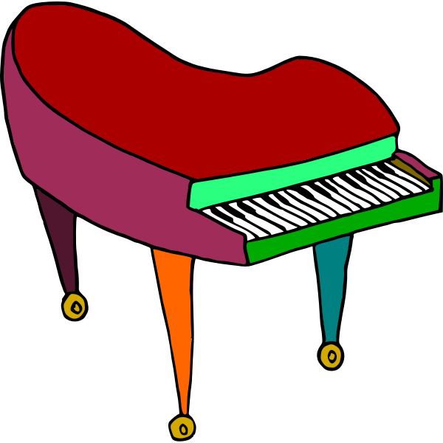
Art - 300
What is the standardized frequency of the note A?

Slide 27
Art - 300
Answer: 440 (Hertz)

Slide 28
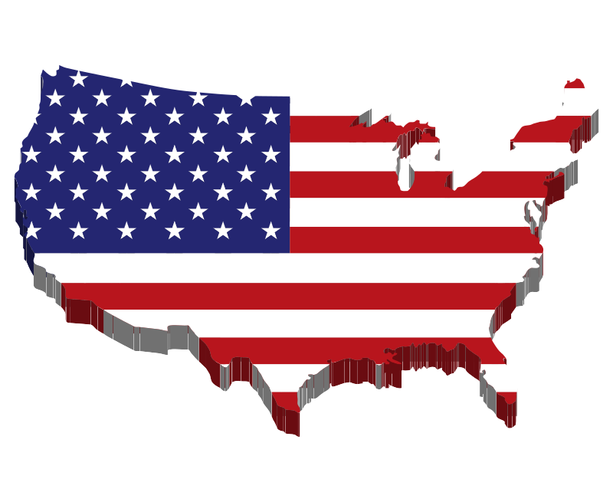
Art - 400
Who wrote the lyrics for America the Beautiful?

Slide 29
Art - 400
Answer: Katharine Lee Bates

Slide 30
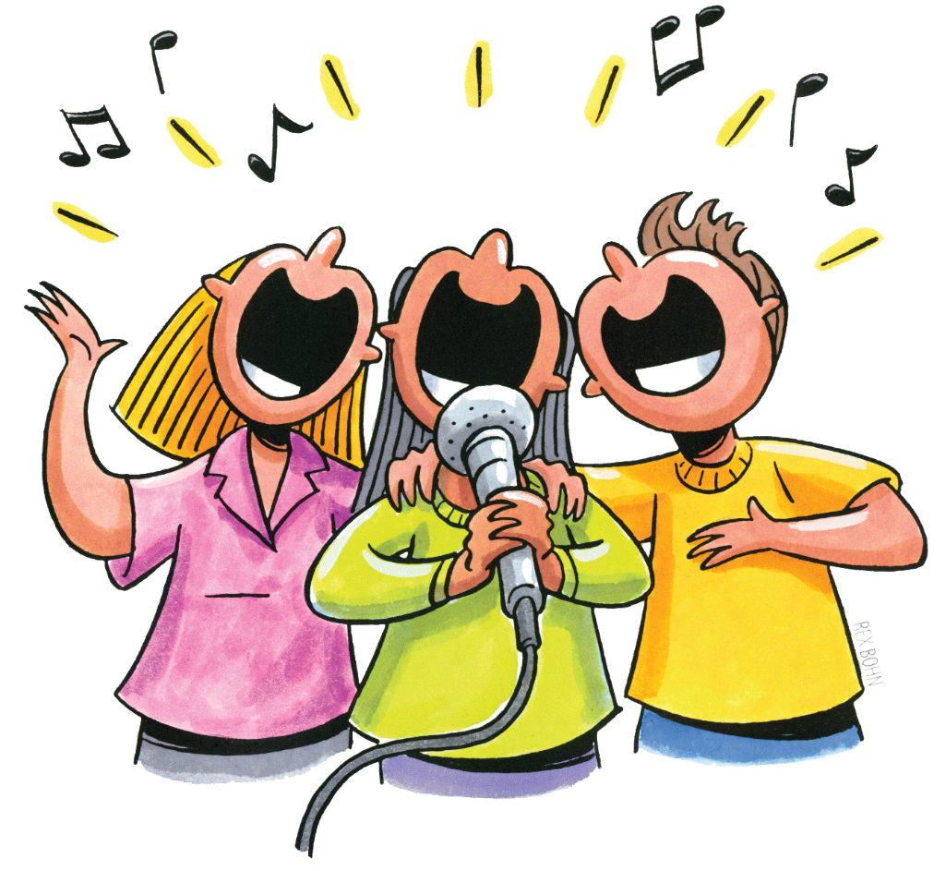
Art - 500
Woody Guthrie is most famous for what song?

Slide 31
Art - 500
Answer: This Land is Your Land

Slide 32
Sports - 100
Who was the first basketball player to score 38,000 points in his career?

Slide 33
Sports - 100
Answer: Kareem Abdul-Jabbar

Slide 34
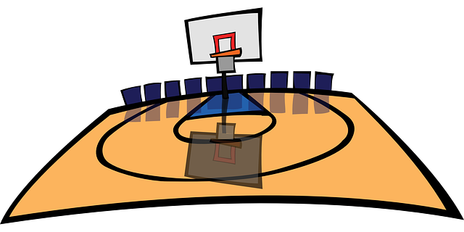
Sports - 200
In the NBA Finals between the Western and Eastern champions, how many games does a team have to win to be declared the league champion?

Slide 35
Sports - 200
Answer: 4

Slide 36
Sports - 300
The first World Cup Soccer game was held one year after the start of The Great Depression. In what year was the first World Cup Soccer game held?

Slide 37
Sports - 300
Answer: 1930

Slide 38
Sports - 400
In bowling, what is the maximum number of points a bowler can score in one game?

Slide 39
Sports - 400
Answer: 300

Slide 40
Sports - 500
In Taekwondo sparring, what is the greatest number of points a player can get with one kick?

Slide 41
Sports - 500
Answer: 4

Slide 42
History - 100
What was the first year of the 20th century?

Slide 43
History - 100
Answer: 1901

Slide 44
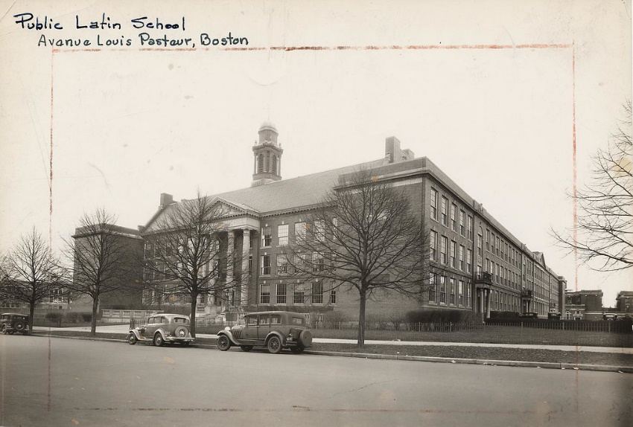
History - 200
The first public school and oldest existing school in the United States is Boston Latin School. It was founded 141 years before the signing of the Declaration of Independence. When was Boston Latin School founded?

Slide 45
History - 200
Answer: 1635

Slide 46
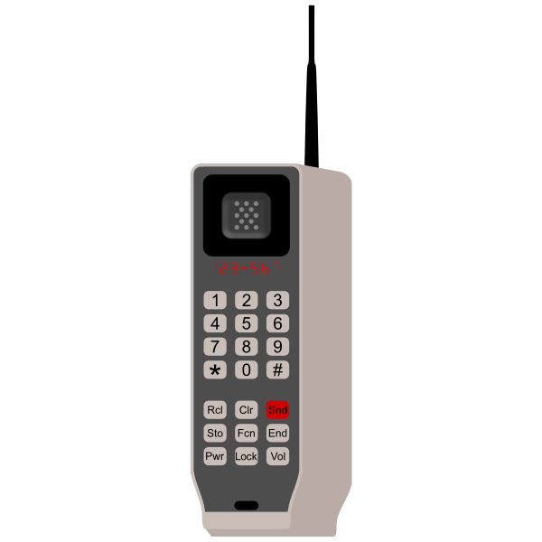
History - 300
The first handheld cell phone was invented in 1973 at Motorola. It weighed 2 kilograms.
To the nearest tenth, how many pounds did that phone weigh?

Slide 47
History - 300
Answer: 4.4 lbs.

Slide 48
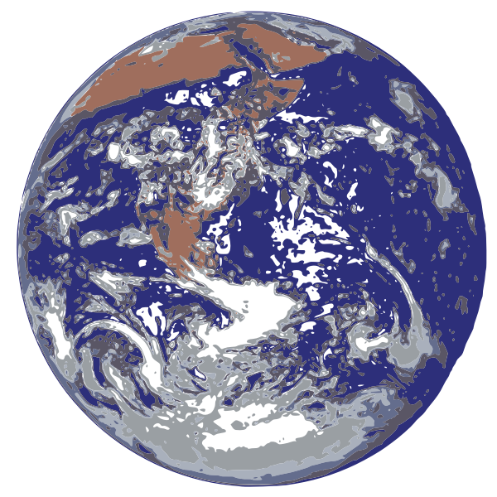
History - 400
On which continent was the French and Indian War fought?

Slide 49
History - 400
Answer: North America

Slide 50
History - 500
Eyeglasses were invented in the 13th century.
The hundreds and tens digits of the year add to 10.
The sum of all digits is 11.

Slide 51
History - 500
Answer: 1280

