Slide 1
SMASH Game 5
Science | Math | Art | Sports | History
100 | 100 | 100 | 100 | 100
200 | 200 | 200 | 200 | 200
300 | 300 | 300 | 300 | 300
400 | 400 | 400 | 400 | 400
500 | 500 | 500 | 500 | 500

Slide 2
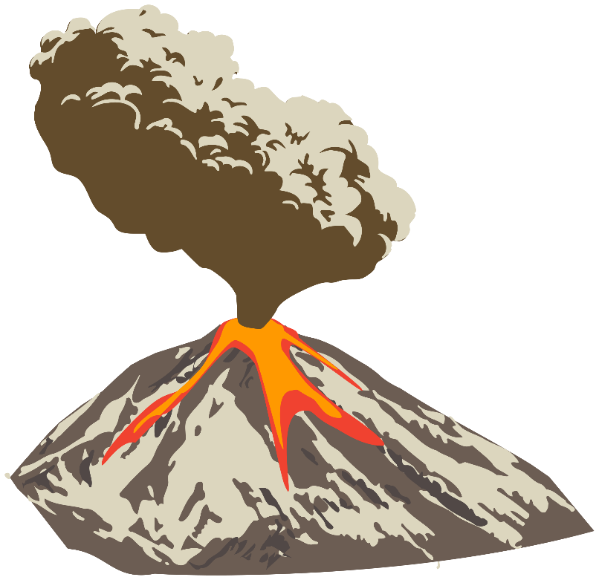
Science - 100
What is the name of molten rock that flows from a volcano?
Answer
Notes:
The Sun

Slide 3
Science - 100
Answer: Lava

Slide 4
Science - 200
Which member of the canine family is known to live and hunt in packs?
Answer
Notes:
Tsunami

Slide 5
Science - 200
Answer: Wolf

Slide 6
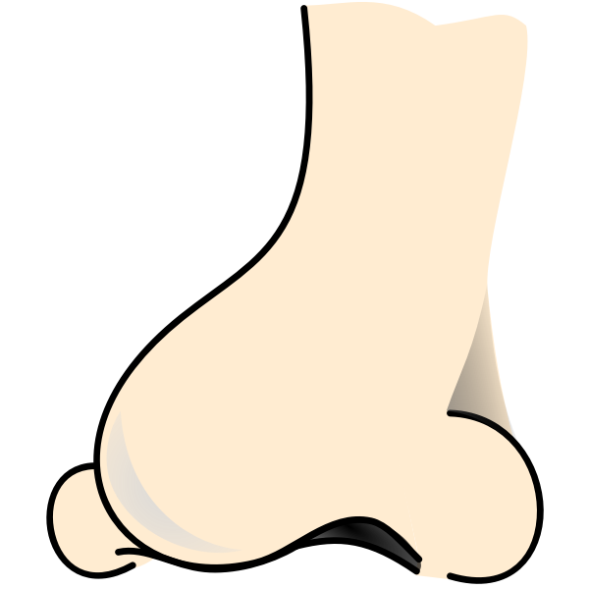
Science - 300
The length of your nose is approximately the same length of which of your fingers?
Answer
Notes:
0

Slide 7
Science - 300
Answer: Thumb

Slide 8
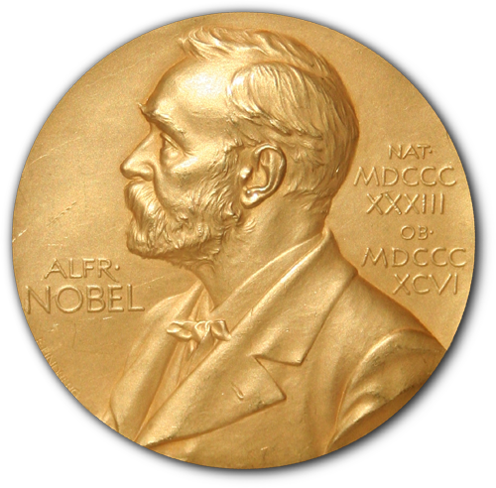
Science - 400
In 1921, who won the Nobel Prize in Physics?
Answer
Notes:
40-50 years

Slide 9
Science - 400
Answer: Albert Einstein

Slide 10
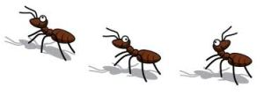
Science - 500
Why do termites follow ink trails?
Answer
Notes:
The Femur

Slide 11
Science - 500
Answer: Ink smells like the trails termites leave for each other (pheromones).

Slide 12
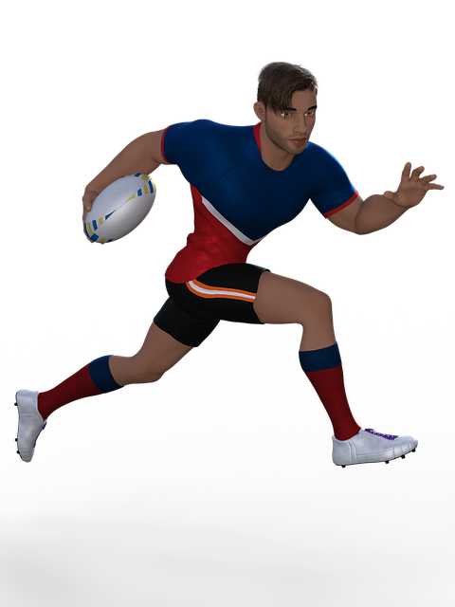
Sports - 100
How many minutes is a rugby match?
Hint: 1 1/3 hour
Answer
Notes:
26 miles

Slide 13
Sports - 100
Answer: 80 minutes

Slide 14
Sports - 200
In football, how many points is a touchdown?
Answer
Notes:
90 feet

Slide 15
Sports - 200
Answer: 6

Slide 16
Sports - 300
The Olympic-size tennis court is 78 ft long. For doubles games, the area of the court is 2808 square feet.
What is the width of the doubles court?
Answer
Notes:
10 feet

Slide 17
Sports - 300
Answer: 36 feet

Slide 18
Sports - 400
Where were the first Olympic Games held?
Answer
Notes:
Butterfly, Backstroke, Breaststroke, Freestyle

Slide 19
Sports - 400
Answer: Olympia, Greece

Slide 20
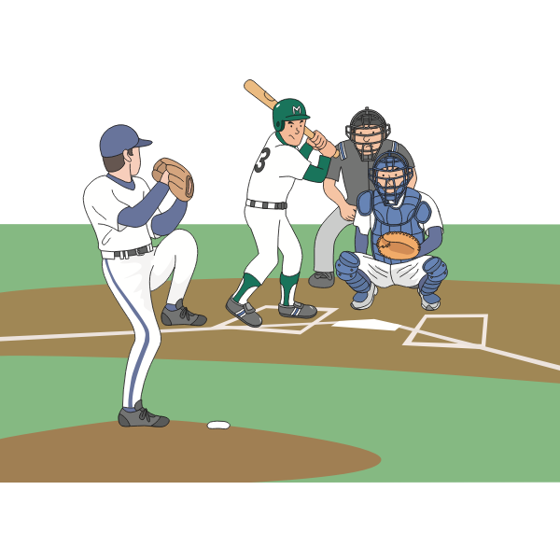
Sports - 500
In professional baseball, what is the distance between the pitcher’s mound and home plate?
Answer
Notes:
Moses Fleetwood Walker

Slide 21
Sports - 500
Answer: 60 feet 6 inches

Slide 22
Math - 100
What is the smallest prime number?
Answer
Notes:
2

Slide 23
Math - 100
Answer: 2

Slide 24
Math - 200
What type of triangle has three congruent sides?
Answer
Notes:
Pythagoras

Slide 25
Math - 200
Answer: Equilateral Triangle

Slide 26
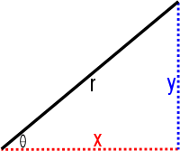
Math - 300
What is the name of the longest side of a right triangle?
Answer
Notes:
four

Slide 27
Math - 300
Answer: Hypotenuse

Slide 28
Math - 400
Filling a flat surface, with one or more shapes with no gaps, is known as?
Answer
Notes:
13

Slide 29
Math - 400
Answer: Tessellation

Slide 30
Math - 500
Which two-digit prime numbers less than 100 have digits that add to a square number?
Answer
Notes:
125

Slide 31
Math - 500
Answer: 13, 31, 79 and 97

Slide 32
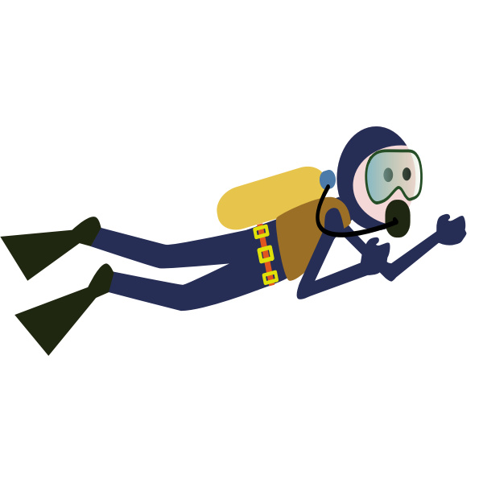
History - 100
Jacques Cousteau and Emile Gagnan, French oceanographers, were famous for the design of the self-contained underwater breathing apparatus.
What is the name of that apparatus?
Answer
Notes:
13

Slide 33
History - 100
Answer: SCUBA (Self-Contained Underwater Breathing Apparatus)

Slide 34
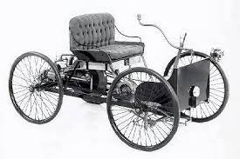
History - 200
Henry Ford’s first car was a quadricycle.
He built it in the 19th century.
The tens digit of the year is one more than the hundred’s digit.
The sum of the digits is 24.
In what year did Ford build his first car?
Answer
Notes:
13

Slide 35
History - 200
Answer: 1896

Slide 36
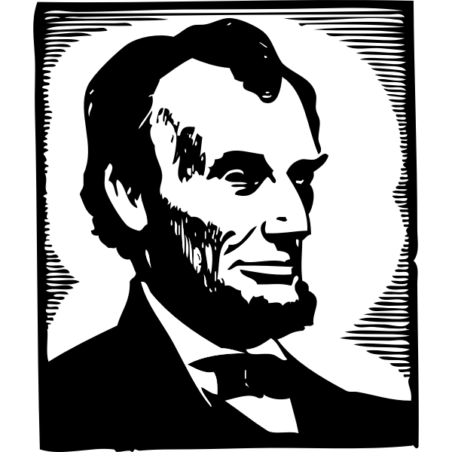
History - 300
What famous speech did Abraham Lincoln give on November 19th, 1863?
Answer
Notes:
300 (million)

Slide 37
History - 300
Answer: The Gettysburg Address

Slide 38
History - 400
Which U.S. state is farthest west?
Answer
Notes:
1945.

Slide 39
History - 400
Answer: Alaska

Slide 40
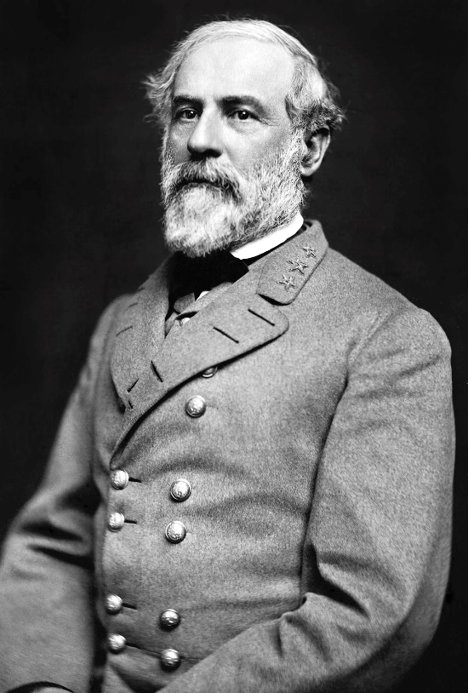
History - 500
Who was the commanding general of the Confederate Army?
Answer
Notes:
1912

Slide 41
History - 500
Answer: Robert E. Lee

Slide 42
Art - 100
What book character lived at 221B, Baker Street, London?
Answer
Notes:
Green, Orange, Violet (Purple)

Slide 43
Art - 100
Answer: Sherlock Holmes

Slide 44
Art - 200
Who is the French Impressionist artist famous for painting water lilies and bridges?
Answer
Notes:
Vincent van Gogh.

Slide 45
Art - 200
Answer: Claude Monet

Slide 46
Art - 300
What colors do you have to mix to make brown?
Answer
Notes:
The Lion King

Slide 47
Art - 300
Answer: Red, Yellow, and Blue

Slide 48
Art - 400
What is the name of the technique of neo-impressionist painting that uses tiny dots of various pure colors which become blended in the viewer's eye?
Answer
Notes:
Athena.

Slide 49
Art - 400
Answer: Pointillism

Slide 50
Art - 500
Fahrenheit 451, by Ray Bradbury, is a novel about a future society where books are outlawed and "firemen" burn any that are found. What does the title refer to?
Answer
Notes:
Red, orange, yellow, green, blue, indigo, and violet.

Slide 51
Art - 500
Answer: The temperature that Bradbury thought to be the burning point of paper.

