Slide 1
SMASH Game 2
Science | Math | Art | Sports | History
100 | 100 | 100 | 100 | 100
200 | 200 | 200 | 200 | 200
300 | 300 | 300 | 300 | 300
400 | 400 | 400 | 400 | 400
500 | 500 | 500 | 500 | 500

Slide 2
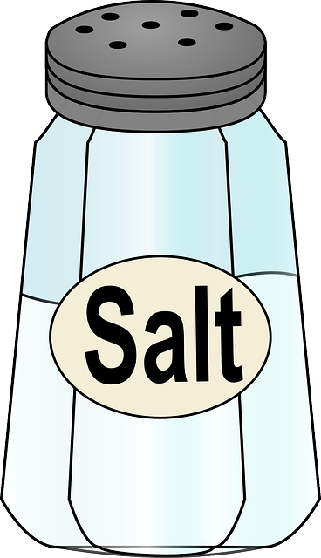
Science - 100
Which mineral is a flavor enhancer?
Answer
Notes:
The Sun

Slide 3
Science - 100
Answer: Salt

Slide 4

Science - 200
The largest animal on earth is the Antarctic blue whale. It can weigh up to 400,000 pounds.
What is this weight in tons?
Answer
Notes:
Tsunami

Slide 5
Science - 200
Answer: 200 tons

Slide 6

Science - 300
What is the fastest land animal in the world?
Answer
Notes:
0

Slide 7
Science - 300
Answer: Cheetah

Slide 8
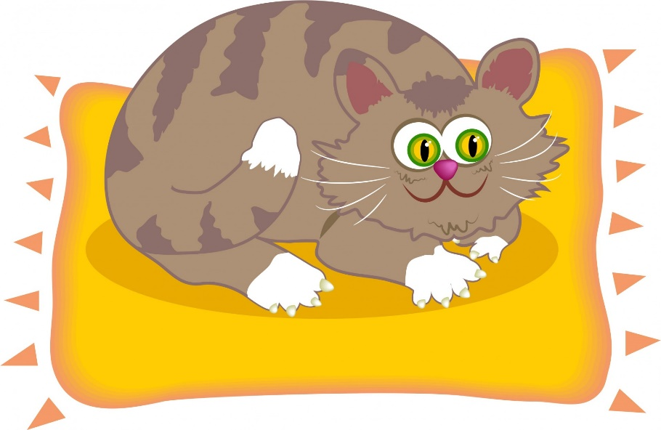
Science - 400
What animal is the largest member
of the (big) cat family?
Answer
Notes:
40-50 years

Slide 9
Science - 400
Answer: Tiger

Slide 10
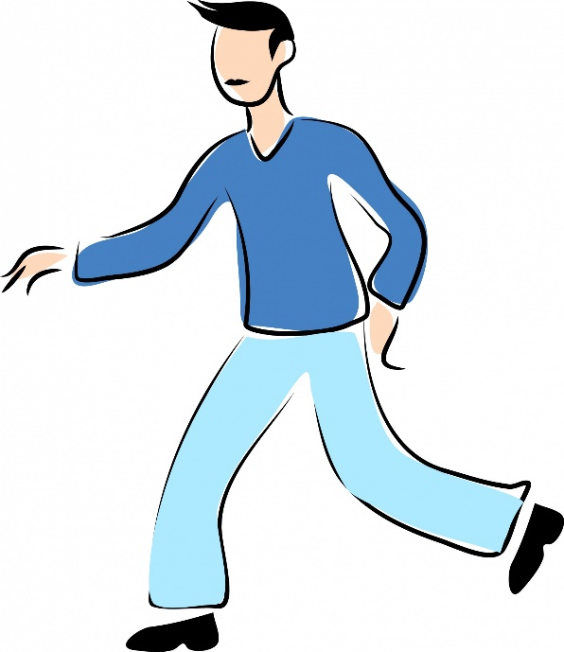
Science - 500
Which organ in the human body is the largest and weighs the most?
Answer
Notes:
The Femur

Slide 11
Science - 500
Answer: Skin

Slide 12
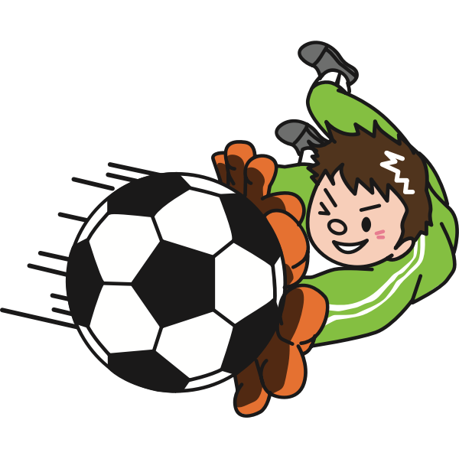
Sports - 100
In soccer, what is the name of the area where
goal keepers can use their hands?
Answer
Notes:
26 miles

Slide 13
Sports - 100
Answer: Goalie Box

Slide 14

Sports - 200
In men’s lacrosse, how many players are on the field for each team?
Answer
Notes:
90 feet

Slide 15
Sports - 200
Answer: 10

Slide 16
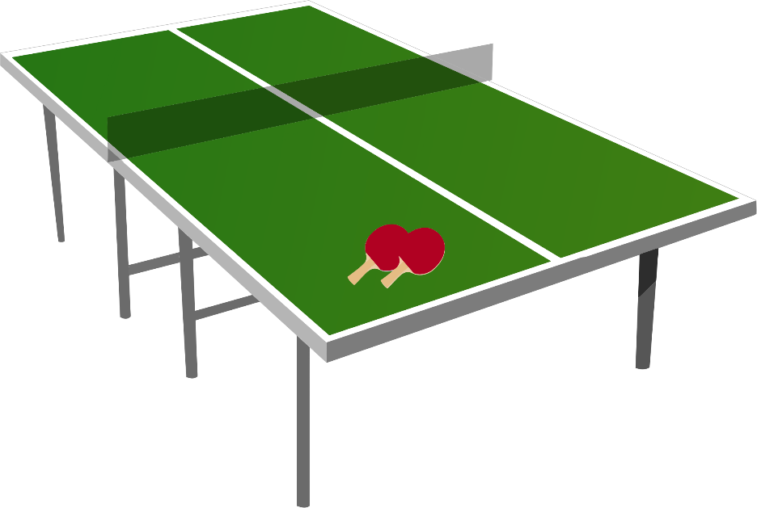
Sports - 300
The area of a regulation size ping pong table is
45 sq ft. The length is 4 ft longer than the width.
What is the width?
Answer
Notes:
10 feet

Slide 17
Sports - 300
Answer: 5 feet

Slide 18

Sports - 400
What is the national winter sport of the country that has this national flag?
Answer
Notes:
Butterfly, Backstroke, Breaststroke, Freestyle

Slide 19
Sports - 400
Answer: Ice Hockey
(Flag of Canada)

Slide 20
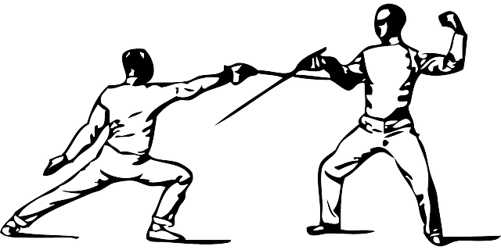
Sports - 500
What are the names of the three different weapons in fencing?
Answer
Notes:
Moses Fleetwood Walker

Slide 21
Sports - 500
Answer: Foil, Épée, and Sabre

Slide 22

Math - 100
What is the name of this symbol?
Answer
Notes:
2

Slide 23
Math - 100
Answer: Pi

Slide 24

Math - 200
What is the second triangular number?
Answer
Notes:
Pythagoras

Slide 25
Math - 200
Answer: 3
(Triangular numbers are sums of consecutive counting numbers.
1 is the first triangular number.
1 + 2, or 3 is the second triangular number.)

Slide 26

Math - 300
How many zeroes are in a googol?
Answer
Notes:
four

Slide 27
Math - 300
Answer: 100

Slide 28

Math - 400
If 20 people shake hands once and only once with each other, how many handshakes will there be?
Answer
Notes:
13

Slide 29
Math - 400
Answer: 190
[(20 x 19) ÷ 2]

Slide 30

Math - 500
What is the unit of time for 1/100th of a second?
Answer
Notes:
125

Slide 31
Math - 500
Answer: A Jiffy

Slide 32
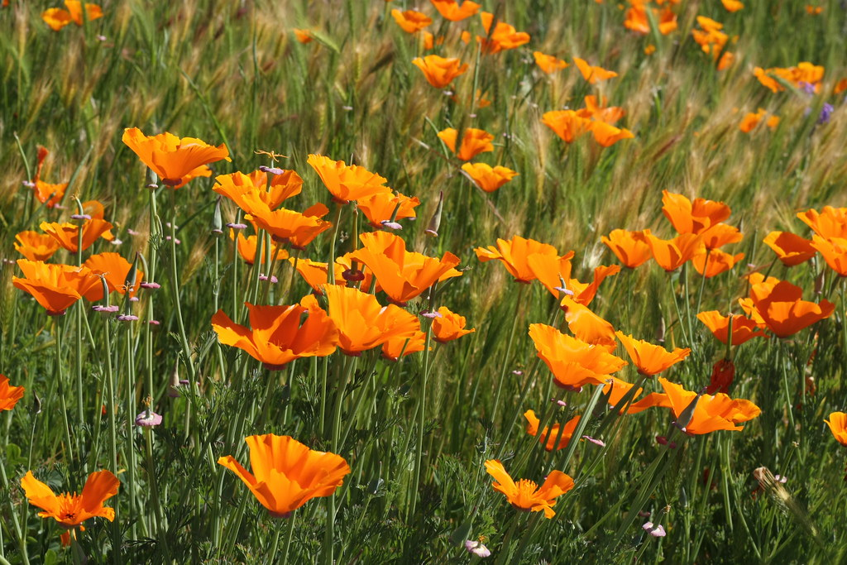
History - 100
What is the California state flower?
Answer
Notes:
13

Slide 33
History - 100
Answer: California Poppy

Slide 34

History - 200
What is the number of the Amendment to the Constitution that eliminated slavery?
Answer
Notes:
13

Slide 35
History - 200
Answer: 13

Slide 36

History- 300
In what year was the Declaration of Independence signed?
Answer
Notes:
300 (million)

Slide 37
History - 300
Answer: 1776

Slide 38
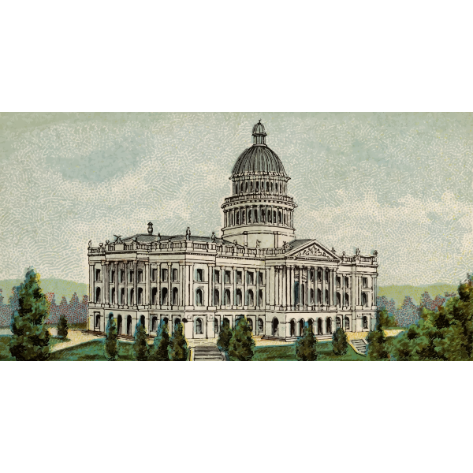
History - 400
What was the first capital of the United States?
Answer
Notes:
1945.

Slide 39
History - 400
Answer: New York City (1785 – 1790)

Slide 40
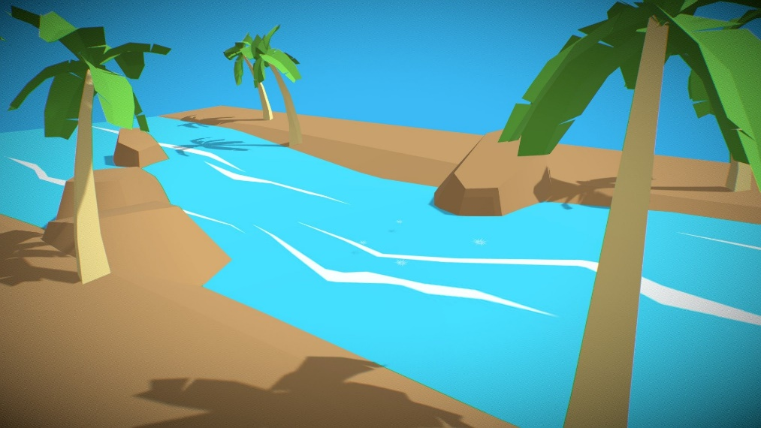
History - 500
What is the longest U.S. river?
Answer
Notes:
1912

Slide 41
History - 500
Answer: The Missouri River

Slide 42

Art - 100
What fast moving dance is named for a spicy Latin American sauce?
Answer
Notes:
Green, Orange, Violet (Purple)

Slide 43
Art - 100
Answer: Salsa

Slide 44

Art - 200
What color should a person wear to help portray authority and power?
Answer
Notes:
Vincent van Gogh.

Slide 45
Art - 200
Answer: Black

Slide 46
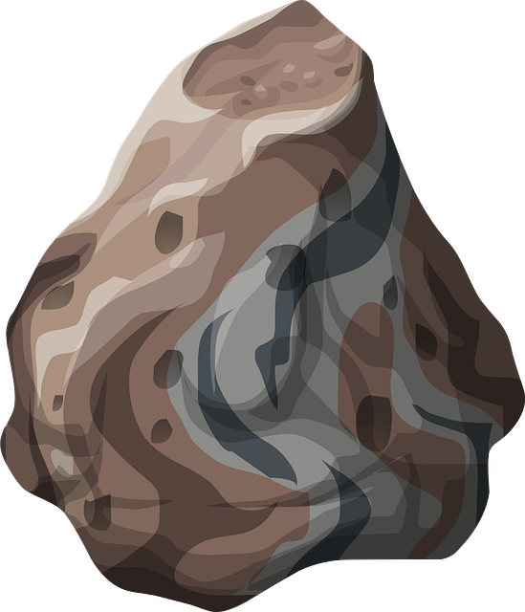
Art - 300
What is the name for prehistoric images and carvings made on rocks?
Answer
Notes:
The Lion King

Slide 47
Art - 300
Answer: Petroglyphs

Slide 48
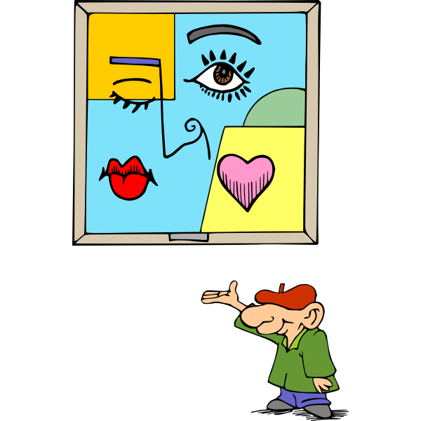
Art - 400
Which famous Spanish painter helped develop the painting style of “Cubism”?
Answer
Notes:
Athena.

Slide 49
Art - 400
Answer: Pablo Picasso

Slide 50
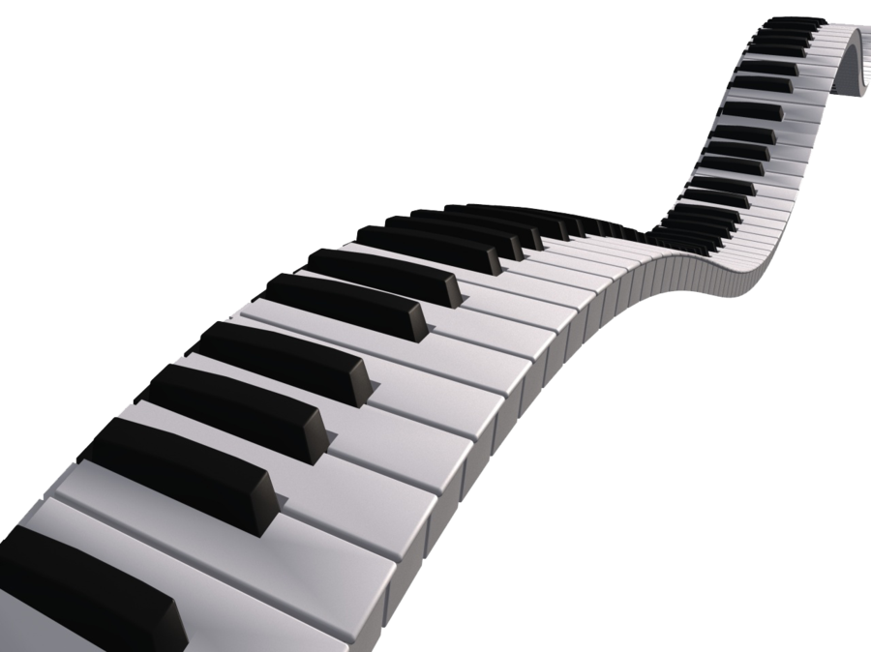
Art - 500
Full size piano keyboards have a total of 88 keys. How many keys are black?
Answer
Notes:
Red, orange, yellow, green, blue, indigo, and violet.

Slide 51
Art - 500
Answer: 36 black keys

