Slide 1
SMASH Game 1
Science | Math | Art | Sports | History
100 | 100 | 100 | 100 | 100
200 | 200 | 200 | 200 | 200
300 | 300 | 300 | 300 | 300
400 | 400 | 400 | 400 | 400
500 | 500 | 500 | 500 | 500

Slide 2

Science - 100
Which star is closest to Earth?
Answer
Notes:
The Sun

Slide 3
Science - 100
Answer: The Sun

Slide 4

Science - 200
What is another name for a tidal wave?
Answer
Notes:
Tsunami

Slide 5
Science - 200
Answer: Tsunami

Slide 6

Science - 300
How many bones are in a shark?
Answer
Notes:
0

Slide 7
Science - 300
Answer: Zero

Slide 8
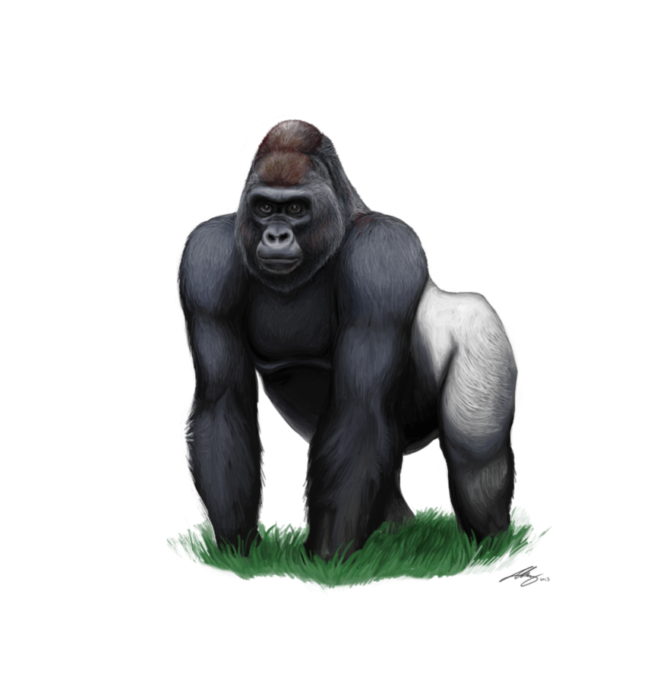
Science - 400
The average life span of a gorilla is 1.75 to 2 scores. What is the average life span of a gorilla in years?
Answer
Notes:
40-50 years

Slide 9
Science - 400
Answer: 35 - 40 years

Slide 10
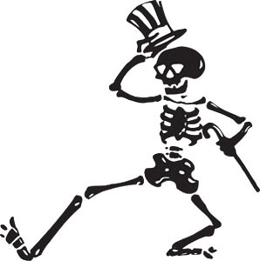
Science - 500
Which bone in the human body is the longest?
Answer
Notes:
The Femur

Slide 11
Science - 500
Answer: The femur (a thigh bone)

Slide 12

Sports - 100
To the nearest mile, how long is a full marathon?
Answer
Notes:
26 miles

Slide 13
Sports - 100
Answer: 26 miles

Slide 14

Sports - 200
In archery, the target is 1.22 meters in diameter.
To the nearest hundredth of a meter, what is the circumference of the target?
Answer
Notes:
90 feet

Slide 15
Sports - 200
Answer: 3.83 meters

Slide 16

Sports - 300
In NBA basketball, what is the height of the hoop from the floor?
Answer
Notes:
10 feet

Slide 17
Sports - 300
Answer: 10 feet

Slide 18

Sports - 400
In swimming, what is the order of the four different strokes in a medley?
Answer
Notes:
Butterfly, Backstroke, Breaststroke, Freestyle

Slide 19
Sports - 400
Answer: first, backstroke; second, breaststroke;
third, butterfly; and fourth, freestyle

Slide 20

Sports - 500
Who was the first African American to play major league baseball?
Answer
Notes:
Moses Fleetwood Walker

Slide 21
Sports - 500
Answer: Moses Fleetwood Walker
(Walker played long before Jackie Robinson)

Slide 22

Math - 100
What is the smallest even number?
Answer
Notes:
2

Slide 23
Math - 100
Answer: 0

Slide 24
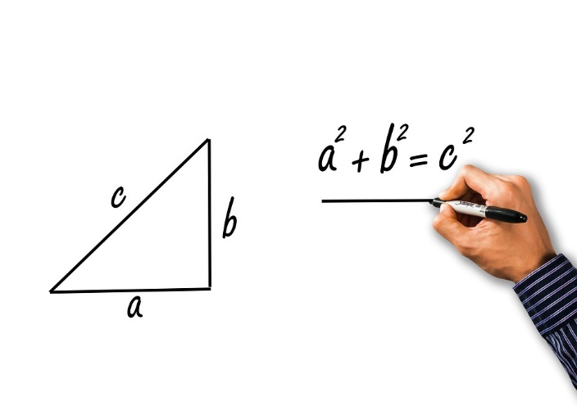
Math - 200
Who formulated this right triangle relationship?
Answer
Notes:
Pythagoras

Slide 25
Math - 200
Answer: Pythagoras

Slide 26

Math - 300
What is the smallest Prime Triplet?
(3 sequential prime numbers where the smallest prime number and the largest prime number differ by exactly 6)
I’m the first prime number.
But darn! I’m not part of the triplet.
Answer
Notes:
13

Slide 27
Math - 300
Answer: 5, 7, 11

Slide 28

Math - 400
People who suffer from triskaidekaphobia are
fearful of what number?
Answer
Notes:
125

Slide 29
Math - 400
Answer: 13

Slide 30

Math - 500
What is the greatest perfect number less than 100?
Perfect?
Answer
Notes:
four

Slide 31
Math - 500
Answer: 28
(A Perfect Number is a positive integer that is equal
to the sum of its positive divisors, excluding itself:
1 + 2 + 4 + 7 + 14 = 28)

Slide 32
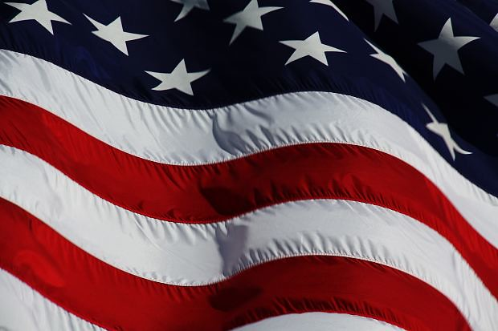
History - 100
How many stripes are on the US flag?
Answer
Notes:
13

Slide 33
History - 100
Answer: 13

Slide 34
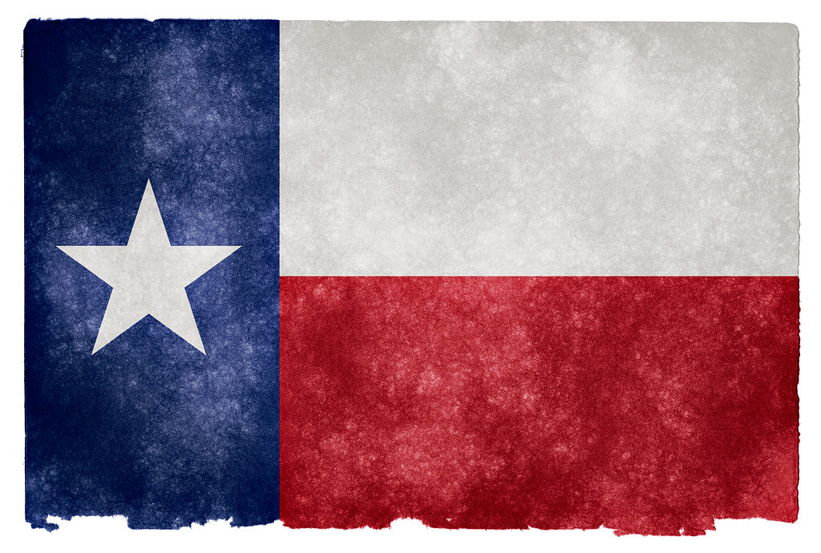
History - 200
Which country did Texas gain independence from before becoming a part of the Unites States?
Answer
Notes:
13

Slide 35
History - 200
Answer: Mexico

Slide 36
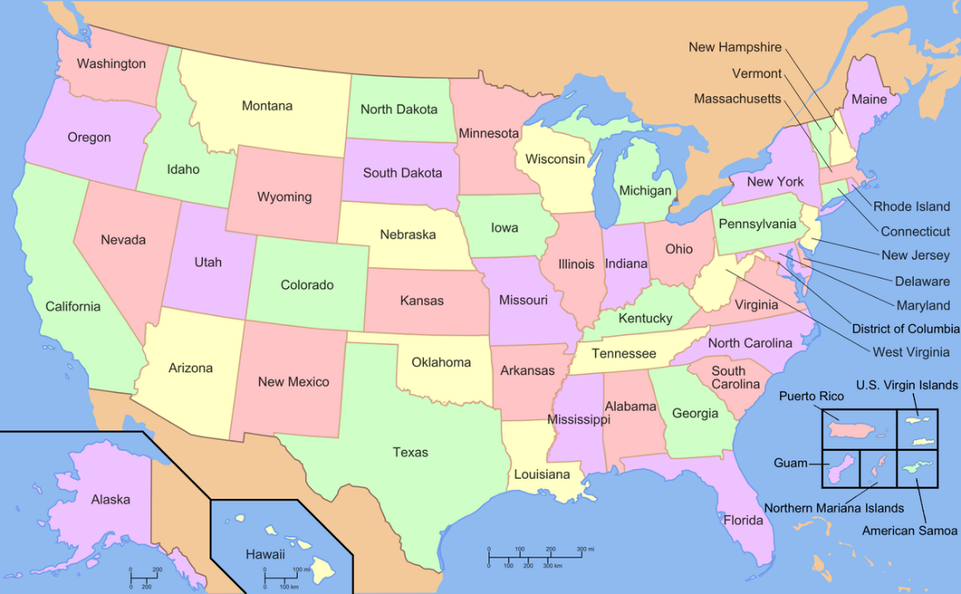
History- 300
To the nearest hundred million, what is the population of the United States?
Answer
Notes:
300 (million)

Slide 37
History - 300
Answer: 300 million

Slide 38
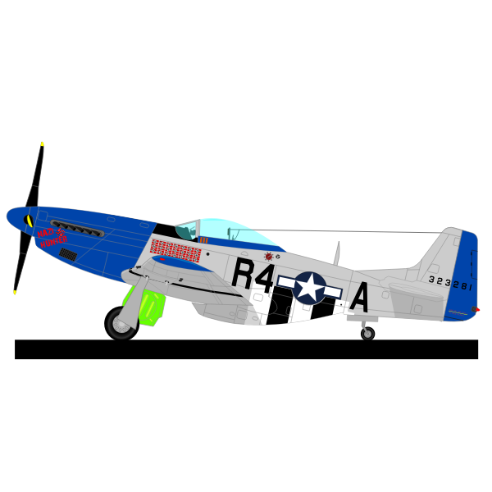
History - 400
In what year did the Second World War end?
Answer
Notes:
1945.

Slide 39
History - 400
Answer: 1945

Slide 40


History - 500
What are the last two states to join the Union?
Answer
Notes:
1912

Slide 41
History - 500
Answer: Alaska and Hawaii

Slide 42

Art - 100
What are the secondary colors?
Answer
Notes:
Green, Orange, Violet (Purple)

Slide 43
Art - 100
Answer: Green, Orange, Violet (Purple)

Slide 44

Art - 200
Which Dutch artist is known for chopping off part of his ear?
Answer
Notes:
Vincent van Gogh.

Slide 45
Art - 200
Answer: Vincent van Gogh

Slide 46
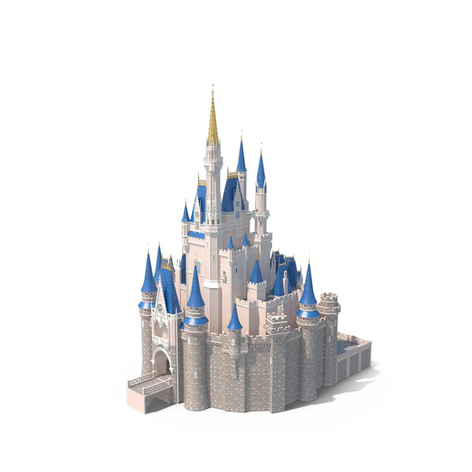
Art - 300
Which Disney movie and Broadway musical named for an animal in the cat family is the top-earning title in box-office history for both stage productions and films?
Answer
Notes:
The Lion King

Slide 47
Art - 300
Answer: Lion King

Slide 48

Art - 400
The Parthenon, a famous Greek monument, was built to honor which Greek Goddess of Wisdom?
Answer
Notes:
Athena.

Slide 49
Art - 400
Answer: Athena

Slide 50

Art - 500
What are the colors of the rainbow?
Answer
Notes:
Red, orange, yellow, green, blue, indigo, and violet.

Slide 51
Art - 500
Answer: Red, Orange, Yellow, Green, Blue, Indigo, and Violet

