Slide 1
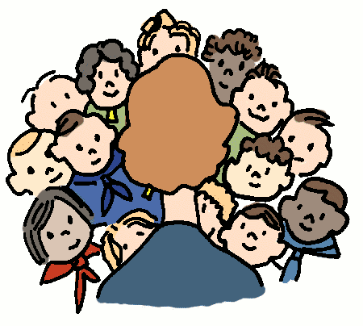
6-1 MATH TALKS
Data Talks (Slides 2-4)
Dot Talks (Slides 5-7)

Slide 2

DATA TALK A
IT’S A FACT!
*Based upon brain science studies, teenager brains are not great at remembering upcoming tasks.
Responsible people realize that this is no excuse to blow things off!
What can you do to help yourself remember things that are expected of you?
Some ideas:
use a written planner
use the calendar on your phone
use a phone app (several exist)
*Source: https://knoxvillemoms.com/weird-facts-to-help-us-better-understand-teens/

Slide 3

DATA TALK B
ANOTHER FACT
Texting is often the first and last thing a teen does each day.
64
____% of teens text during class*
What number seems too low?
Too high?
About right?
15
____% of teens text more than 200 times per day*
*Source: https://knoxvillemoms.com/weird-facts-to-help-us-better-understand-teens/

Slide 4
DATA TALK C
HOW I SPEND MY TIME
What do you notice?
What do you wonder?
What is the graph about?
Do you think someone might be misled by this graph?
Choose any section. What could it represent?

Slide 5
DOT TALK A
Without counting one by one, how many dots do you see?
How do you see them?
What numerical expressions could we write to describe the total number of dots?

Slide 6
DOT TALK B
Without counting one by one, how many dots do you see?
How do you see them?
What numerical expressions could we write to describe the total number of dots?

Slide 7
DOT TALK C
Without counting one by one, how many dots do you see?
How do you see them?
What numerical expressions could we write to describe the total number of dots?

