Slide 1
DOT TALK A
Without counting one by one, how many dots do you see?
How do you see them?
What numerical expressions could we write to describe the total number of dots?

Slide 2
DOT TALK B
Without counting one by one, how many dots do you see?
How do you see them?
What numerical expressions could we write to describe the total number of dots?

Slide 3
DOT TALK C
Without counting one by one, how many dots do you see?
How do you see them?
What numerical expressions could we write to describe the total number of dots?

Slide 4
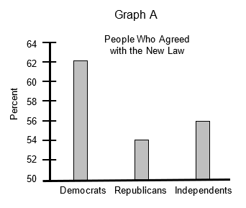
GRAPH TALK A
What do you notice?
What do you wonder?
What is the graph about?
Do you think someone might be misled by this graph?
What prediction(s) could you make based on this graph?

Slide 5
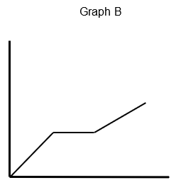
GRAPH TALK B
What do you notice?
What do you wonder?
What could this graph be about?
What could be a reasonable title and axis labels?
What could this graph definitely NOT be about?

