Slide 1
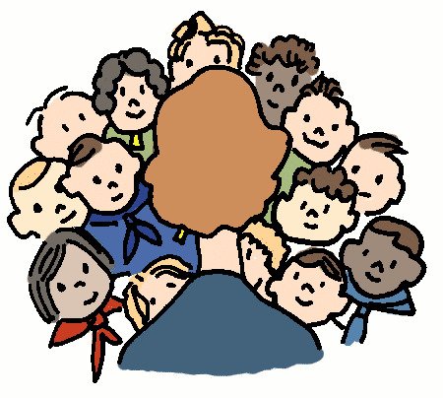
7-2 MATH TALKS
Data Talks (2-3)
Picture Talks (Slides 4-7)
Number Talks (Slides 8-11)

Slide 2
DATA TALK A
TRUE OR FALSE?
Teens are more susceptible to addiction than adults.
When teens get something they want, their dopamine levels increase higher than adult levels. So their lows are lower and their highs are higher. This “feel-good” hormone makes teens more susceptible to addiction.
What are some HEALTHY, thrilling activities you enjoy that may steer you away from drugs and alcohol?
Sports, exercise, and artistic performances are some good examples
*Source: https://knoxvillemoms.com/weird-facts-to-help-us-better-understand-teens/

Slide 3
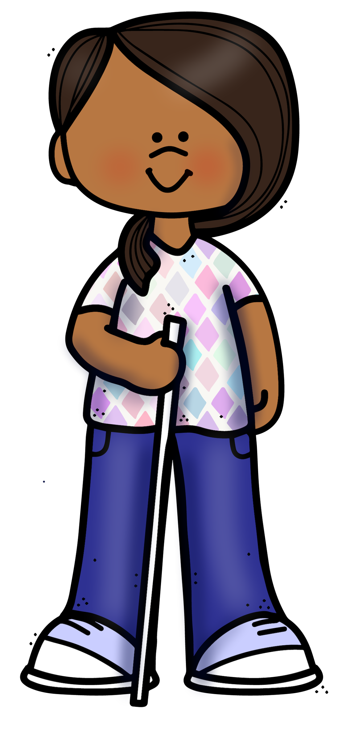
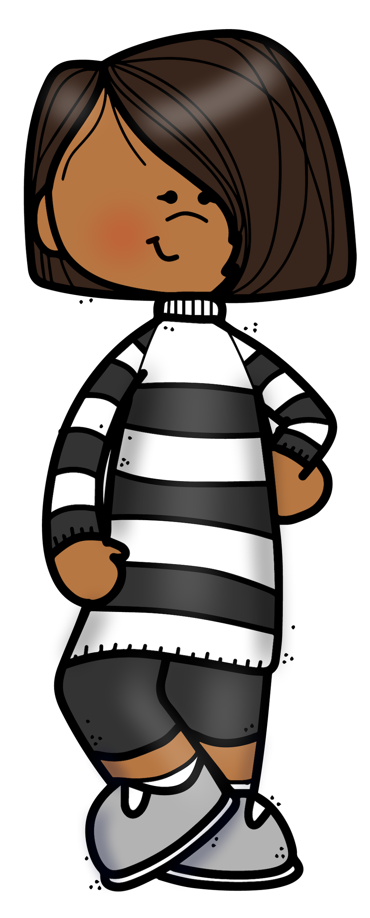
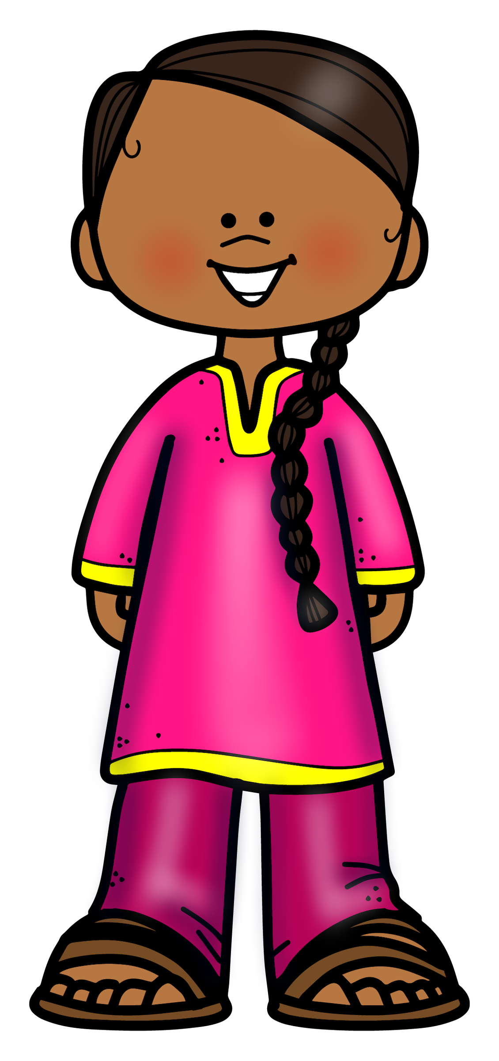
DATA TALK B
FACTS and STATISTICS
Many girls believe they are not good enough in some way, including body size or shape, academics, social life, and/or school performance.
70
____% of teens girls feel this way*
What number seems too low?
Too high?
About right?
*Source: https://knoxvillemoms.com/weird-facts-to-help-us-better-understand-teens/

Slide 4
PICTURE TALK A
Container A
What is an unreasonably high estimate? Unreasonably low?
What is a reasonable estimate?
If the container can hold 100 mg of water, how much water is in the container?
If it can hold 120 mg?
If it can hold 80 mg?

Slide 5
PICTURE TALK B
Container B
What is an unreasonably high estimate? Unreasonably low?
What is a reasonable estimate?
If the container can hold 100 mg of water, how much water is in the container?
If it can hold 120 mg?
If it can hold 80 mg?

Slide 6
PICTURE TALK C
Container C
0
What is an unreasonably high estimate? Unreasonably low?
What is a reasonable estimate?
If the container can hold 100 mg of water, how much water is in the container?
If it can hold 120 mg?
If it can hold 80 mg?

Slide 7
PICTURE TALK D
Container D
What is an unreasonably high estimate? Unreasonably low?
What is a reasonable estimate?
If the container can hold 100 mg of water, how much water is in the container?
If it can hold 120 mg?
If it can hold 80 mg?

Slide 8
NUMBER TALK A
50% of $60 or 25% of $80
50% of $100 or 25% of $120
50% of $25 or 25% of $40
Which would you rather have?
Be prepared to explain your reasoning.

Slide 9
NUMBER TALK B
10% of $20 or 1% of $40
10% of $70 or 1% of $1,000
10% of $14 or 1% of $140
Which would you rather have?
Be prepared to explain your reasoning.

Slide 10
NUMBER TALK C
50% of $60 or 75% of $40
25% of $200 or 75% of $100
50% of $75 or 75% of $50
Which would you rather have?
Be prepared to explain your reasoning.

Slide 11
NUMBER TALK D
60% of $45 or 40% of $60
30% of $20 or 20% of $25
10% of $15 or 15% of $20
Which would you rather have?
Be prepared to explain your reasoning.

