Slide 1
SMASH Game 3
Science | Math | Art | Sports | History
100 | 100 | 100 | 100 | 100
200 | 200 | 200 | 200 | 200
300 | 300 | 300 | 300 | 300
400 | 400 | 400 | 400 | 400
500 | 500 | 500 | 500 | 500

Slide 2
Science - 100
What is the name of a scientist who studies living things?
Answer
Notes:
The Sun

Slide 3
Science - 100
Answer: Biologist

Slide 4
Science - 200
Which long-neck animal gives birth while standing up?
Answer
Notes:
Tsunami

Slide 5
Science - 200
Answer: Giraffe

Slide 6
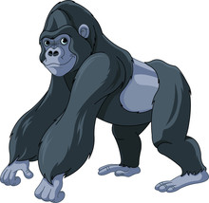
Science - 300
Are gorillas herbivores, carnivores, or omnivores?
Answer
Notes:
0

Slide 7
Science - 300
Answer: Herbivores

Slide 8
Science - 400
Which organ in the human body weighs the least?
Answer
Notes:
40-50 years

Slide 9
Science - 400
Answer: Lung

Slide 10
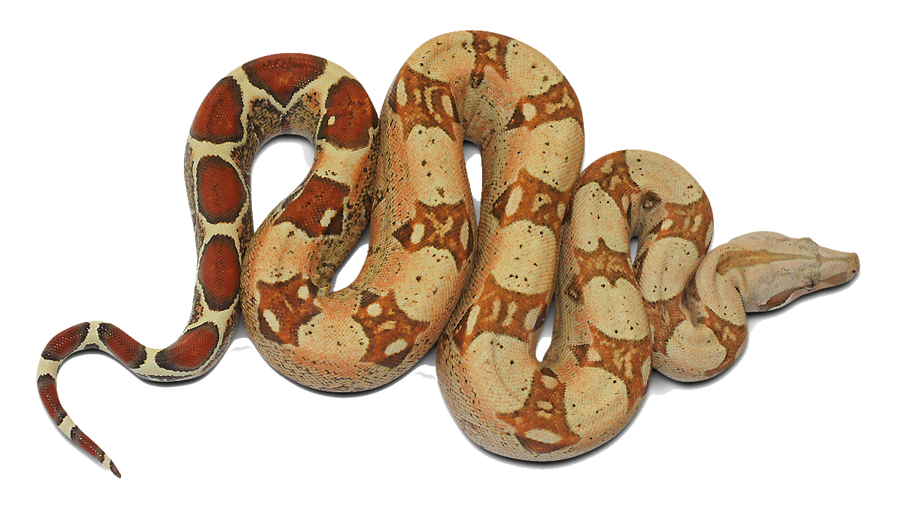
Science - 500
How does a boa constrictor kill its prey?
Answer
Notes:
The Femur

Slide 11
Science - 500
Answer: Suffocation

Slide 12
Sports - 100
In baseball, who was known as the Sultan of Swat?
Answer
Notes:
26 miles

Slide 13
Sports - 100
Answer: Babe Ruth

Slide 14
Sports - 200
What is the name of the “ball” in Badminton?
Answer
Notes:
90 feet

Slide 15
Sports - 200
Answer: Shuttlecock also known as a Birdie

Slide 16
Sports - 300
Which Olympian has won the most gold medals?
Answer
Notes:
10 feet

Slide 17
Sports - 300
Answer: Michael Phelps

Slide 18
Sports - 400
In a football game, the winning team scored 23 points.
How many touchdowns (with the extra point) did the winning team make?
How many field goals?
Answer
Notes:
Butterfly, Backstroke, Breaststroke, Freestyle

Slide 19
Sports - 400
Answer: 2 touch downs (2 x 7 = 14 points)
and
3 field goals (3 x 3 = 9 points)

Slide 20
Sports - 500
Which stadium in the U.S. can seat the greatest number of attendees?
Answer
Notes:
Moses Fleetwood Walker

Slide 21
Sports - 500
Answer: The University of Michigan Stadium
The stadium can seat 109,901 attendees.

Slide 22
Math - 100
How many thousands are equal to 1 million?
Answer
Notes:
2

Slide 23
Math - 100
Answer: 1,000

Slide 24
Math - 200
What is the smallest composite number?
Answer
Notes:
Pythagoras

Slide 25
Math - 200
Answer: 4

Slide 26
Math - 300
What is the name of a line that touches a circle at one point?
Answer
Notes:
four

Slide 27
Math - 300
Answer: Tangent

Slide 28
Math - 400
What is the length of a broken white strip on a
federal highway (in feet)?
Hint: Sum of the first 3 prime numbers
Answer
Notes:
13

Slide 29
Math - 400
Answer: 10 feet

Slide 30
Math - 500
A B C D
How many different arrangements of these four letters can you make?
Answer
Notes:
125

Slide 31
Math - 500
Answer: There are 24 different arrangements
of the 4 letters.
4 choices for the first letter, 3 choices for the second letter, 2 choices for the third letter, and 1 choice for the fourth letter: 4 x 3 x 2 x 1 = 24.

Slide 32
History - 100
What is the name of the famous tower in Paris, France?
Answer
Notes:
13

Slide 33
History - 100
Answer: The Eiffel Tower

Slide 34
History - 200
The U.S. purchased Alaska from what country?
Answer
Notes:
13

Slide 35
History - 200
Answer: Russia

Slide 36
History - 300
Who was the first person to walk on the moon?
Answer
Notes:
300 (million)

Slide 37
History - 300
Answer: Neil Armstrong

Slide 38
History - 400
The Greeks are known to have invented which form of government?
Answer
Notes:
1945.

Slide 39
History - 400
Answer: Democracy

Slide 40
History - 500
What is the name of the most famous
pyramid in Egypt?
Answer
Notes:
1912

Slide 41
History - 500
Answer: The Pyramid of Giza

Slide 42
Art - 100
What is the name for art that is written, drawn, or painted on a wall?
Answer
Notes:
Green, Orange, Violet (Purple)

Slide 43
Art - 100
Answer: Graffiti

Slide 44
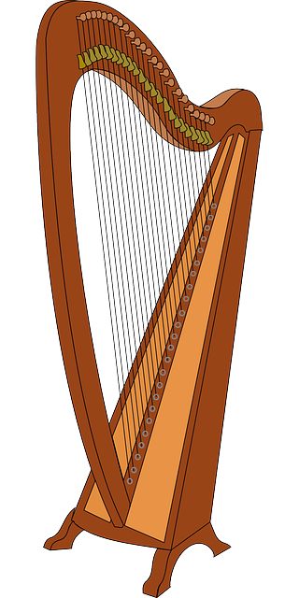
Art - 200
The number of strings on a harp is one less than 12 times the number of strings on a violin.
How many strings are on a harp?
Answer
Notes:
Vincent van Gogh.

Slide 45
Art - 200
Answer: A harp has 47 strings.
12 x 4 – 1 = 47

Slide 46
Art - 300
Jules Verne wrote a book about Phileas Fogg and his travels in 1873. What is the title of that book?
Answer
Notes:
The Lion King

Slide 47
Art - 300
Answer: Around the World in 80 Days

Slide 48
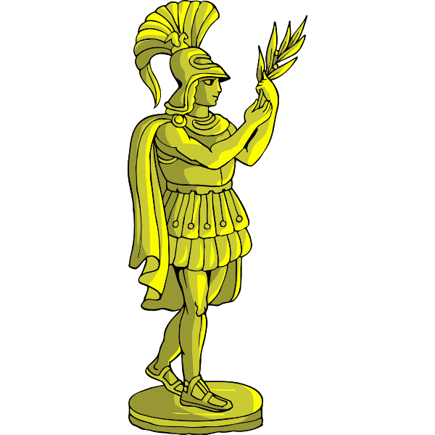
Art - 400
Which two cultures had the greatest influence on art throughout history?
Answer
Notes:
Athena.

Slide 49
Art - 400
Answer: Greek and Roman

Slide 50
Art - 500
Who is the best known artist of the 20th century who is credited with bringing greater interest to Abstract Impressionism?
Answer
Notes:
Red, orange, yellow, green, blue, indigo, and violet.

Slide 51
Art - 500
Answer: Jackson Pollack

